Slide 1
Venipuncture

Slide 2
What is Venipuncture?
The puncture of a vein as part of a medical procedure, typically to withdraw a blood sample or for an intravenous injection

Slide 3
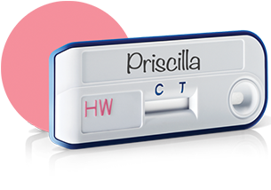
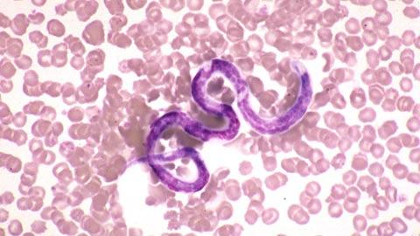
Why do we need blood?
Blood from a patient can help us monitor health or diagnose disease
- Blood cell count
- Blood smear or wet mount
- SNAP tests
- Blood chemistry
- Blood typing
- Blood clotting analysis

Slide 4
Where do we get blood?
Animal | Venipuncture Sites
Dog | Jugular vein Cephalic vein Lateral saphenous vein
Cat | Jugular vein Medial saphenous vein
Ferret | Cephalic vein Lateral saphenous vein
Rabbit | Lateral saphenous vein
Cow | Jugular vein Coccygeal vein
Horse | Jugular vein Transverse facial vein

Slide 5
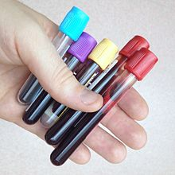
Before drawing blood…
Read medical history of animal
Know what tests are needed (some need to warm up)
Collect tubes, syringes and needles
Have assistant restrain animal
Choose site for venipuncture
Relax…it’s only blood!

Slide 6
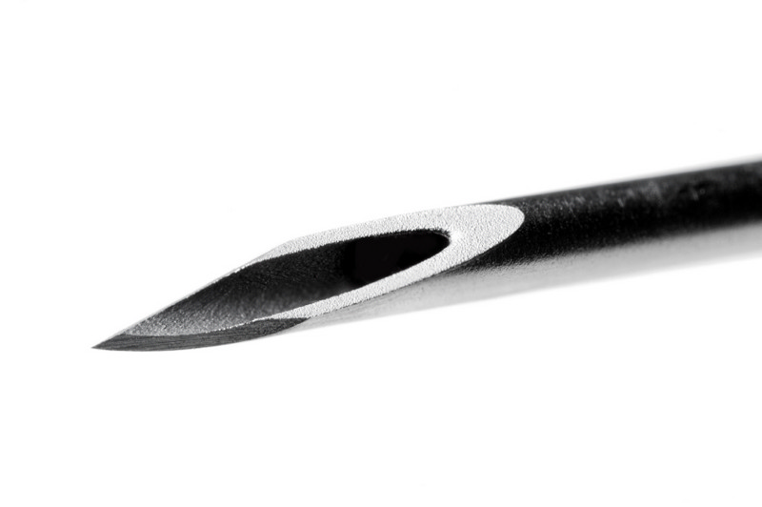
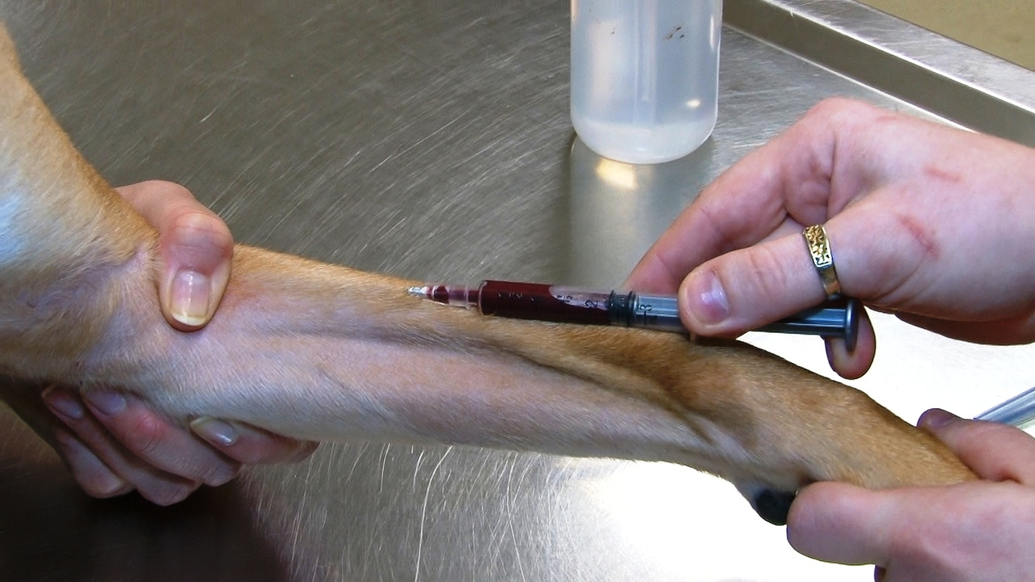
How do we get blood?
Restrain animal (preferably with muzzle)
Clean venipuncture site with alcohol
Make sure plunger is pushed in before inserting
Insert needed with sharpest point downward
Slowly pull on plunger to draw blood
If no blood, gently redirect needle
Remove needle when syringe is full
Place pressure on the venipuncture site
Place blood in appropriate tubes
Check venipuncture site for bleeding

Slide 7
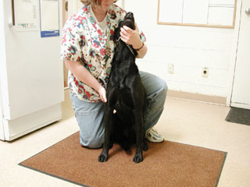
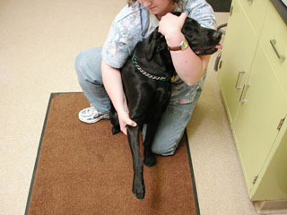
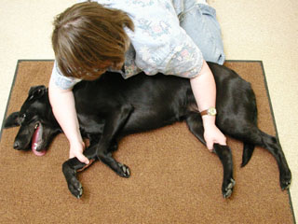
Canine restraint
Jugular
Cephalic
Lateral saphenous

Slide 8
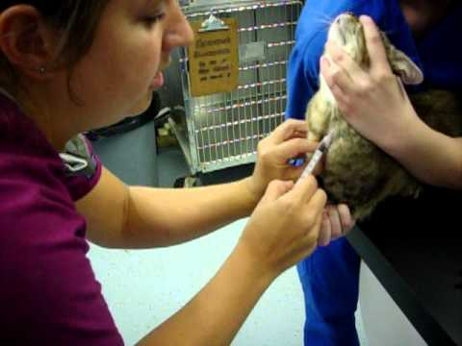
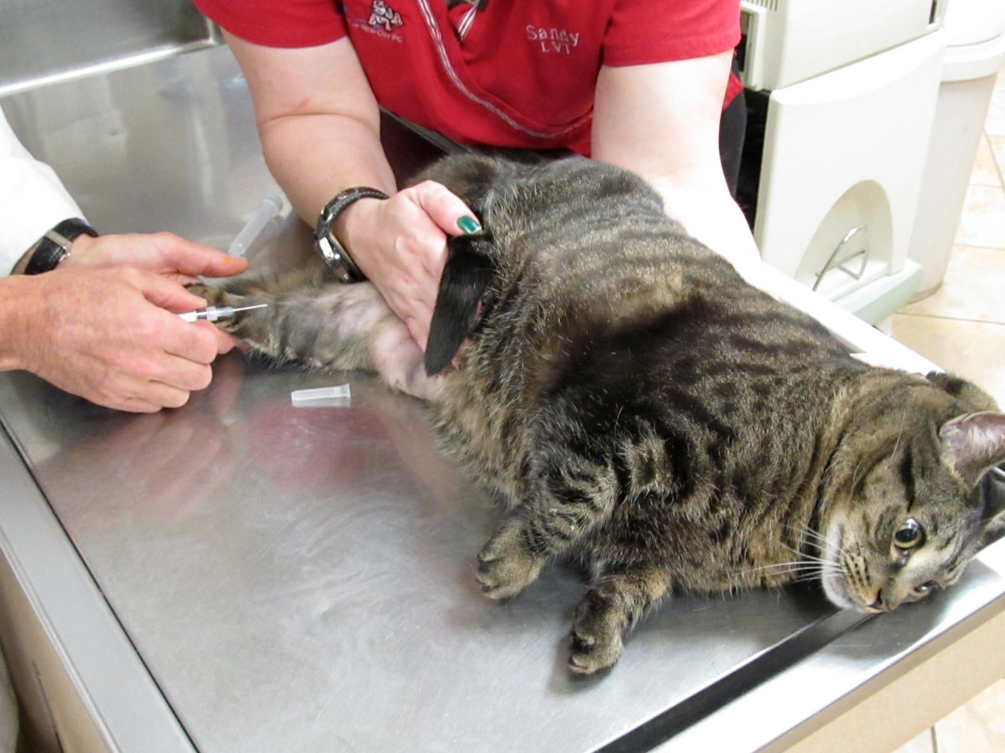
Feline restraint
Jugular
Medial saphenous

Slide 9
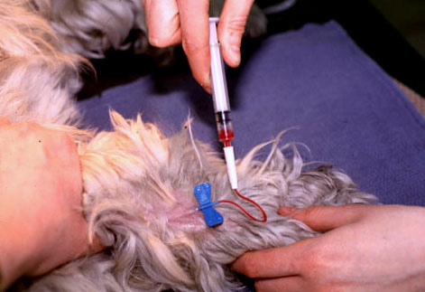
What can go wrong?
No blood- need to try another site
Patient is very wiggly (butterfly catheter)
Vein ruptures (common in cats)
Bleeding under skin (hematoma)
Bleeding won’t stop (coagulation problem?)

Slide 10
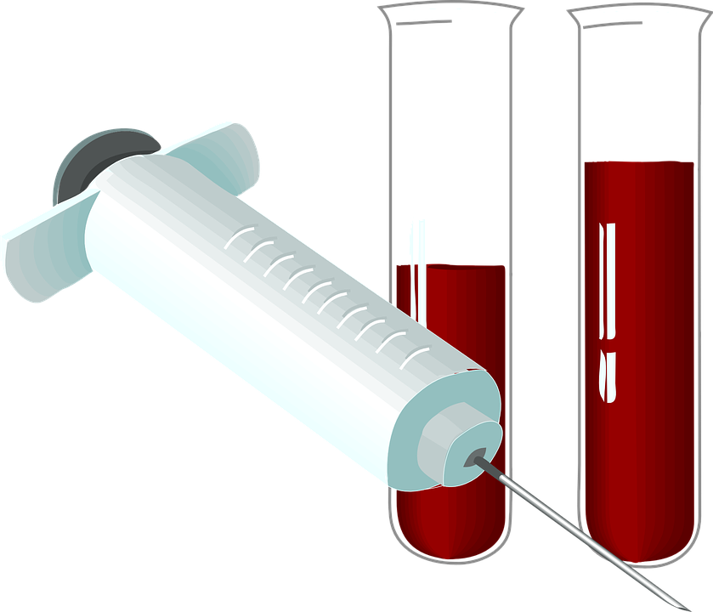
Practice makes perfect!

