Slide 1
Urinalysis

Slide 2
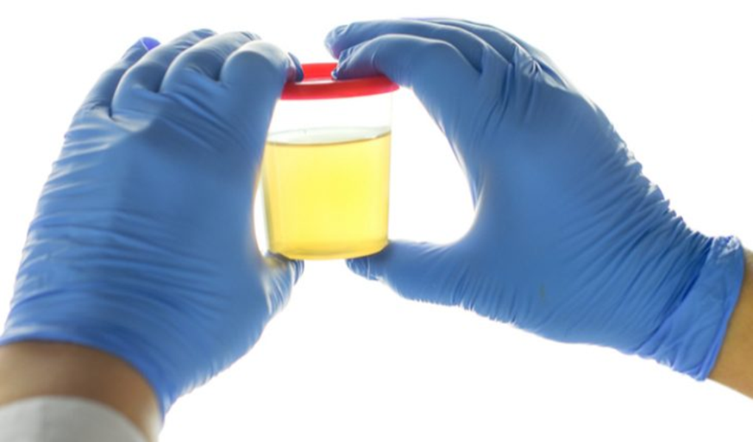
What is urine?
Urine is the end product of a filtering process that removes waste from the body and is a measure of health

Slide 3
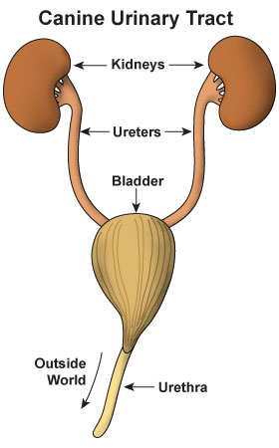
What is the filtering process?
Kidneys contain nephrons which act as filtration units that modify the filtrate (waste products). The filtrate passes out of the kidneys through the ureters into the bladder, where it is stored until it is excreted from the body through the urethra.

Slide 4
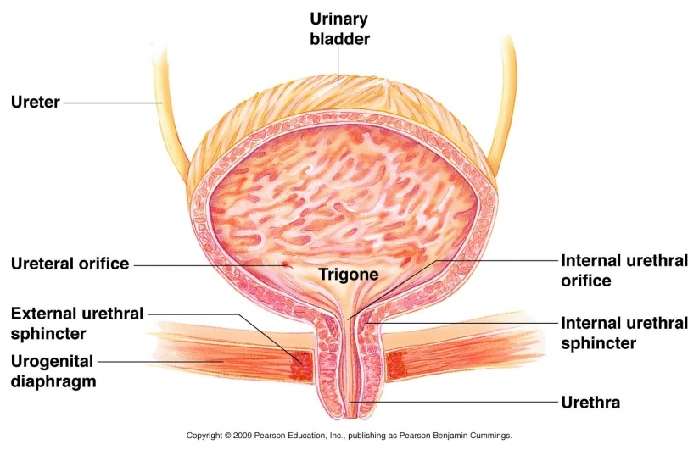
Bladder Structure

Slide 5
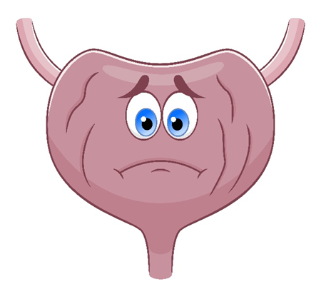
Urinary Tract Problems
Bladder inflammation caused by stress
Bacterial or fungal bladder infections
Inflammation of bladder from crystals
Inflammation of bladder from bladder stones
Inflammation of the urethra from stress or hormones
Damage to the ureters
Damage to kidneys

Slide 6
Feline Idiopathic Cystitis
Inflammation of the bladder by an unknown cause
Can lead to kidney problems if untreated
Can lead to urinary blockage in males (emergency)
Symptoms include:
- straining to urinate
- urinating frequently
- urinating in weird places
- vocalizing while urinating
- visible blood in urine

Slide 7
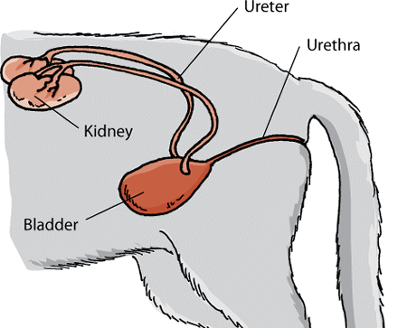
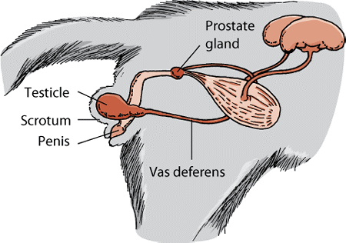
Differences in Cats
Male cats are more at risk for urinary tract issues due to the proximity of their reproductive system

Slide 8
Bladder Infection
Bladder contamination through urethra
Females are more at risk due to proximity to anus
Can lead to kidney infection
Symptoms are very similar to cystitis but urine is cloudy and smells bad

Slide 9
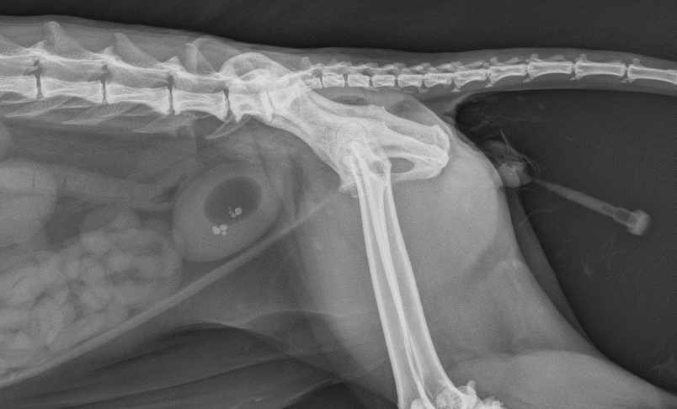
Bladder Stones
Caused by minerals in diet
Very irritating to bladder
Usually identifiable on radiographs
Often removed surgically
Special diet needed

Slide 10
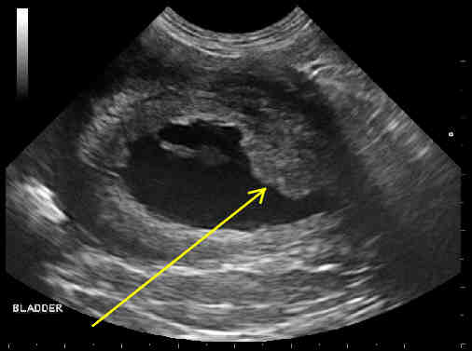
Bladder Cancer
Causes an obstruction within the urinary tract
More common in dogs
Transitional cell carcinoma is most common type
Cancer is very aggressive
Symptoms are similar to bladder infection
Should always be considered if blood is in urine

Slide 11
Urine Color
Clear to light yellow is normal
Bright or dark yellow indicates dehydration
Colors other than yellow indicate a problem
- Pink, orange or dark red indicates blood
- Brown to dark brown indicates muscle damage

Slide 12
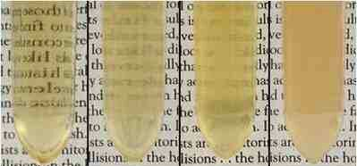
Urine Clarity
Urine should be clear
Cloudy urine can indicate bladder infection
Chunks in urine can indicate kidney infection or cancer

Slide 13
Urine Stream
Urination should occur in a steady stream
A slow stream indicates a problem
Leakage (incontinence) indicates a problem
Posturing to urinate without urine is called anuria

Slide 14
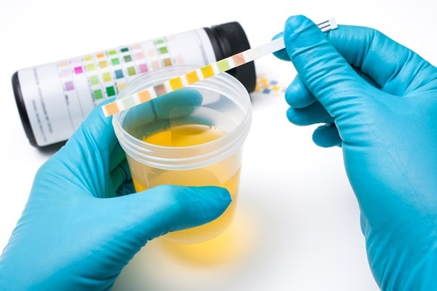
Urine Dipstick
Part of a standard urinalysis
Measures several things
- pH
- RBCs and WBCs
- Protein
- Glucose
- Bilirubin
- Creatinine
- Keytones

Slide 15
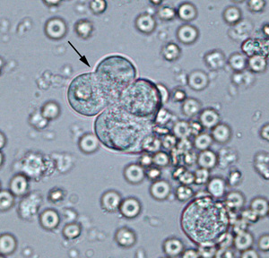
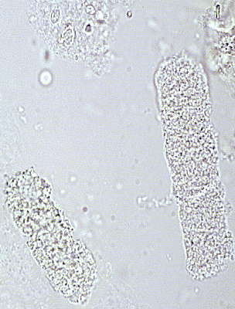
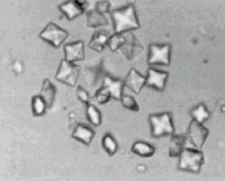
Urine Sediment
Identification of materials present in urine including:
- Bacteria
- Casts
- Blood
- Crystals
- Cancer cells

Slide 16
Let’s Get to Work!

