Slide 1
The Immune System
By Megan Llewellyn

Slide 2
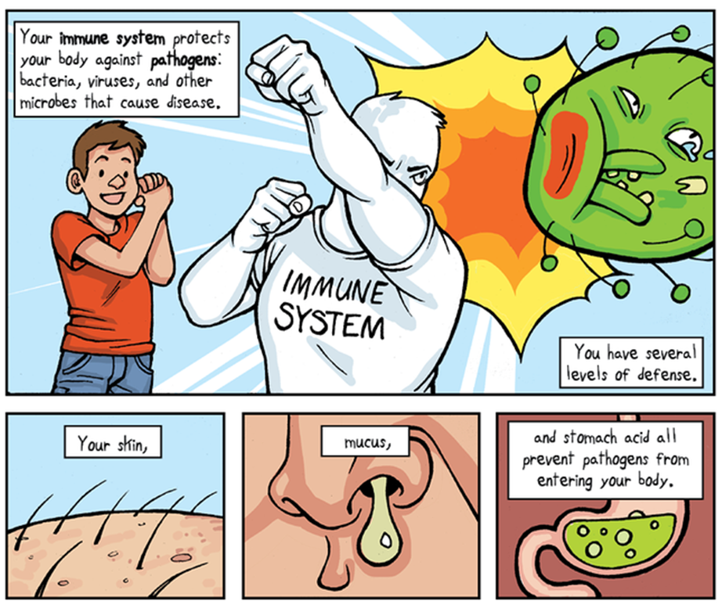
Innate Immunity

Slide 3
Adaptive Immunity

Slide 4
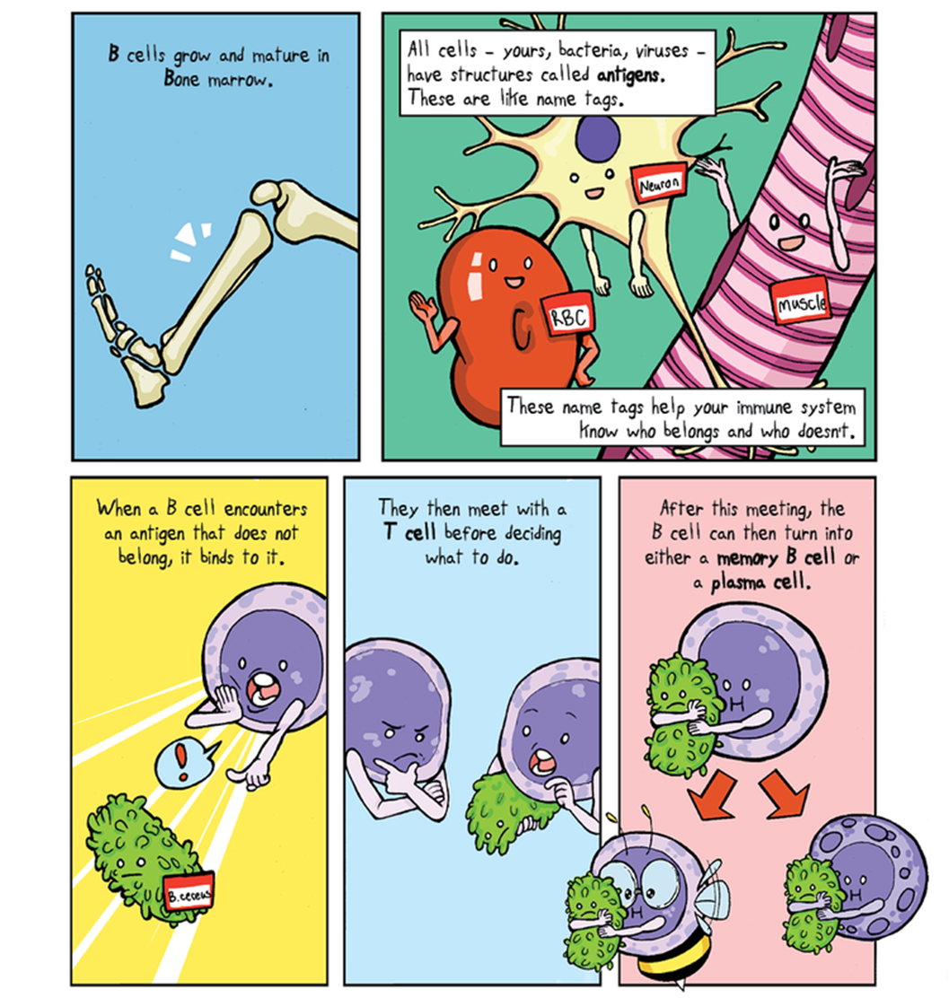
B cells

Slide 5
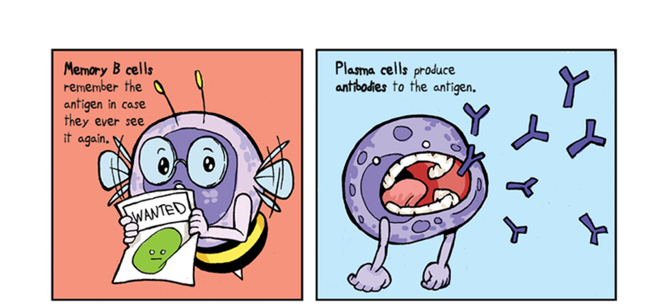
The 2 Bees

Slide 6
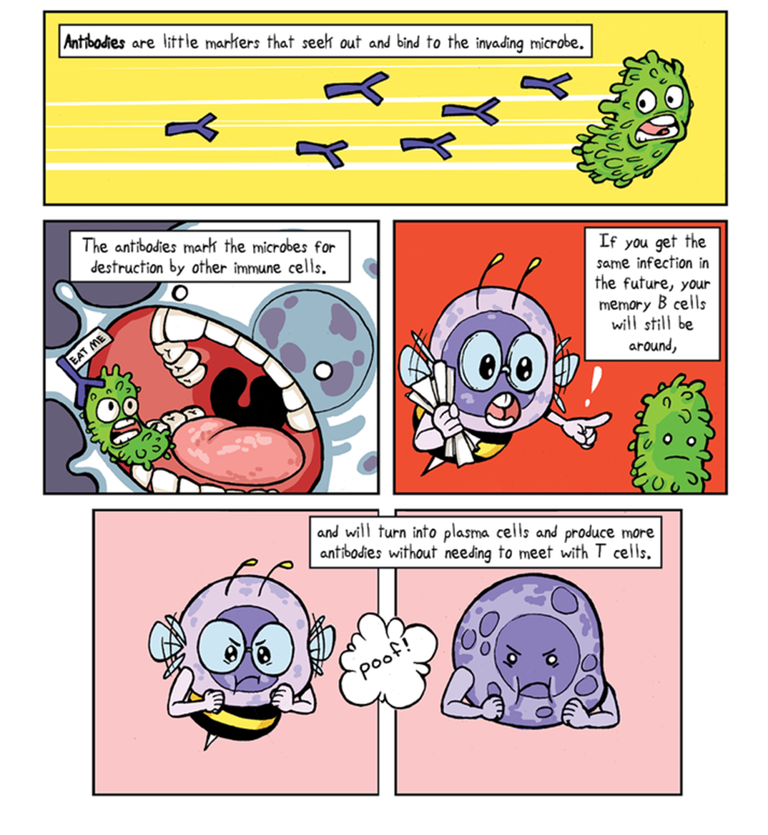
Antibodies

Slide 7
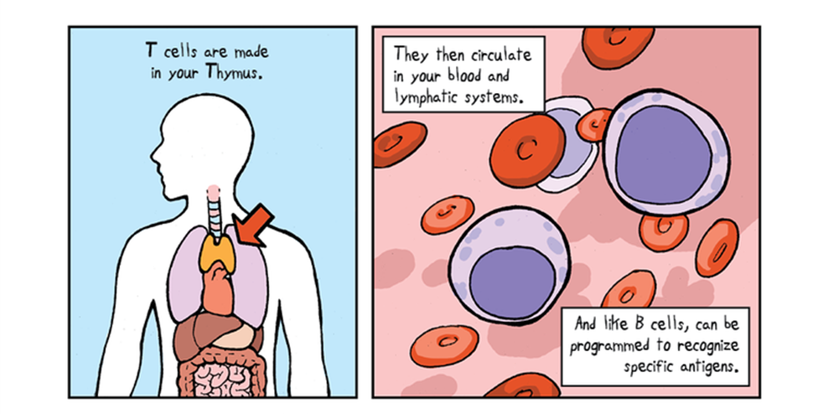
T cells

Slide 8
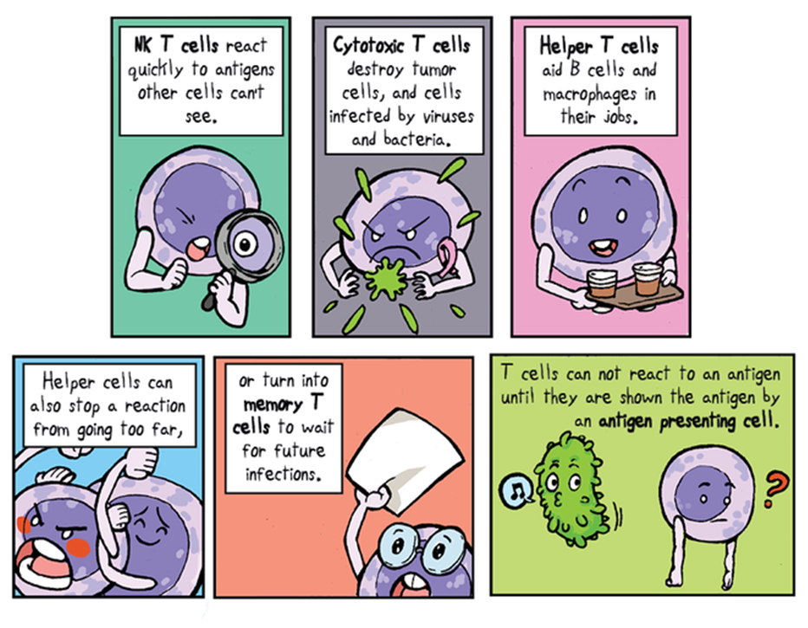
The 3 tees

Slide 9
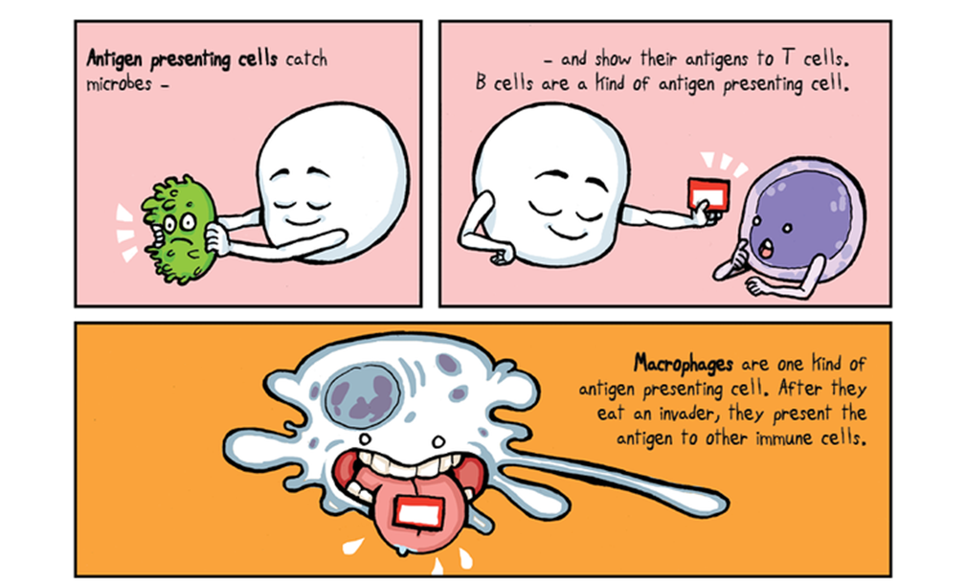
Presenting cells

Slide 10
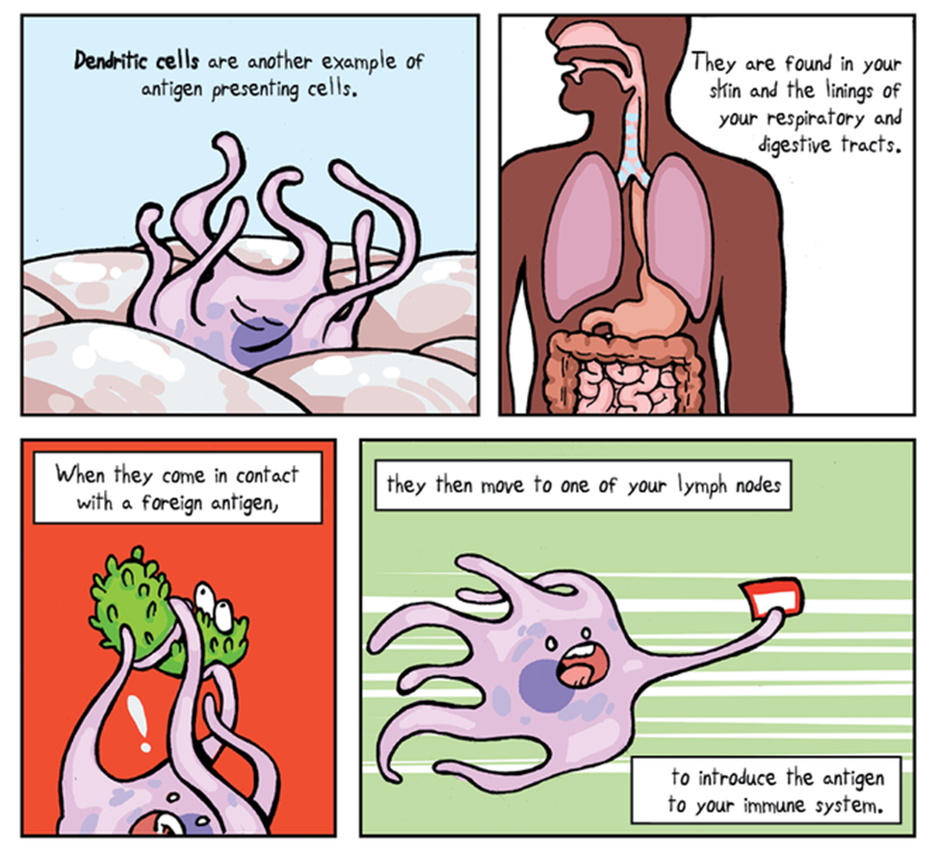
The mighty Dendritic Cell

Slide 11
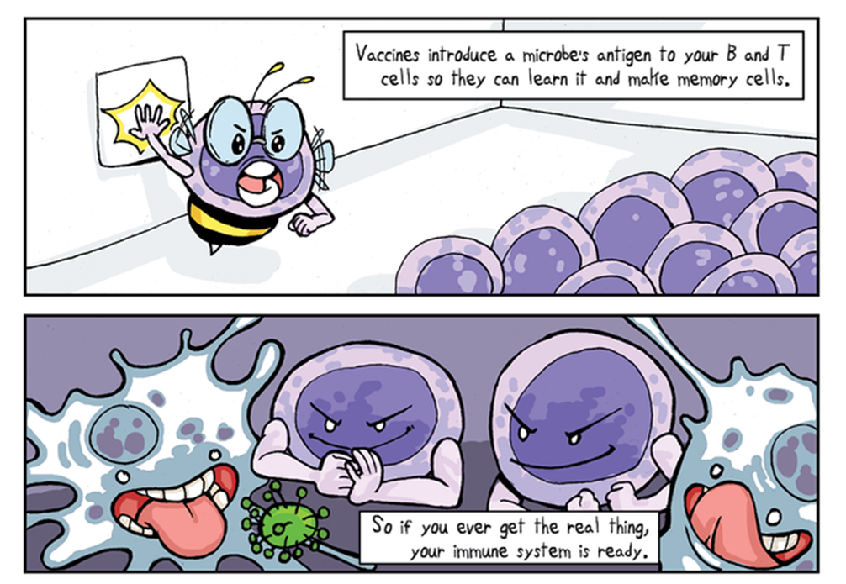
How vaccines work

Slide 12
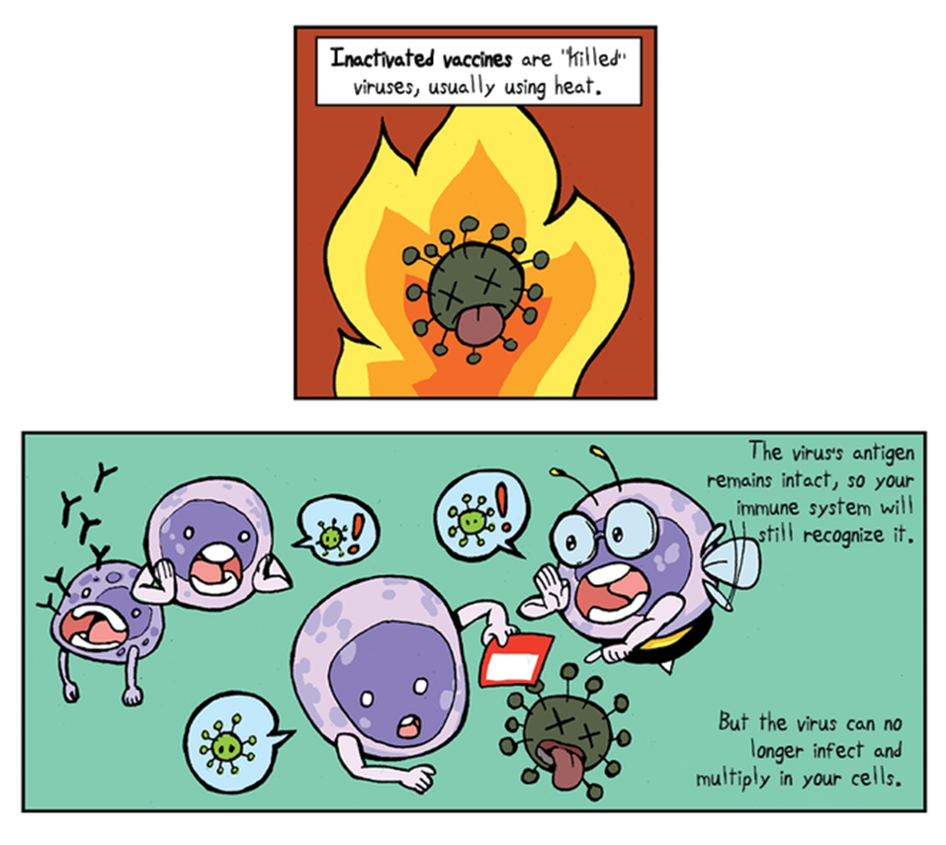
Killed (inactivated) vaccines

Slide 13
Attenuated (modified-live) vaccines

Slide 14
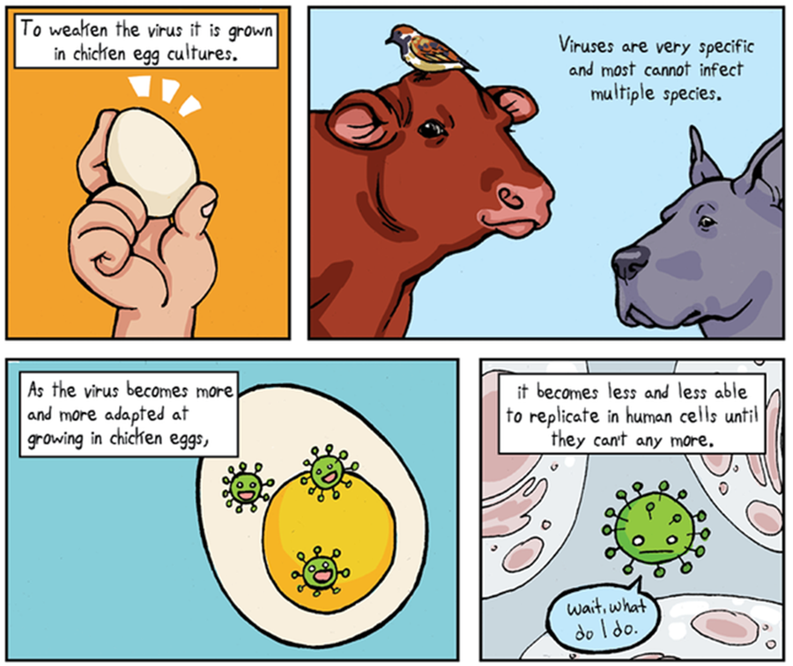
Making attenuated vaccines

Slide 15
subunit vaccines

Slide 16
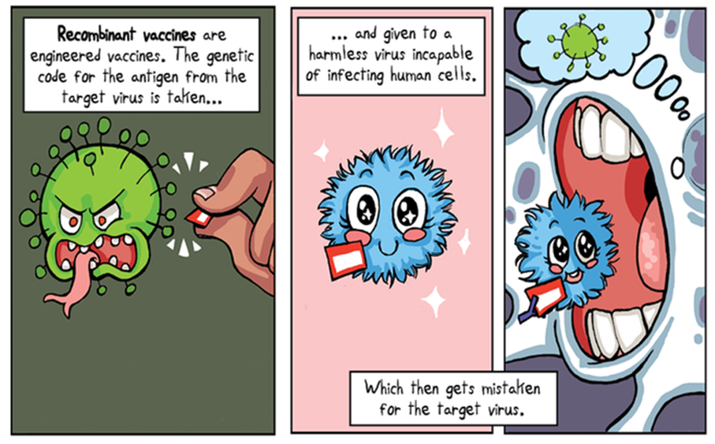
Recombinant vaccines

Slide 17
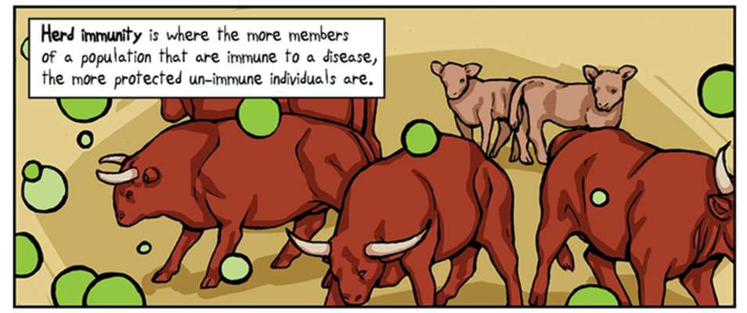
Herd immunity

Slide 18
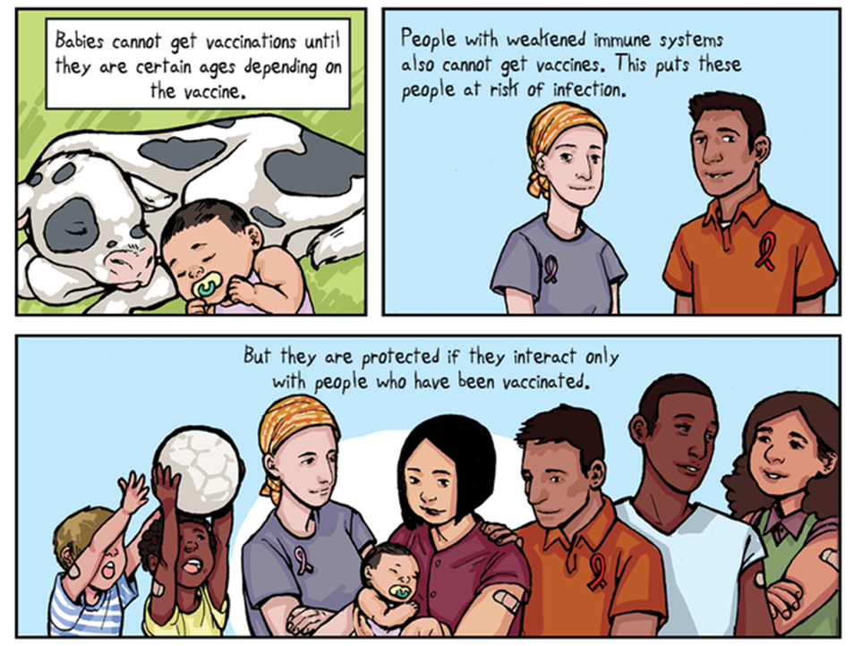
Protection through herd immunity

Slide 19
Mutation of pathogens

Slide 20
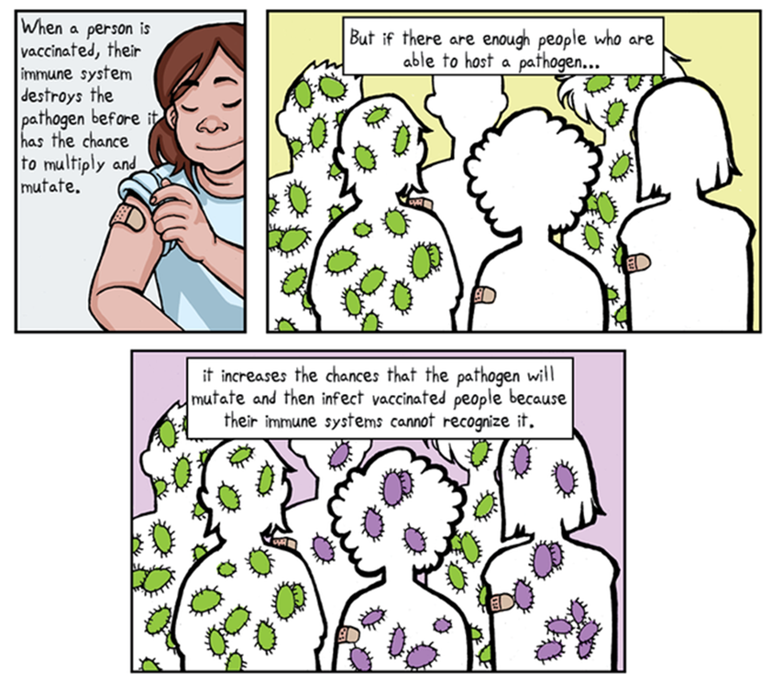
Outsmarting pathogens by immunization

Slide 21
Questions?

