Slide 1
Teeth Laboratory
Brushy, Brushy, Brushy!

Slide 3
Definitions
Veterinary dentistry includes the cleaning, adjustment, filing, extraction, or repair of animals' teeth and all other aspects of oral health care in animals.
Periodontal disease is an inflammatory disease that affects the soft and hard structures that support the teeth.
Tartar is a hard calcified deposit that forms on the teeth and contributes to their decay.
Plaque is a biofilm or mass of bacteria that grows on surfaces within the mouth.
Gingivitis is inflammation of the gums (gingiva) that is commonly caused by the accumulation of plaque.
Lingual is a term relating to the side toward the tongue.
Buccal is a term relating to the side toward the cheek.
Occlusal is a term relating to the area of contact between upper and lower teeth.
Rostral is a term relating to the direction toward the nose.
Caudal is a term relating to the direction toward the back of the head.

Slide 4
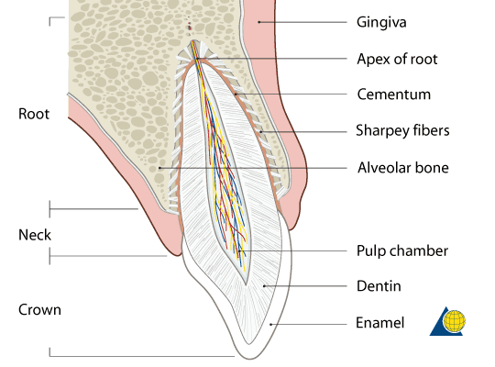
Tooth Structure

Slide 5
Stage I Periodontal Disease
There is visible tartar build up on the teeth and slight swelling and redness of the gums.

Slide 6
Stage II Periodontal Disease
The gums are more swollen and there can be mild loss of bone around the tooth roots on x-ray.

Slide 7
Stage III Periodontal Disease
Looks similar to Stage II on the surface but x-rays show more severe bone loss.

Slide 8
Stage IV Periodontal Disease
Severe tartar accumulation, receded gum lines, tooth damage and decay and bone loss.

Slide 9
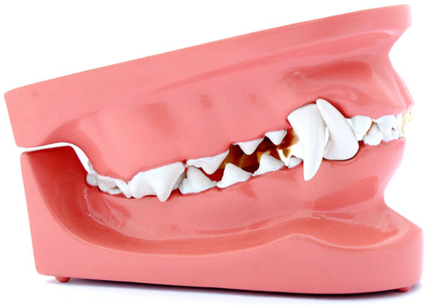
The Mammalian Jaw
Maxilla
Mandible

Slide 10
Dog Teeth
Canine
Incisors
Premolars
Molars
Incisors
Molars
Premolars
Canine

Slide 11
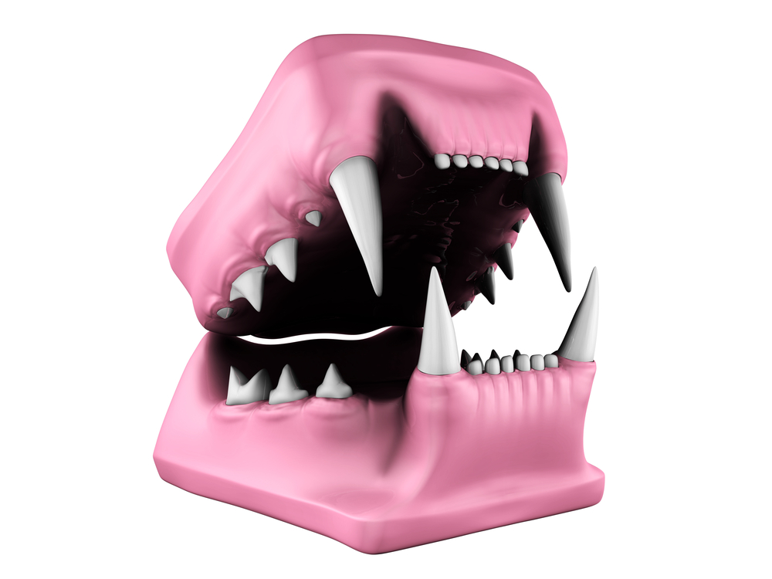
Cat Teeth
Incisors
Canine
Premolars
Molar
Molar
Incisors
Premolars
Canine

Slide 12
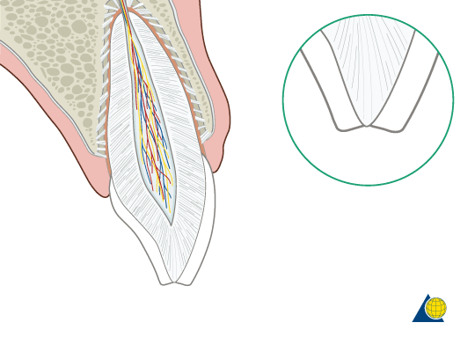
Fracture of Enamel
Usually leave alone in veterinary dentistry…

Slide 13
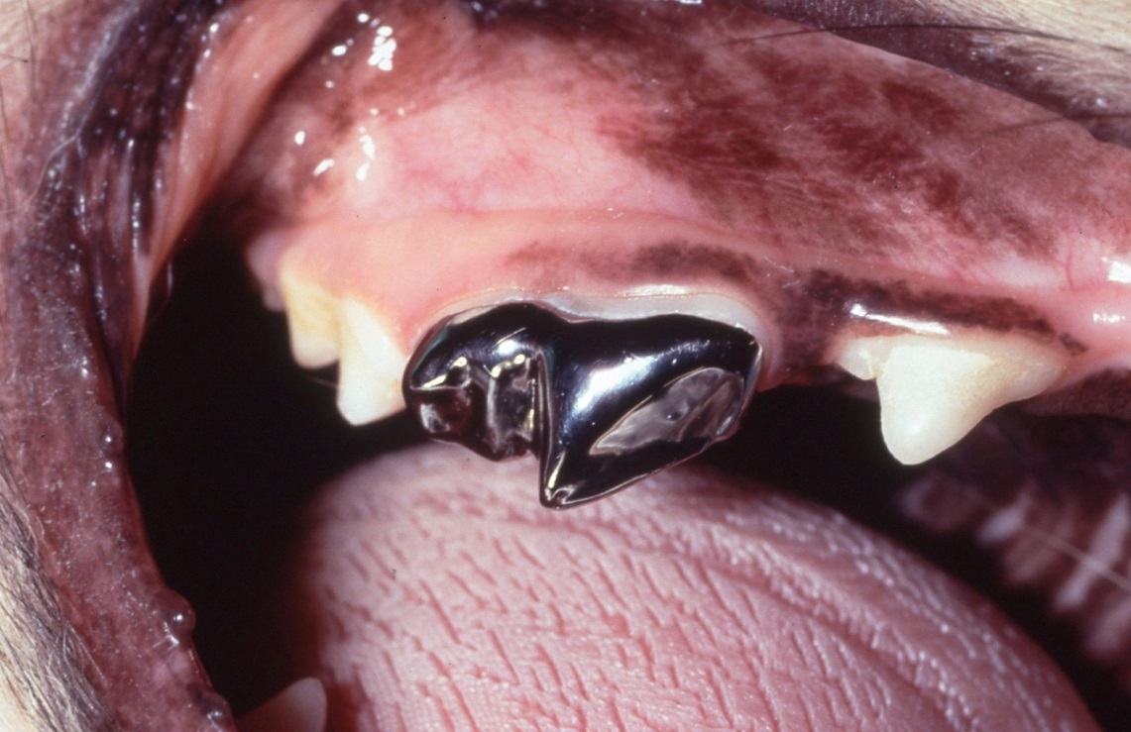
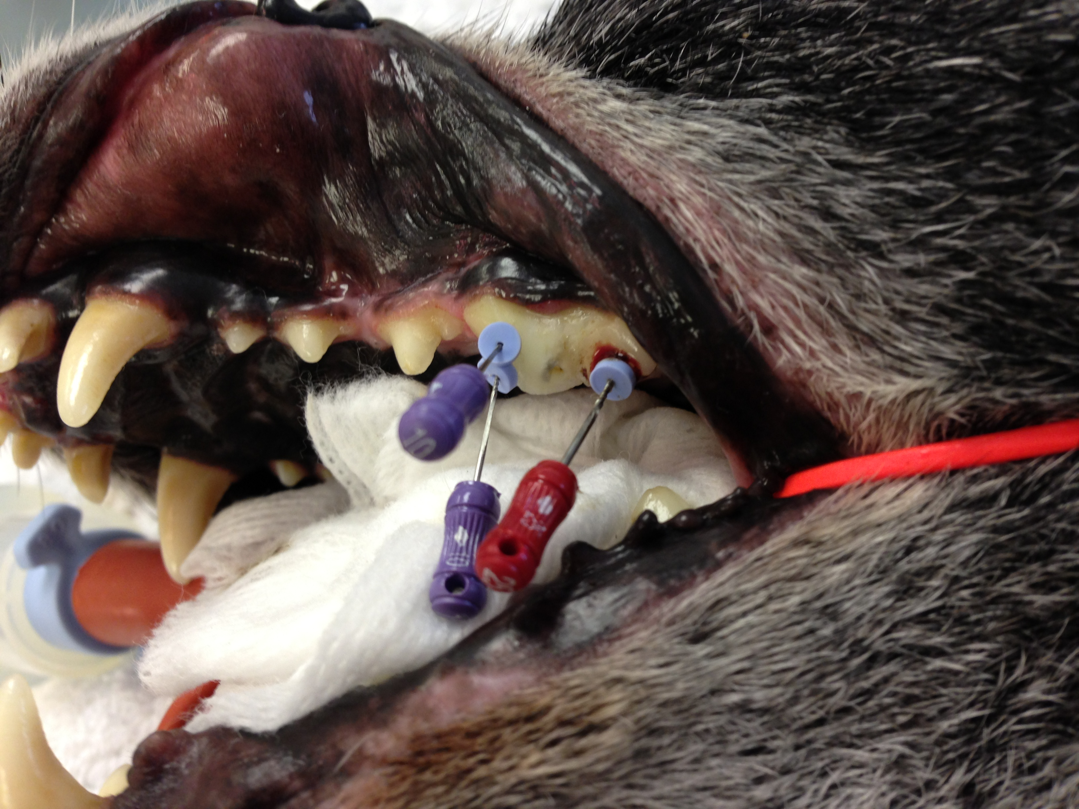
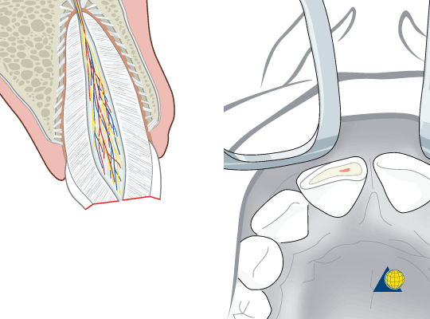
Fracture exposing pulp
Painful! Extract or root canal + crown?

Slide 14
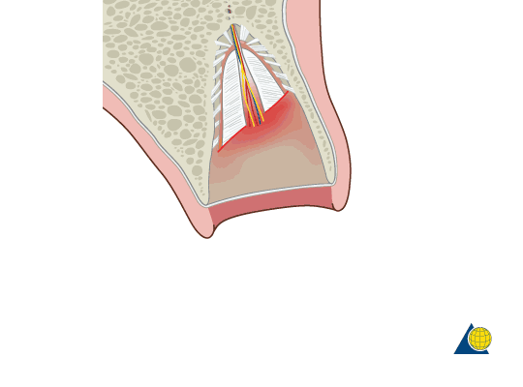
Fracture involving root
Must remove root remnant!

Slide 15
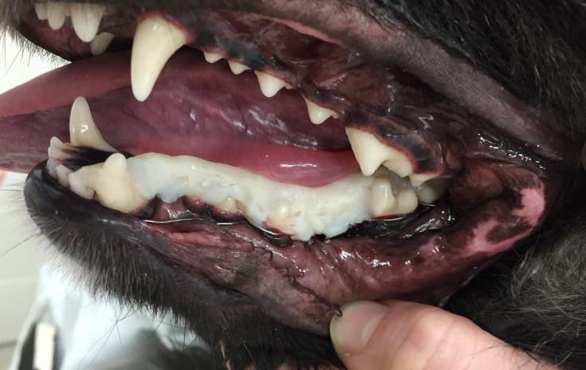
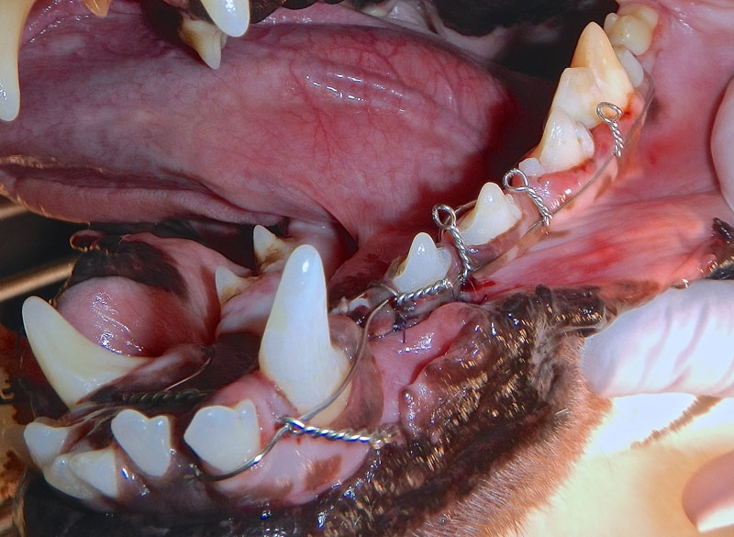
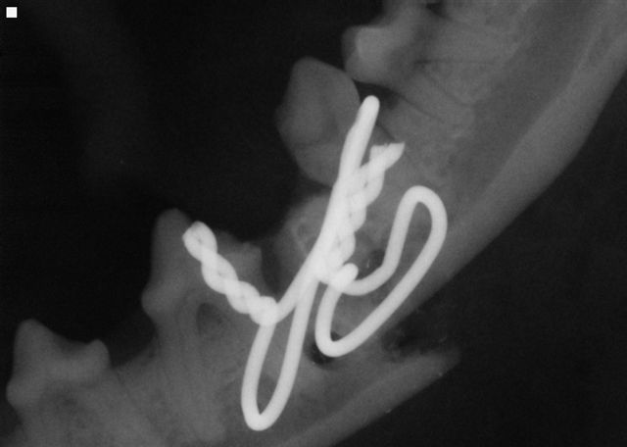
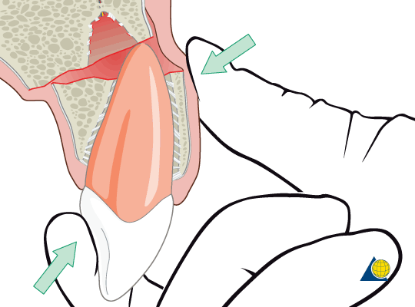
Fracture involving bone
Internal or external fixation?

Slide 16
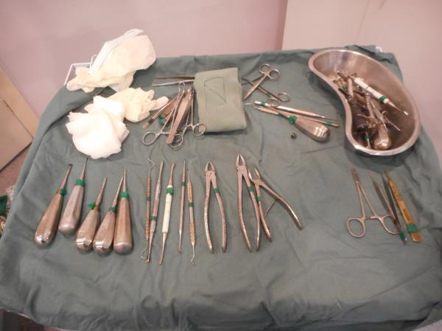
Dental Equipment

Slide 17
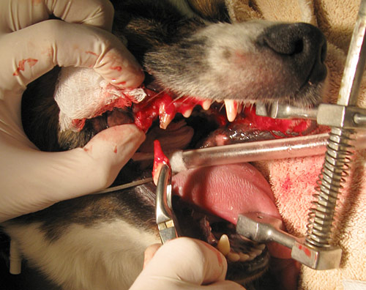
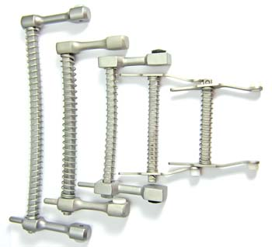
Mouth Speculum

Slide 18
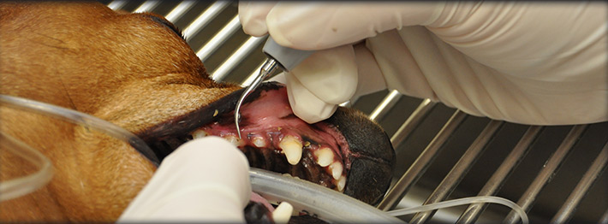
Scaler

Slide 19
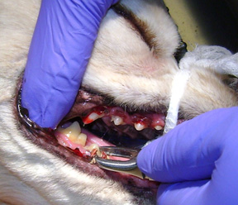
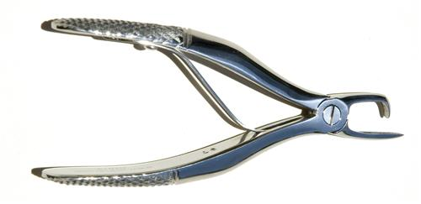
Tartar Removing Forceps

Slide 20
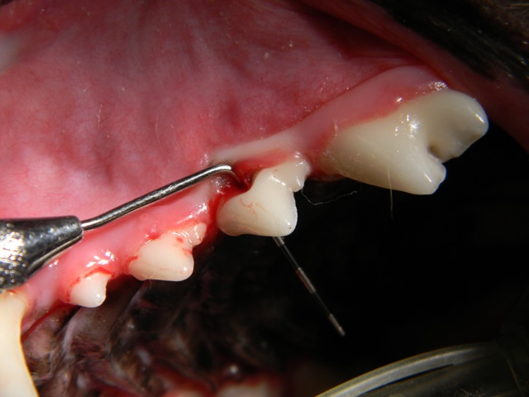
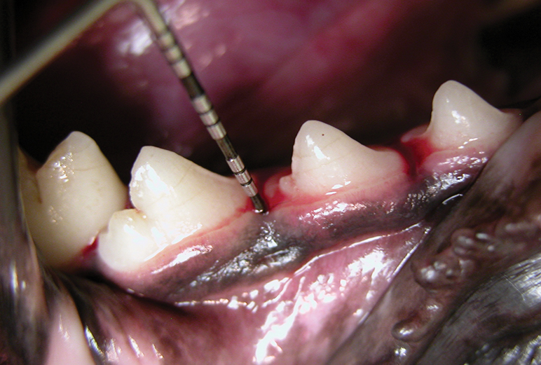
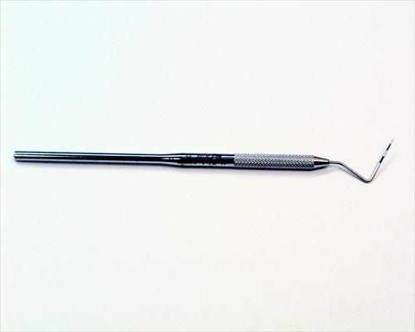
Gingival Probe

Slide 21
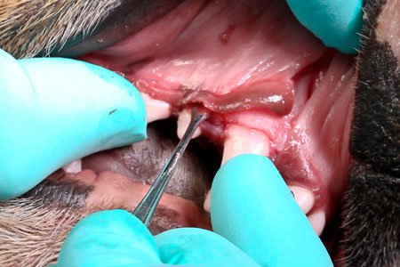
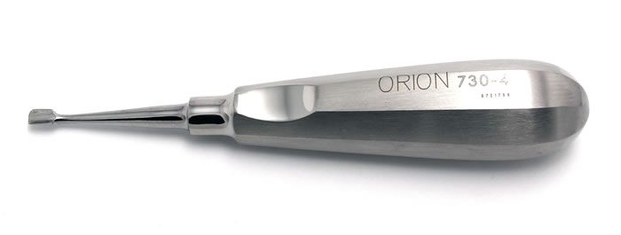
Elevator

Slide 22
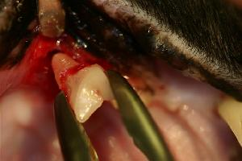
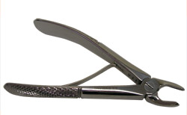
Dental Extractor

Slide 23
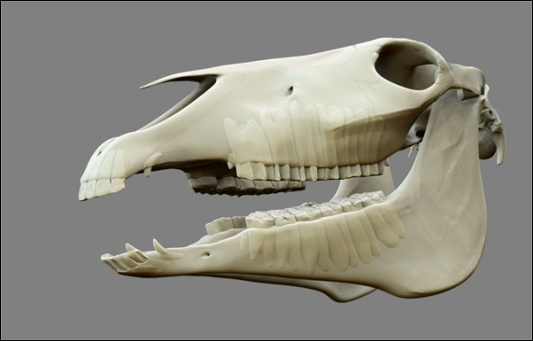
What about our largest pet?

Slide 24
Horse Teeth
Wolf Tooth
Premolars
Canine
Molars
Incisors
Molars
Premolars
Canine
Incisors

Slide 25
What are those?
Infraorbital Foramen
Mental Foramen

Slide 26
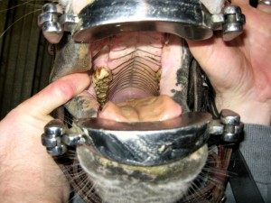
Horse Teeth Problems

Slide 27
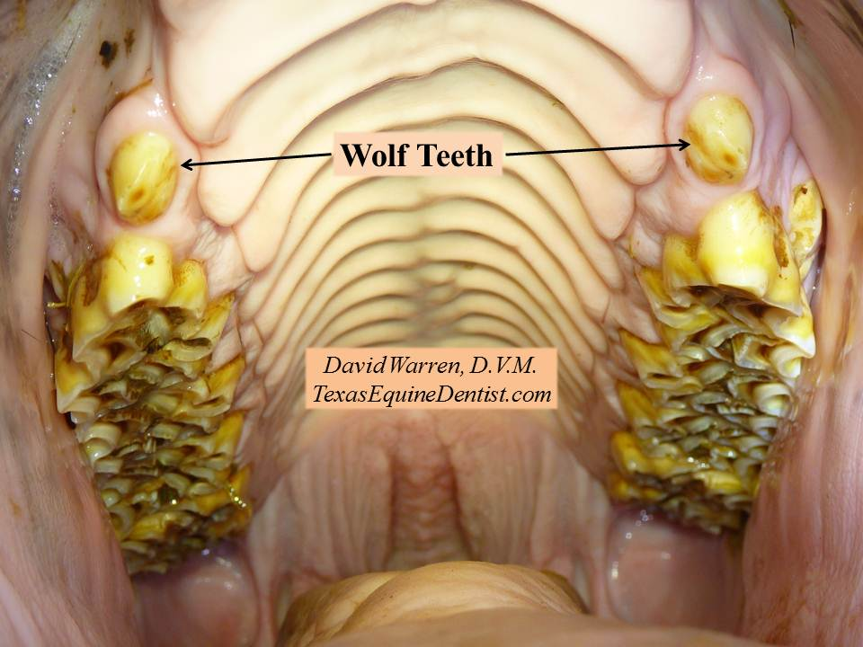
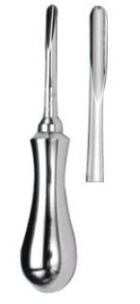
Wolf Teeth
If horse is to wear a bit, these teeth will need to be extracted with a wolf tooth elevator!

Slide 28
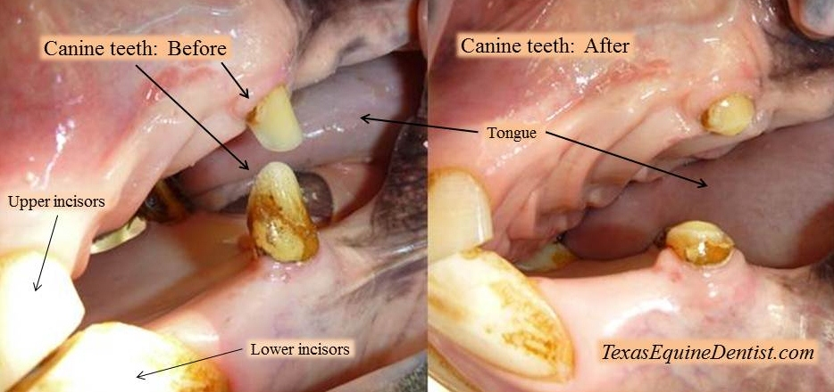
Canine Teeth
Shorten and smooth to prevent damage. Not necessary to remove!

Slide 29
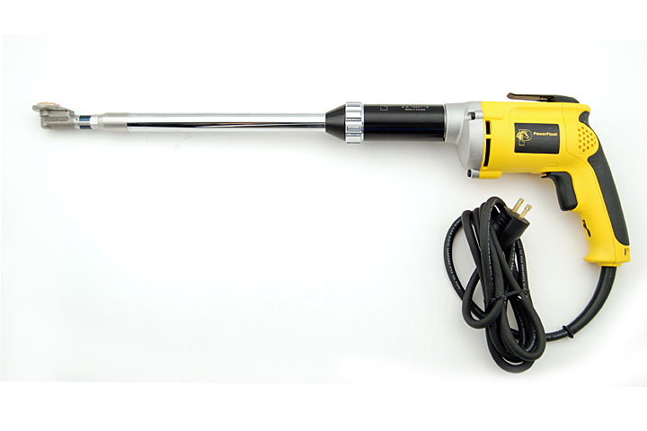
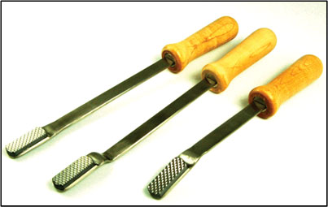
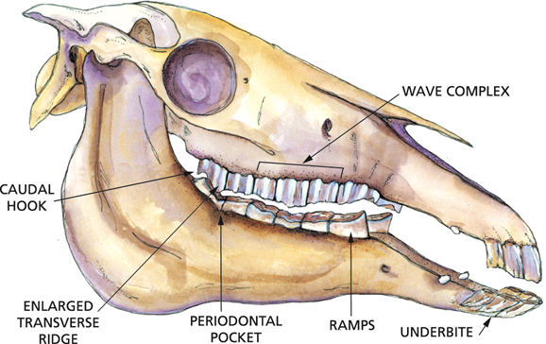
Hooks & Other Defects
Most problems are fixed by floating…

Slide 30
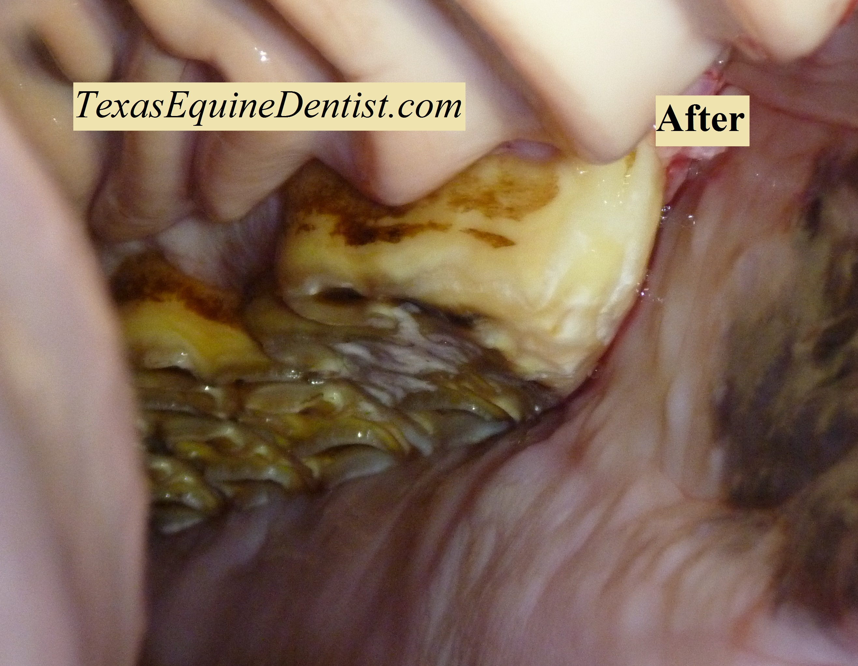
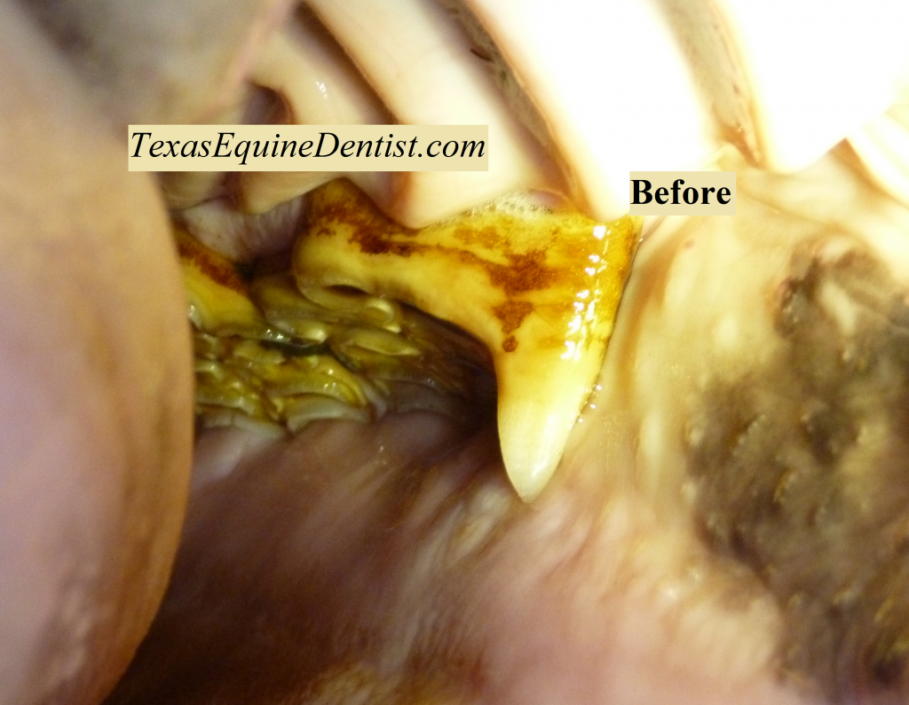
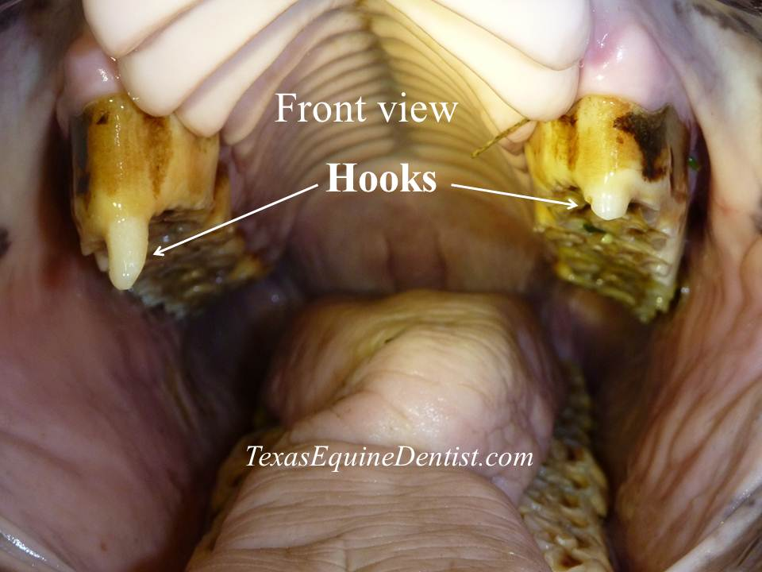
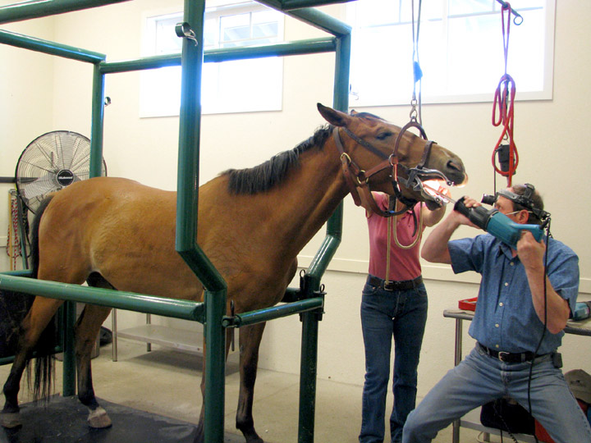
Teeth Floating

Slide 31
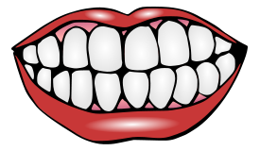
Dental problems are common in all animals!
Start dental care early
Examine often
Fix problems as they arise
Measure benefit versus risk!

