Slide 1
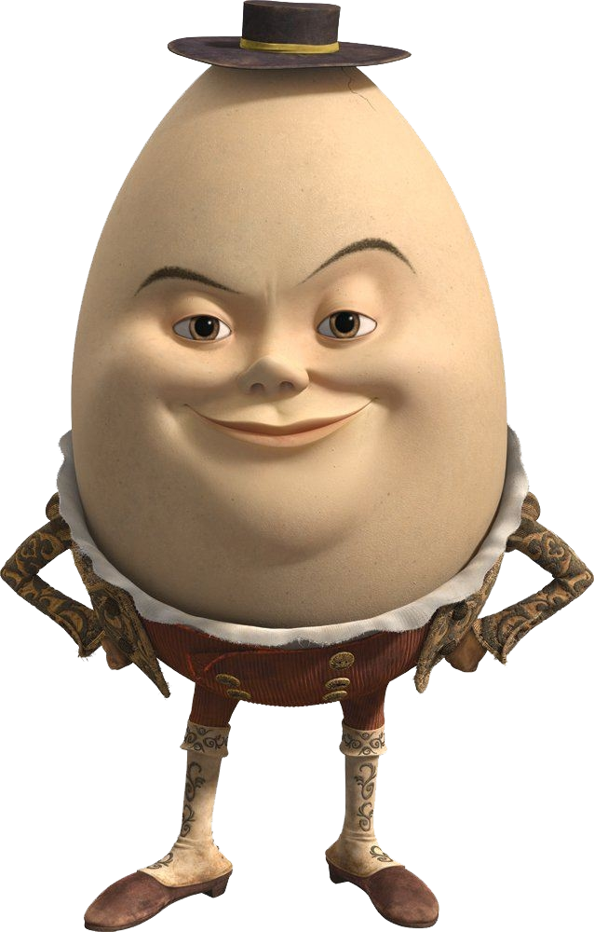
Sutures
Putting Humpty Dumpty Back Together

Slide 2
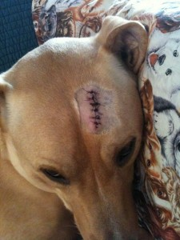
Why do we use sutures?
To close wounds that are large or deep
To keep tissues edges together to aid healing
To restore the function of the tissue
To prevent infection

Slide 3
Did You Know?
The term "stitches" refers to the surgical procedure or process of closing a wound with sutures.
Sutures are the thread-like material used to close the wound.
Staples or tissue adhesive can also be used to close wounds.

Slide 4
Type of Sutures
Absorbable vs Non-Absorbable
- Absorbable good on fast healing tissue
- Absorbable good for internal tissue (organs)
- Absorbable dissolves over a period of time
- Non-absorbable for long healing wounds
- Non-absorbable is great for skin!
- Non-absorbable must be removed
Monofilament vs Multifilament
- Monofilament for sensitive tissue
- Multifilament for strong knots

Slide 5
Patters Common To Vet Med
Simple interrupted
Simple continuous
Horizontal mattress
Vertical mattress
Cruciate interrupted
Subcuticular

Slide 6
Simple Interrupted
Most common
Skin closure for simple wounds
Closure for tissue with low integrity
- if one stitch fails, the others will compensate

Slide 7
Simple Continuous
Used only on healthy low stress tissue
Skin closure for simple wounds

Slide 8
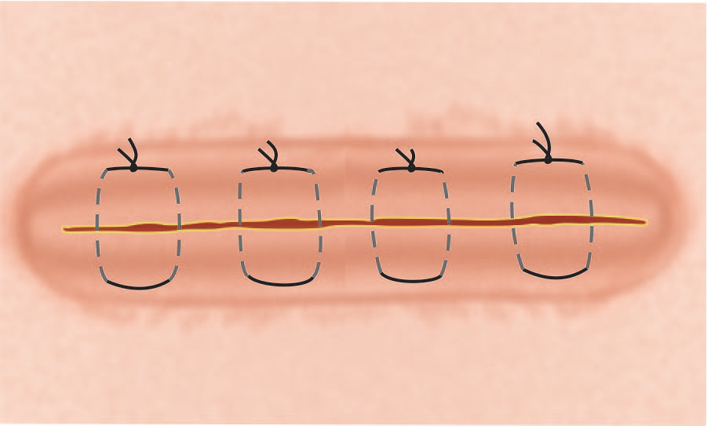
Horizontal Mattress
Used for extra strength
Often used for skin closure of wide wounds

Slide 9
Vertical Mattress
Used for high tension areas
Less likely to invert edges like horizontal

Slide 10
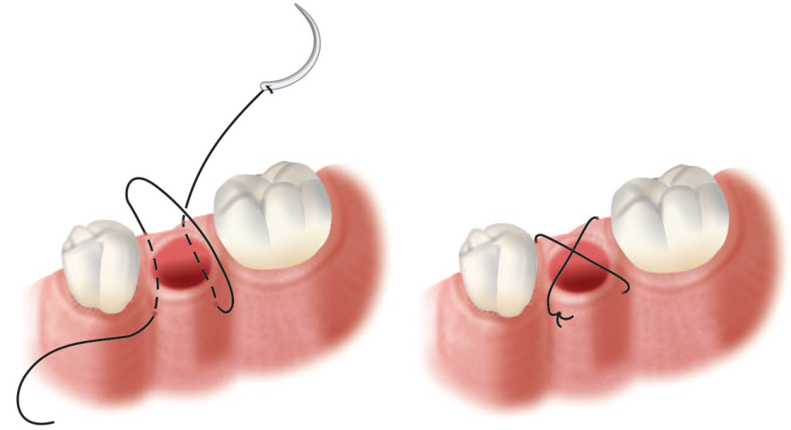
Cruciate
Used for very small wounds
Common stitch in vet dentistry
Provides extra strength

Slide 11
Subcuticular
Skin only
Leaves minimal scar
Often used for spay and neuter surgery

Slide 12
Let’s Start Practicing!
Today we will be performing
- 3 simple interrupted stitches
- 3 cruciate stitches
- 2 horizontal mattress stitches

