Slide 1
Surgery Pack Wrapping
Busy work but someone has to do it!

Slide 2
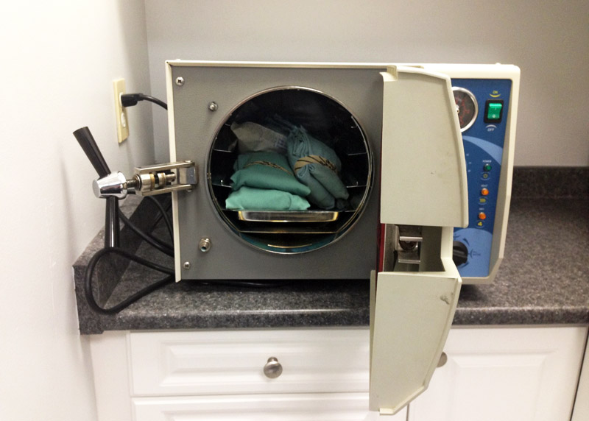
Surgery Packs
Assembled for specific surgical procedures
Used for autoclave sterilization (heated steam and pressure)
Autoclave tape or strip ideally used for assurance
Double wrapped to keep instruments sterile
Anyone can wrap a pack!

Slide 3
Instruments for a basic Spay pack
Mayo Scissors
Scalpel Handle
Spay Hook
Kelly Hemostat- Curved
Metzenbaum Scissors
Tissue Forceps
Adson-Brown Forceps
Allis Forceps
Towel Clamp
Needle Holder
Mosquito Forceps- Curved
Carmalt Forceps- Curved

Slide 4
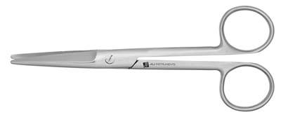
Mayo Scissors

Slide 5
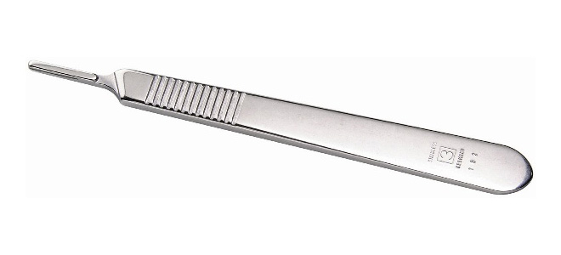
Scalpel Handle

Slide 6
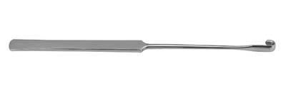
spay Hook

Slide 7
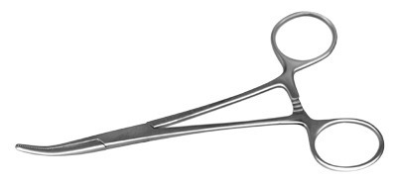
Kelly hemostat- curved

Slide 8
Metzenbaum Scissors

Slide 9
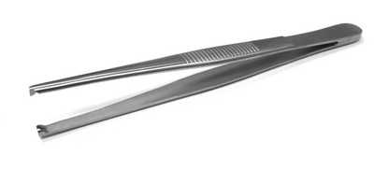
Tissue Forceps

Slide 10
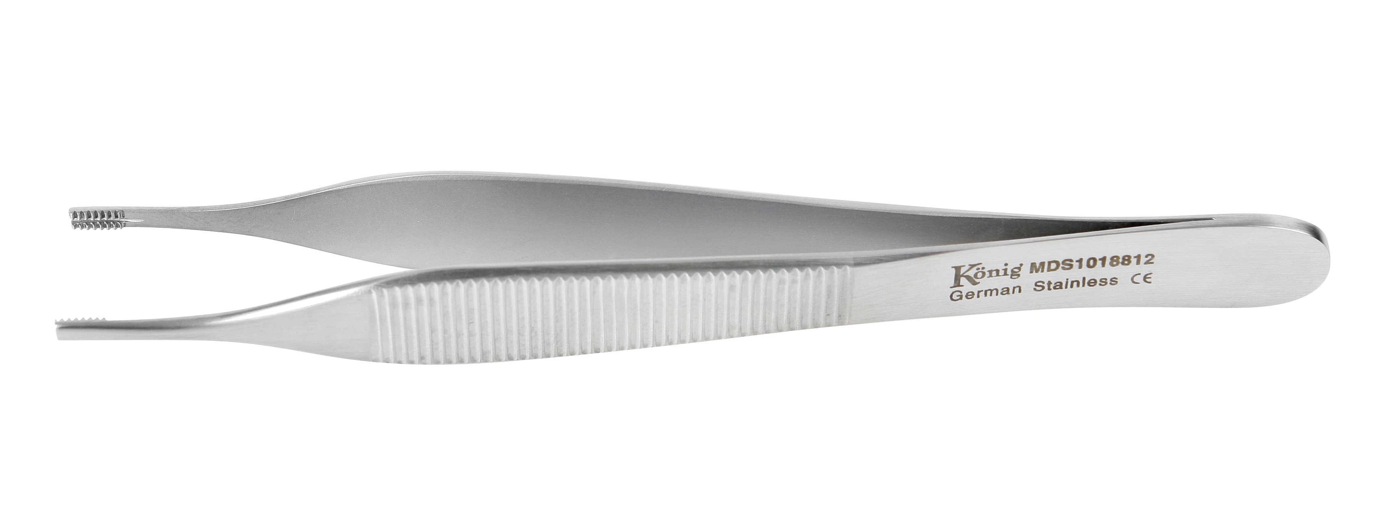
Adson-Brown Forceps

Slide 11
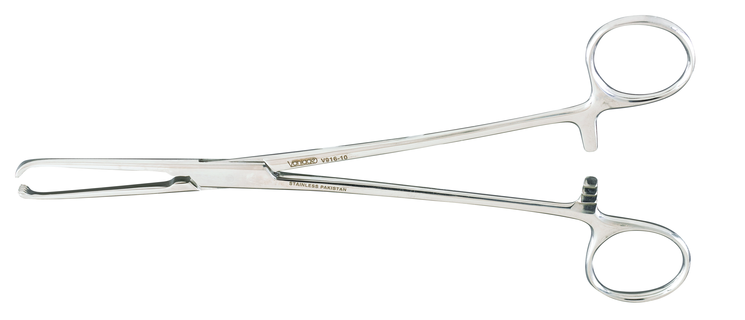
Allis Forceps

Slide 12
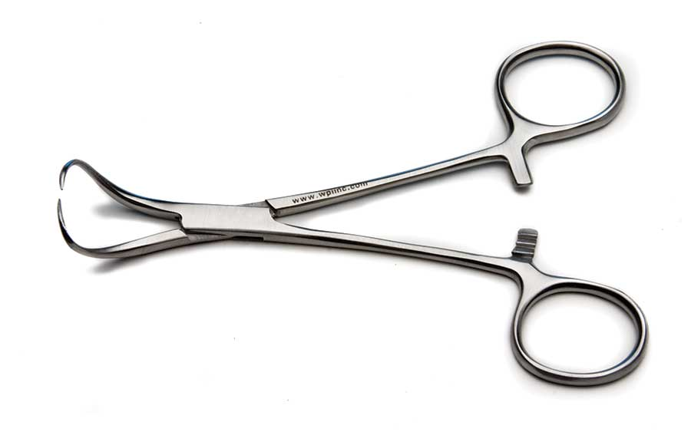
Towel Clamp

Slide 13
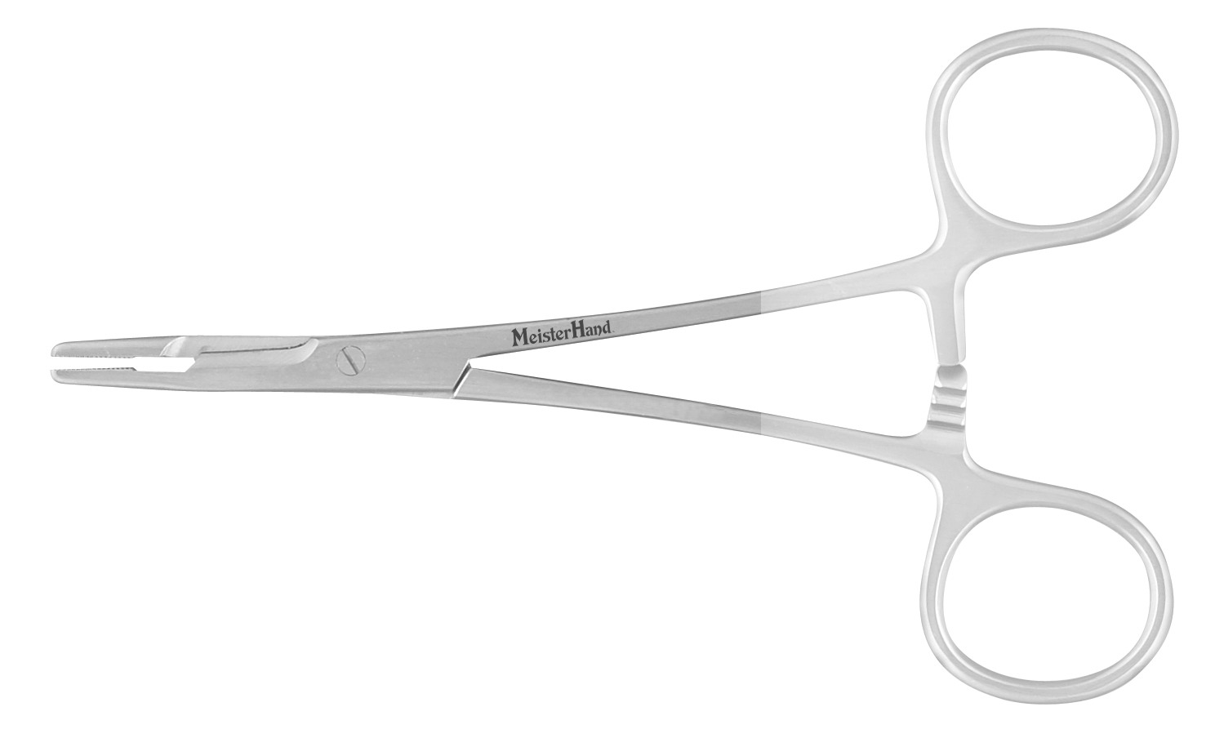
Needle Holder

Slide 14
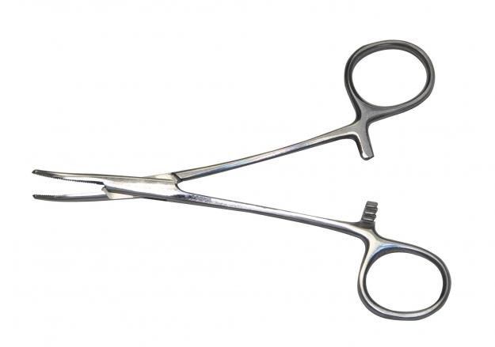
Mosquito Forceps- Curved

Slide 15
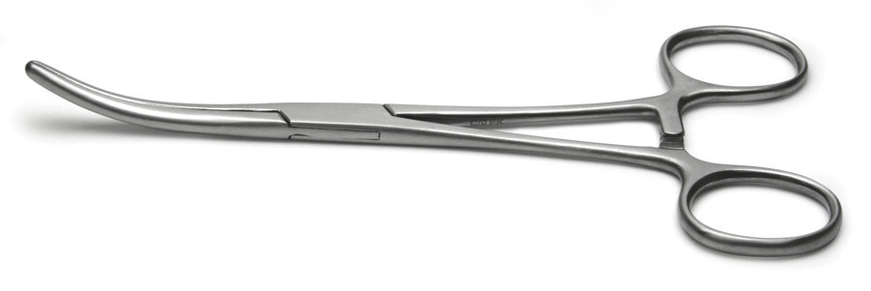
Carmalt Forceps-curved

Slide 17
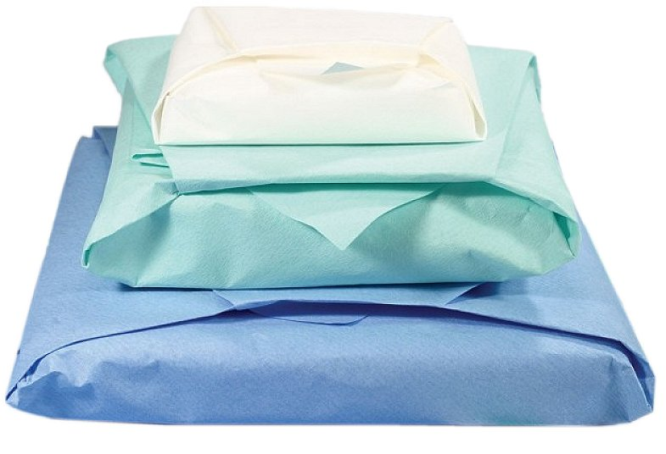
Let’s Start wrapping!

