Slide 1
Small Animal Restraint
Do not trust those sweet furry faces!

Slide 2
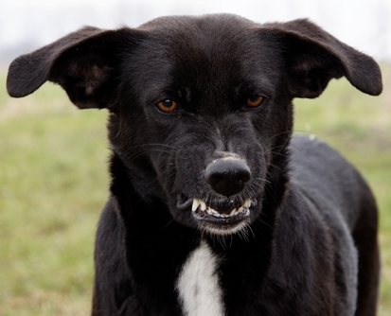
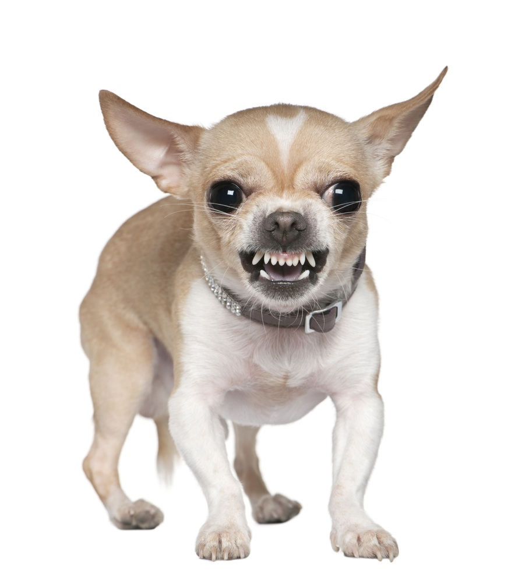
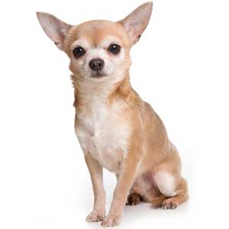
Animal Restraint is for Your Safety!
Animals often become aggressive at the veterinary clinic
Most of the time it is out of fear (fear aggression)
Others may have dominance aggression
Wagging ≠ happy (especially in cats)
Ears back= fear aggression*
Ears forward= attack mode*
Never assume an animal is safe!

Slide 4
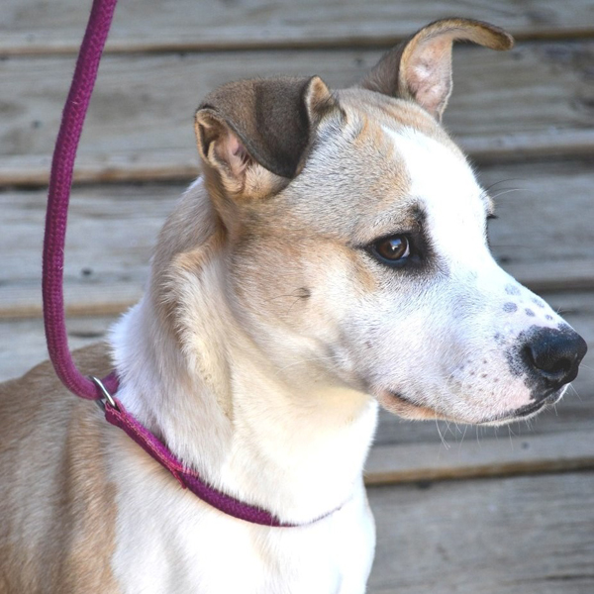
Single or Double Slip Leash Method
Single leash on neck works for most dogs
Leash on neck and another around abdomen for runners
Leash should always be on an animal when out of the kennel
For safety, leash should always be off animal when in kennel

Slide 5
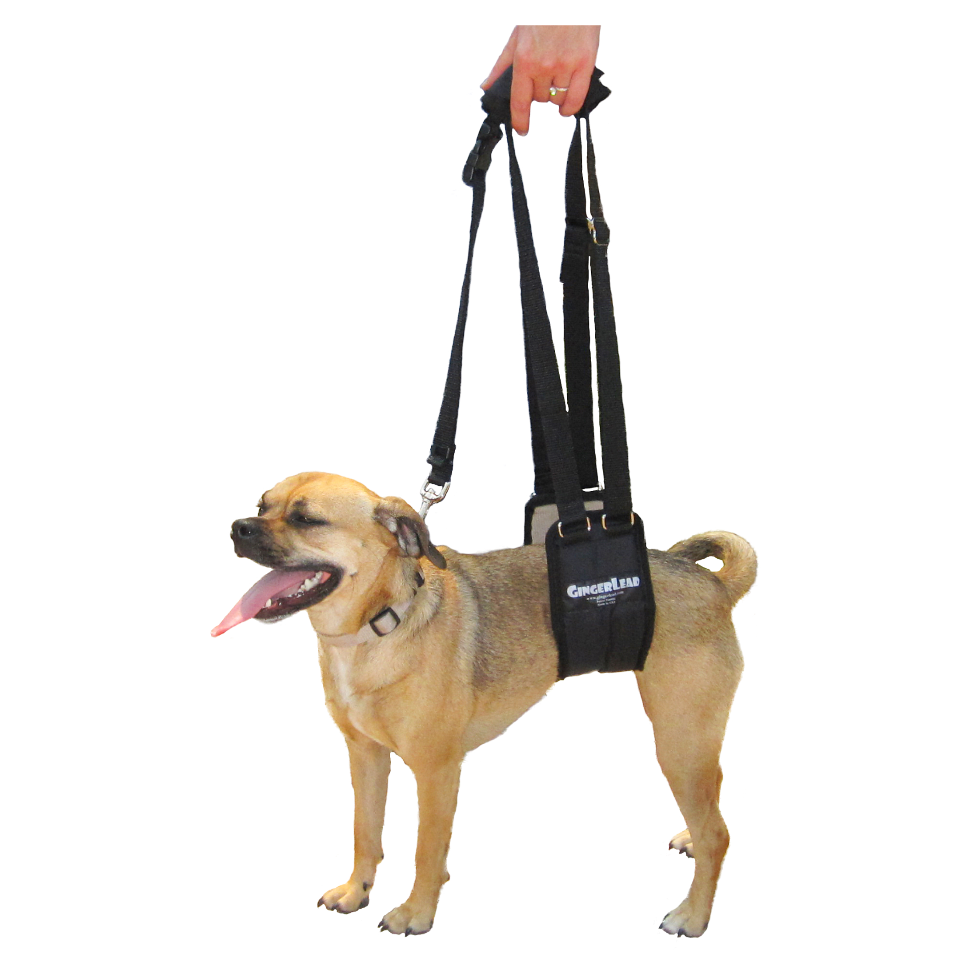
Leash with a sling
Used on dogs with hind leg weakness or injury
Continue to use leash even if weak or injured!

Slide 6
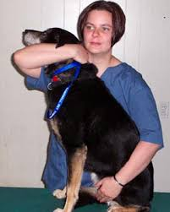
Dog Sitting Restraint
One arm under neck hugging head to body
Other arm under abdomen in front of hip
Used for general restraint for exams and injections
Muzzle recommended

Slide 7
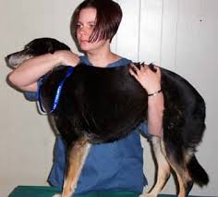
Dog Standing Restraint
One arm under neck hugging head to body
Other hand arm under abdomen
Used for general restraint during examination
Muzzle recommended

Slide 8
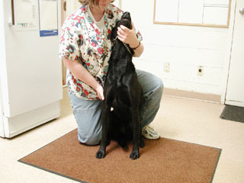
Dog Jugular Venipuncture Restraint
One arm/hand under jaw and hugging head to body
Other arm/hand restraining leg or chest
Leg behind to stop dog from backing up
Muzzle recommended

Slide 9
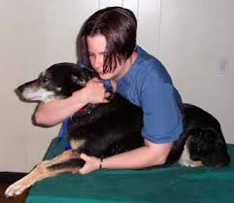
Dog Cephalic Venipuncture Restraint
One arm under neck hugging head to body
Other arm over back and holding arm at elbow
Use thumb to twist skin to the side to expose vein site
Muzzle recommended

Slide 10
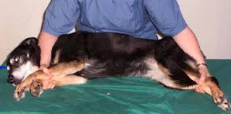
Dog Saphenous Venipuncture Restraint
One arm over neck and holding bottom leg
Other arm over hip and holding top leg for venipuncture
Hold both hind legs if possible
Muzzle Recommended

Slide 11
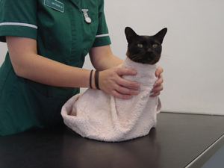
Cat Restraint- The Kitty Burrito
Place towel on a table
Place cat on towel
Criss-Cross towel on nape of neck and hold
After towel is secure, place cat muzzle
Used for examinations and injections

Slide 12
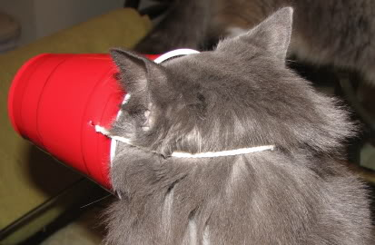
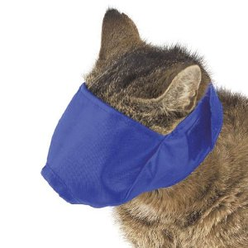
The Cat Muzzle
Very important for safety of cat and holder
Cat bites are very dangerous- lots of bacteria!
Can be made out of household items if in a pinch*

Slide 13
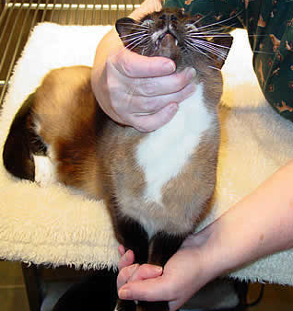
Cat Jugular Venipuncture Restraint
Cat muzzle highly recommended
One hand under jaw
Other hand holding front feet
If cat is declawed or in towel, both hands can hold jaw*

Slide 14
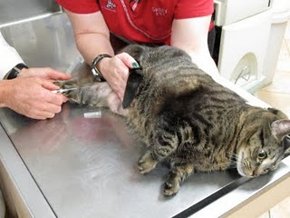
Cat Saphenous Venipuncture Restraint
Cat muzzle recommended
Can be done with towel
One hand holding scruff
Other hand holding top leg and tail
Hand is placed on bottom leg in a “karate chop”

Slide 15
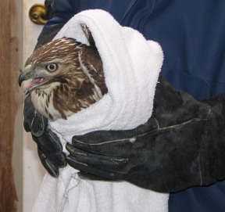
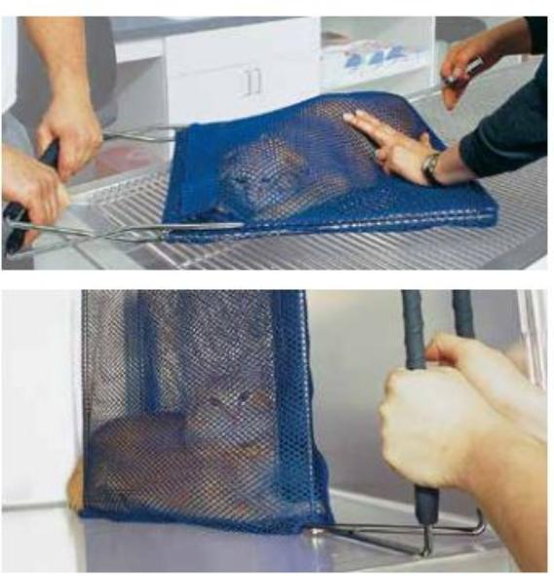
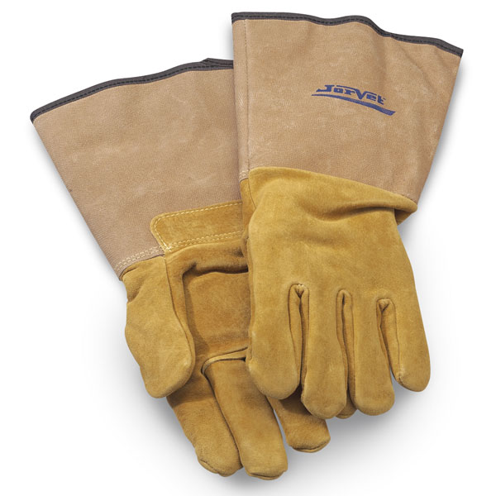
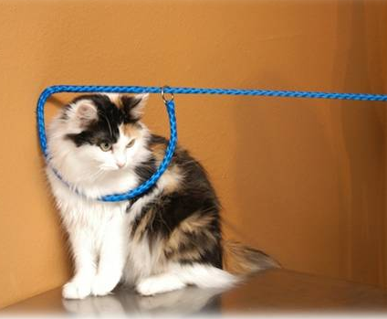
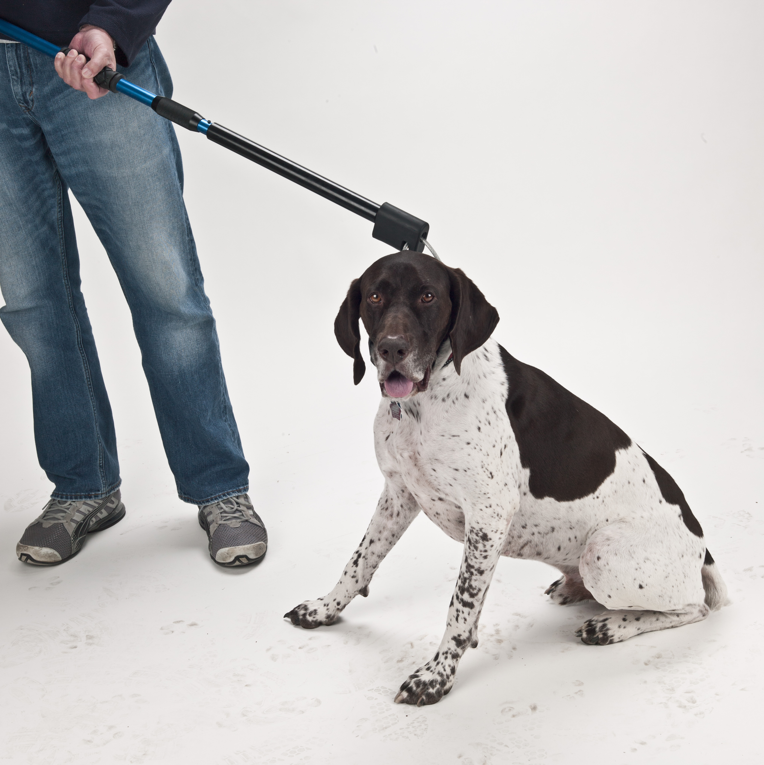
Special Restraints for Difficult Animals
The catch pole (for experienced users only!)
The snare leash (best for cats/dogs in kennel)
The EZ Nabber (for cats and small dogs)
Leather restraint gloves (all small animals)
A thick towel is always good to have around!

Slide 16
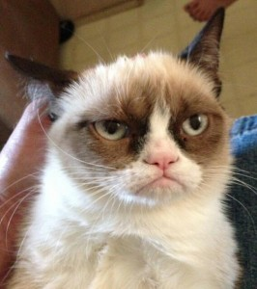
Questions?

