Slide 1
Microscopes
You Break it, you buy it ☺

Slide 2
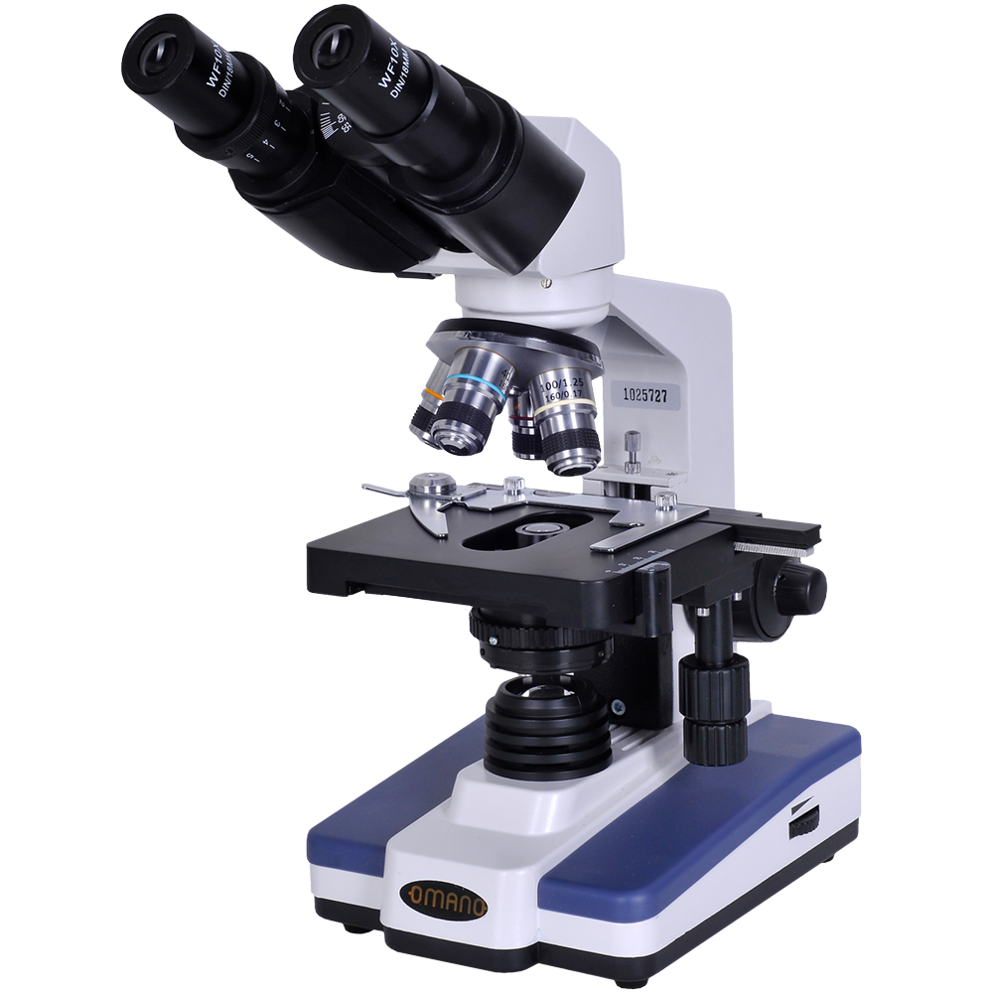
Eyepiece
Objectives
Arm
Stage Clip
Stage
Fine Adjustment
Course Adjustment
Condenser
Stage Control
Lamp
Light switch and adjust
Base

Slide 3
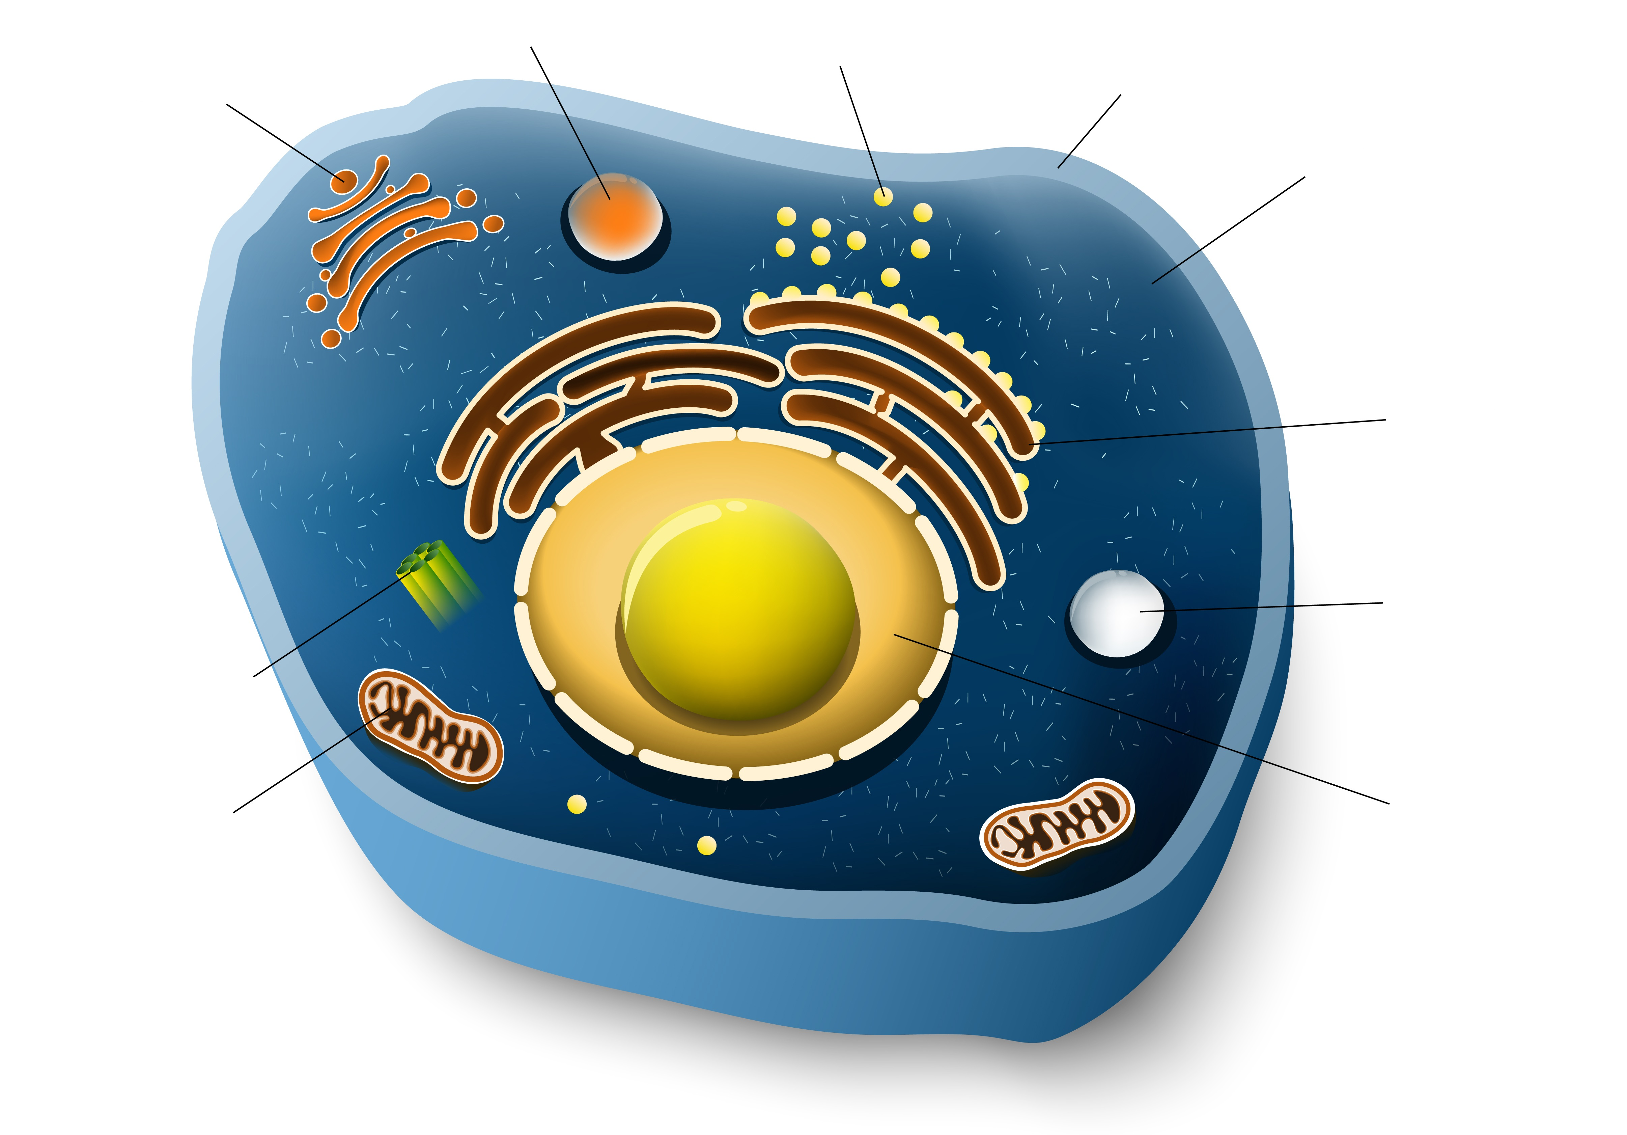
Parts of an Animal Cell
Lysosome
Ribosomes
Golgi Apparatus
Membrane
Cytoplasm
Rough Endoplasmic Reticulum
Peroxisome
Centriole
Mitochondrion
Nucleus

Slide 4
Animal Cells of Interest
Goblet Cell- secretes mucin
Parietal Cell- secretes hydrochloric acid
Chief Cell- secretes pepsinogen
Type I Alveolar Cell- involved in gas exchange
Type II Alveolar Cell- secretes pulmonary surfactant
Macrophage- engulfs and digests cellular debris
Neuron- transmits information through electrical and chemical signals
Red Blood Cell- delivers oxygen to body tissues
Platelet- stops bleeding by clumping and clotting blood vessel injuries
Neutrophils- first-responders of immune defense that create pus

Slide 5
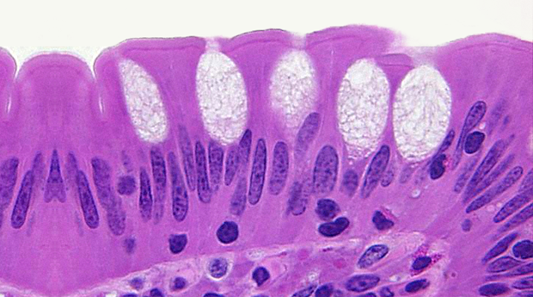
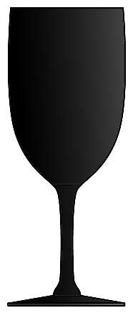
Goblet Cell

Slide 6
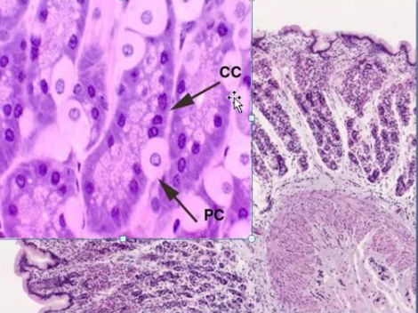
Parietal and Chief Cells

Slide 7
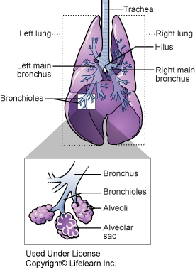
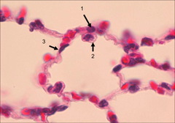
Type I Alveolar Cell (1)
2
1
3
RBC

Slide 8
Type II Alveolar Cell (2)
2
1
3

Slide 9
Pulmonary Macrophage(3)
2
1
3

Slide 10
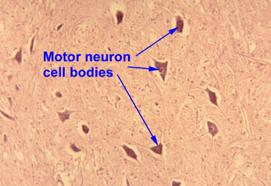
Neuron

Slide 11
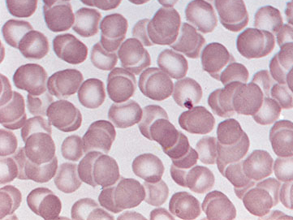
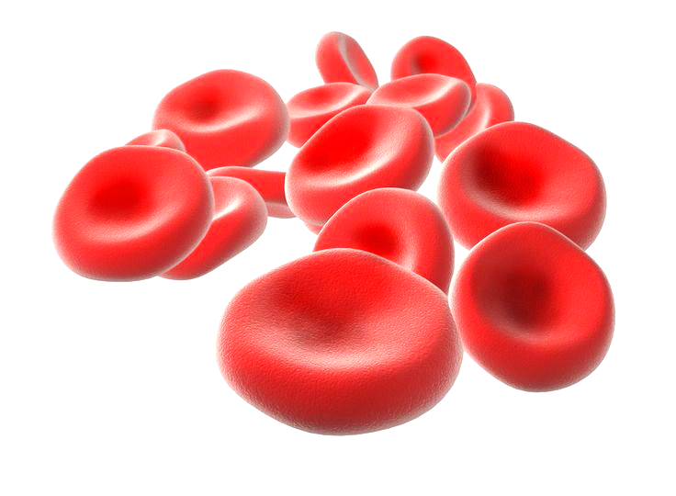
Red Blood Cell

Slide 12
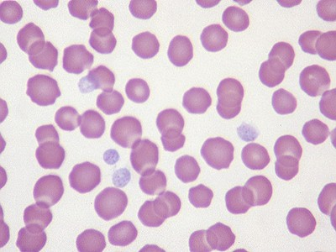
Platelet

Slide 13
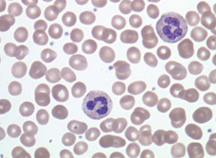
Neutrophil

Slide 14
Monocytes (immature macrophage)
monocyte
neutrophil

Slide 15
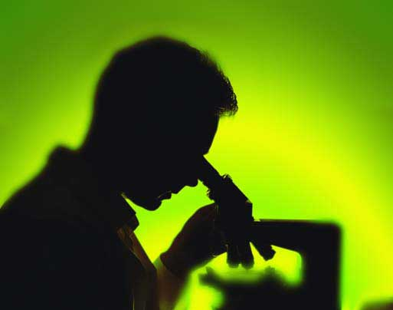
Let’s look at stuff!

