Slide 1
Hybrid Dogs
Sometimes you can guess and sometimes you can’t!

Slide 2
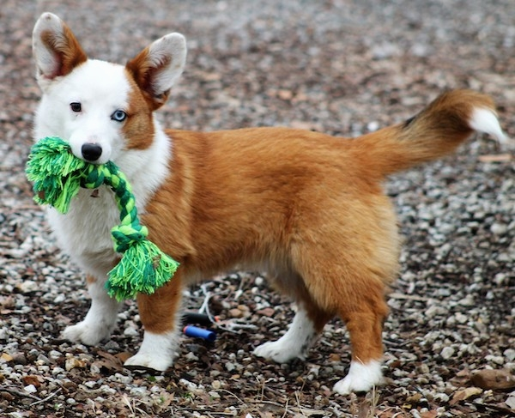
A
Aussie Corgi

Slide 3
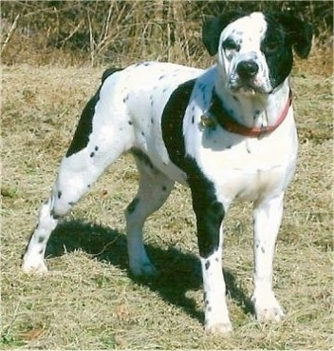
B
Bullmation

Slide 4
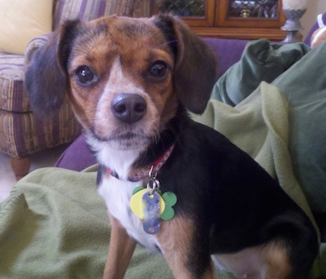
C
Cheagle

Slide 5
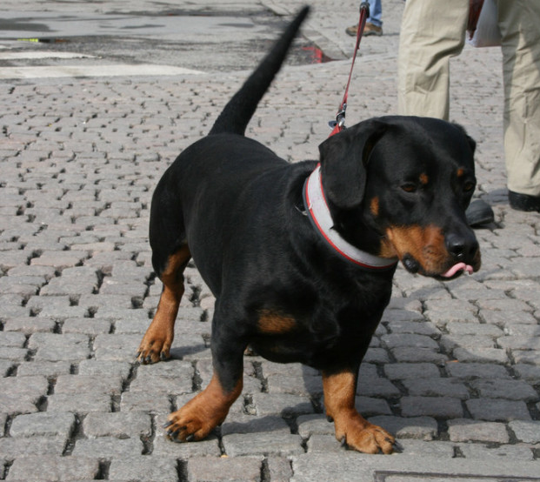
D
Dachsweiler

Slide 6
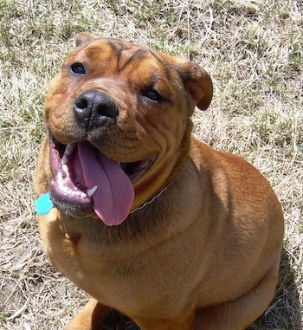
E
English Bullweiler

Slide 7
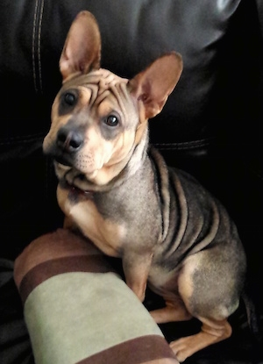
F
Frenchie-Pei

Slide 8
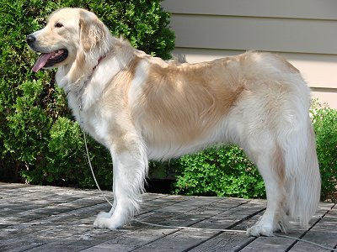
G
Golden Pyrenees

Slide 9
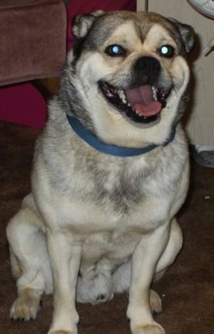
H
Hug

Slide 10
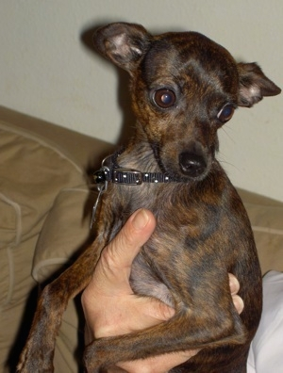
I
Italian Greyhuahua

Slide 11
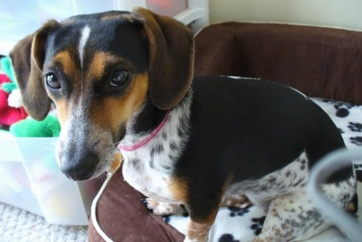
J
Jackshund

Slide 12
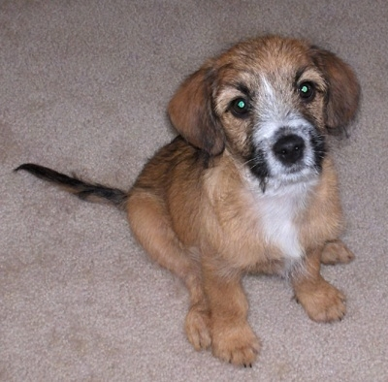
K
King Cavrin

Slide 13
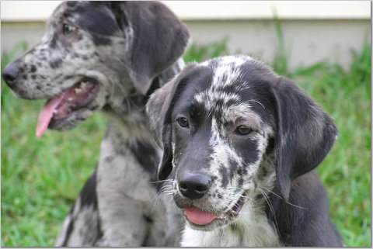
L
Labahoula

Slide 14
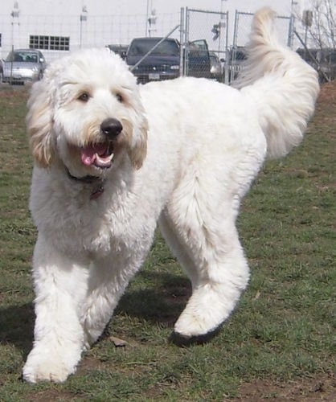
M
Mastidoodle

Slide 15
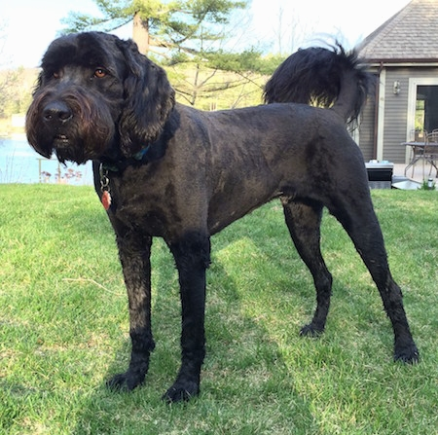
N
Newfypoo

Slide 16
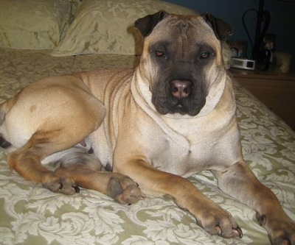
O
Ori Pei

Slide 17
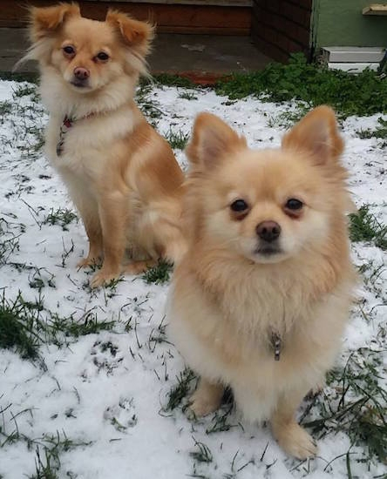
P
Pomchi

Slide 18
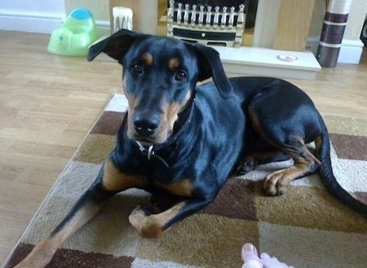
R
Rotterman

Slide 19
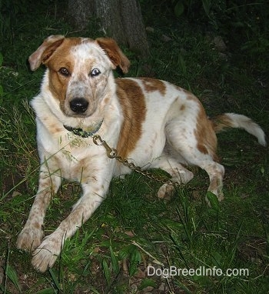
T
Texas Heeler

Slide 20
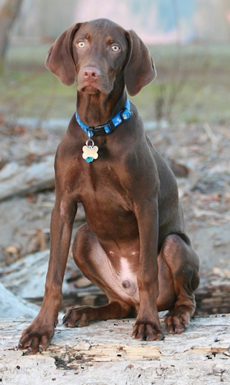
V
Vizmaraner

Slide 21
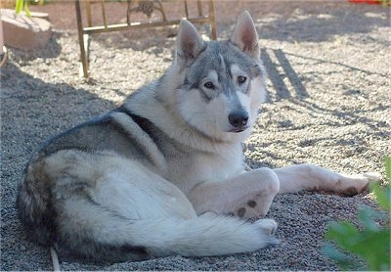
W
Wolamute

Slide 22
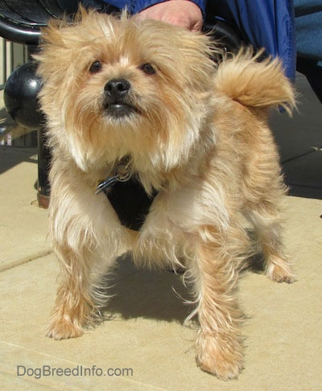
Y
Yoranian

Slide 23
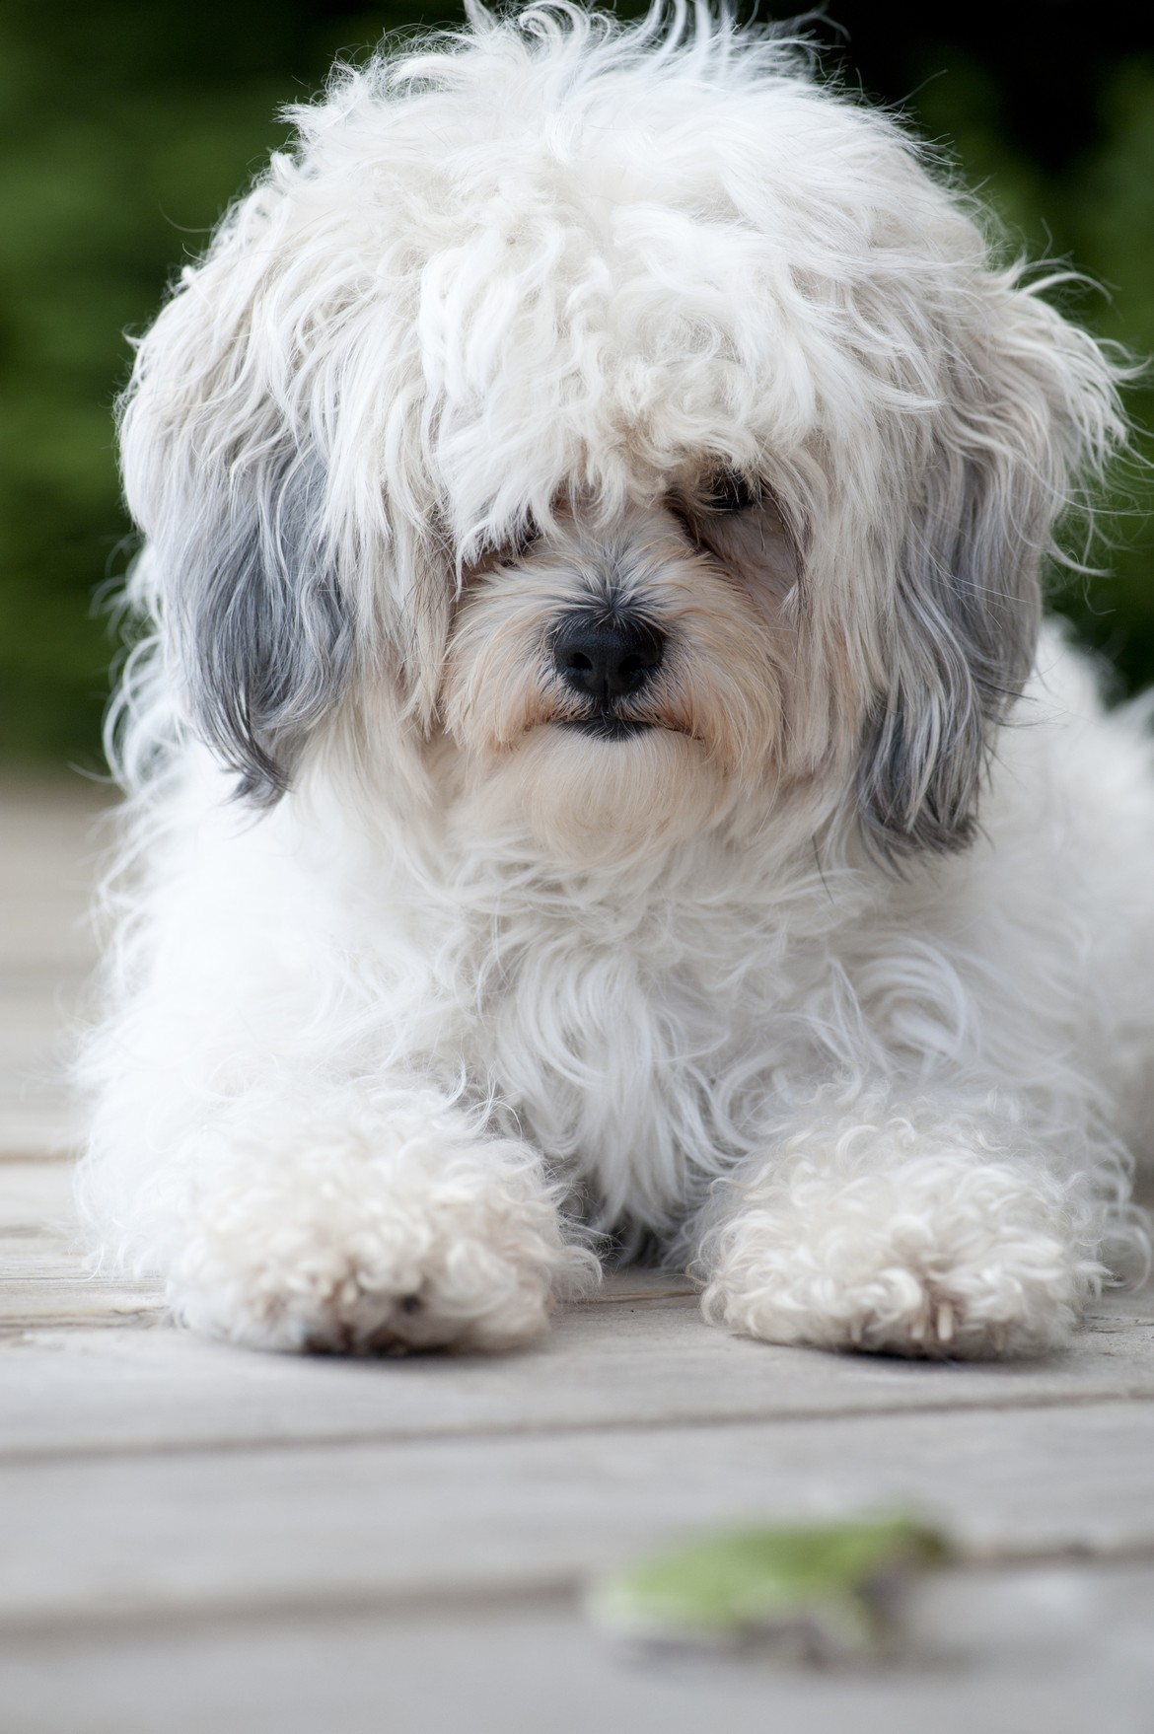
Z
Zuchon

