Slide 1
Fluid therapy

Slide 2
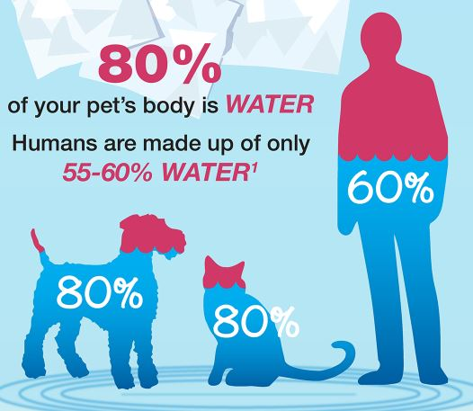
What is Fluid Therapy
Administration of specially formulated liquids for treatment of disease or prevention of problems
More than half of body weight is water!

Slide 3
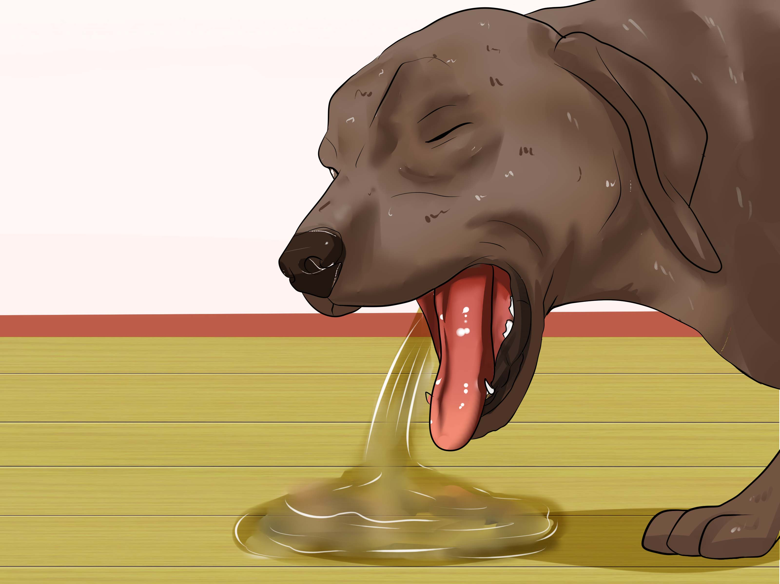
Why do we give fluid therapy?
When animals are sick and do not drink enough
When animals are losing fluids through vomit or diarrhea
When kidneys are not working properly
When electrolytes in the blood are not balanced
When an animal is under anesthesia to maintain blood pressure

Slide 4
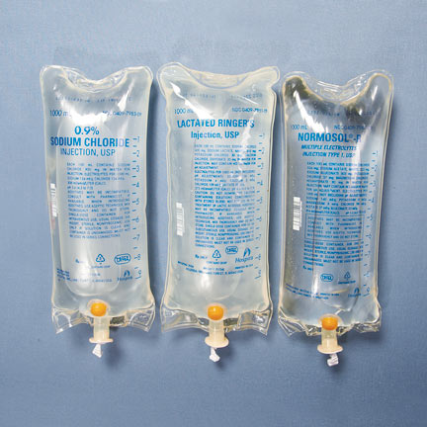
What is in the fluids?
Water is the main component
sodium, potassium, calcium or other electrolytes
May contain glucose
Intravenous medications

Slide 5
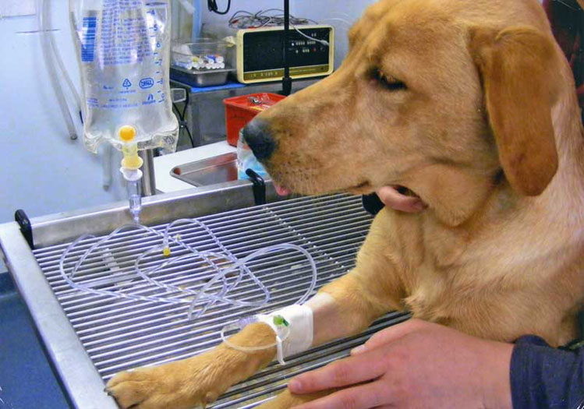
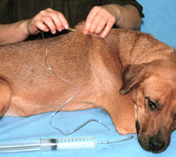
How are fluids given?
Administered through a catheter placed in the animal’s vein
Administered under the skin
Set fluid rate using gravity by drops per Minute
Set fluid rate using pump by milliliters per hour

Slide 6
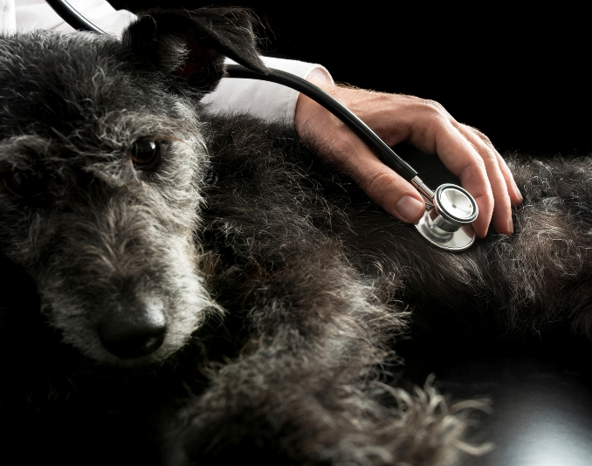
Monitoring fluid therapy
Check pulse quality and heart rate every 2 hours
Check lungs every 2 hours for pulmonary crackles
Anesthesia rate for cats should start at 3ml/kg/hr
ANESTHESIA RATE FOR DOGS SHOULD START AT 5ml/kg/hr
REDUCE RATE BY 25% AFTER FIRST HOUR

Slide 7
Fluid Line set up
Always use a new bag of fluids if given IV
Tear sterile seal on bag and place drip line
Best to use a luer-lock to keep line secure to catheter
Use y-port if more than one bag of fluids is used

