Slide 1
Ferrets 101

Slide 2
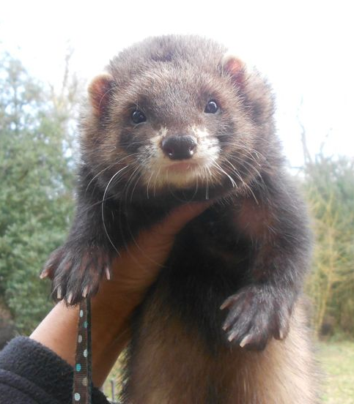
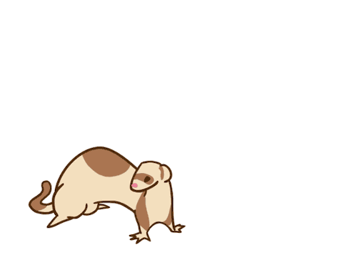
Ferret Characteristics
3rd most popular pet in America
Domesticated from the European Pole Cat
Member of the weasel family
Considered an obligate carnivore
Possesses a distinct musk odor
Famous for their “war dance”
Notorious thieves and hoarders

Slide 3
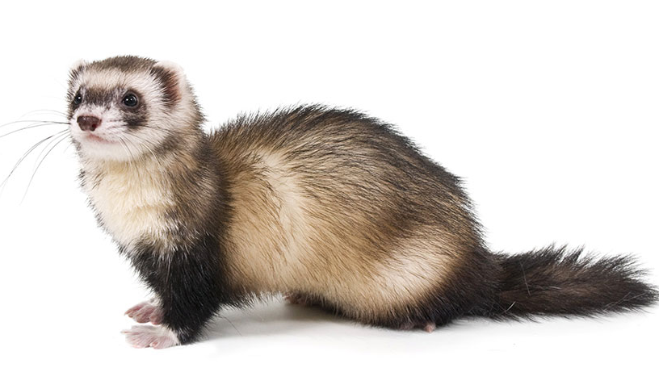
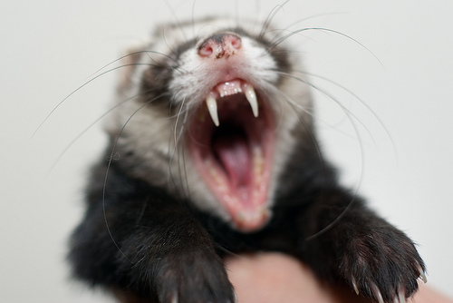
Ferret Basics
Lifespan 5 to 8 years
Weight 1.5 lb to 6 lb (depending on gender)
Body temperature 100°F to 103°F
Heart rate 180-250 beats per minute
Respiratory rate 33-36 breaths per minute
Sexually mature at 5 to 6 months of age
Gestation period of 42 days
Adult teeth appear at 47 days
Choppers are full size at 70 days!

Slide 4
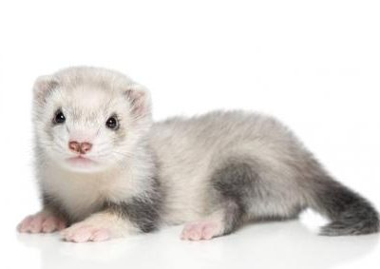
More Ferret Facts
Intact females are “jills” and intact males are “hobs”
Spayed females are “sprites” and neutered males are “gibs”
Baby ferrets are called “kits”
Female ferrets are induced ovulators
Non-mated females in heat may die from estrogen-induced anemia
Heat intolerant
Very high metabolism- sleep up to 18 hours a day
Naturally very itchy
Very intelligent and explore constantly
Like to defecate in corners (latrine users)

Slide 5
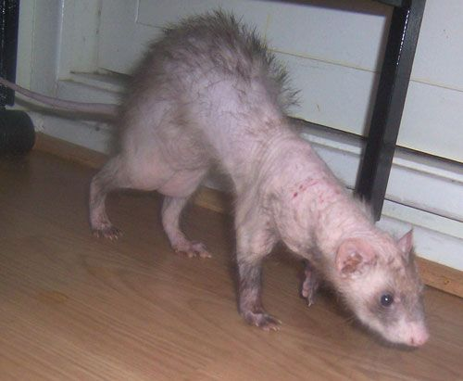
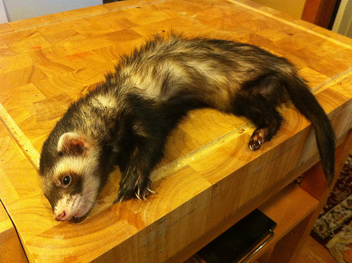
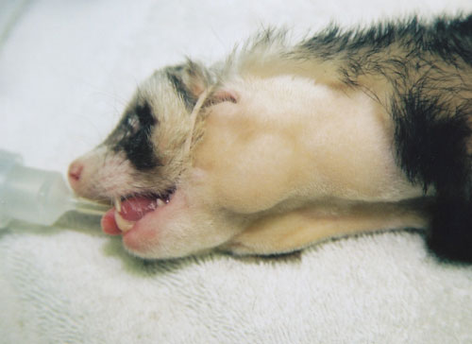
Common Ferret Diseases
Adrenal disease (adrenal gland tumor)
Insulinoma (cancer of the pancreas)
Lymphoma (cancer of the white blood cells)

Slide 6
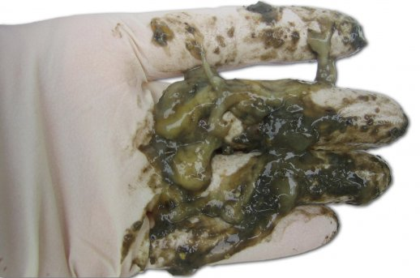
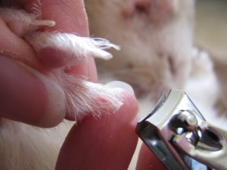
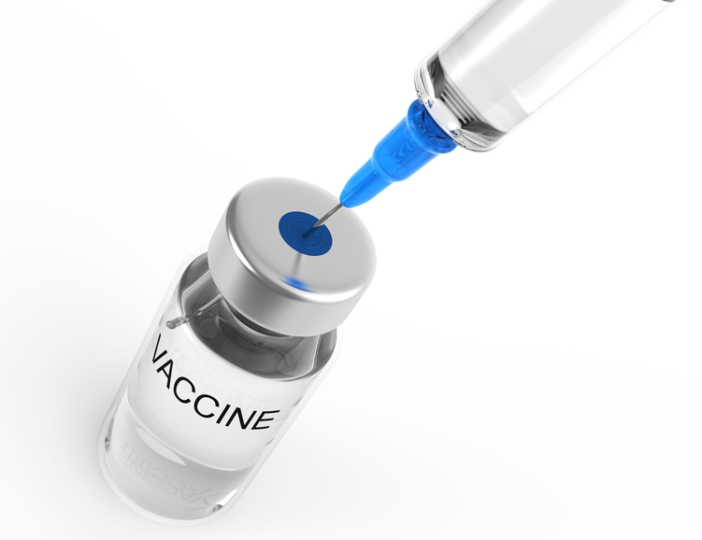
Other ferret diseases
Epizootic Catarrhal Enteritis (ECE) or the “mean greenies”
- Caused by a coronavirus shed in feces of carriers
- Destroys intestinal cells much like canine parvovirus
- Ferrets die of dehydration and malnutrition
Aleutian Disease (ferret parvovirus)
- Chronic wasting disease spread in body fluids of carriers
- Test blood of new ferrets and isolate
Canine Distemper
- Very contagious airborne virus that causes eye discharge, fever and death
- Vaccinate kits at 8, 11 and 14 weeks, then annually as adults
Rabies
- Contagious zoonotic virus spread through saliva
- Vaccinate kits at 12 weeks, then annually as adults*

Slide 7
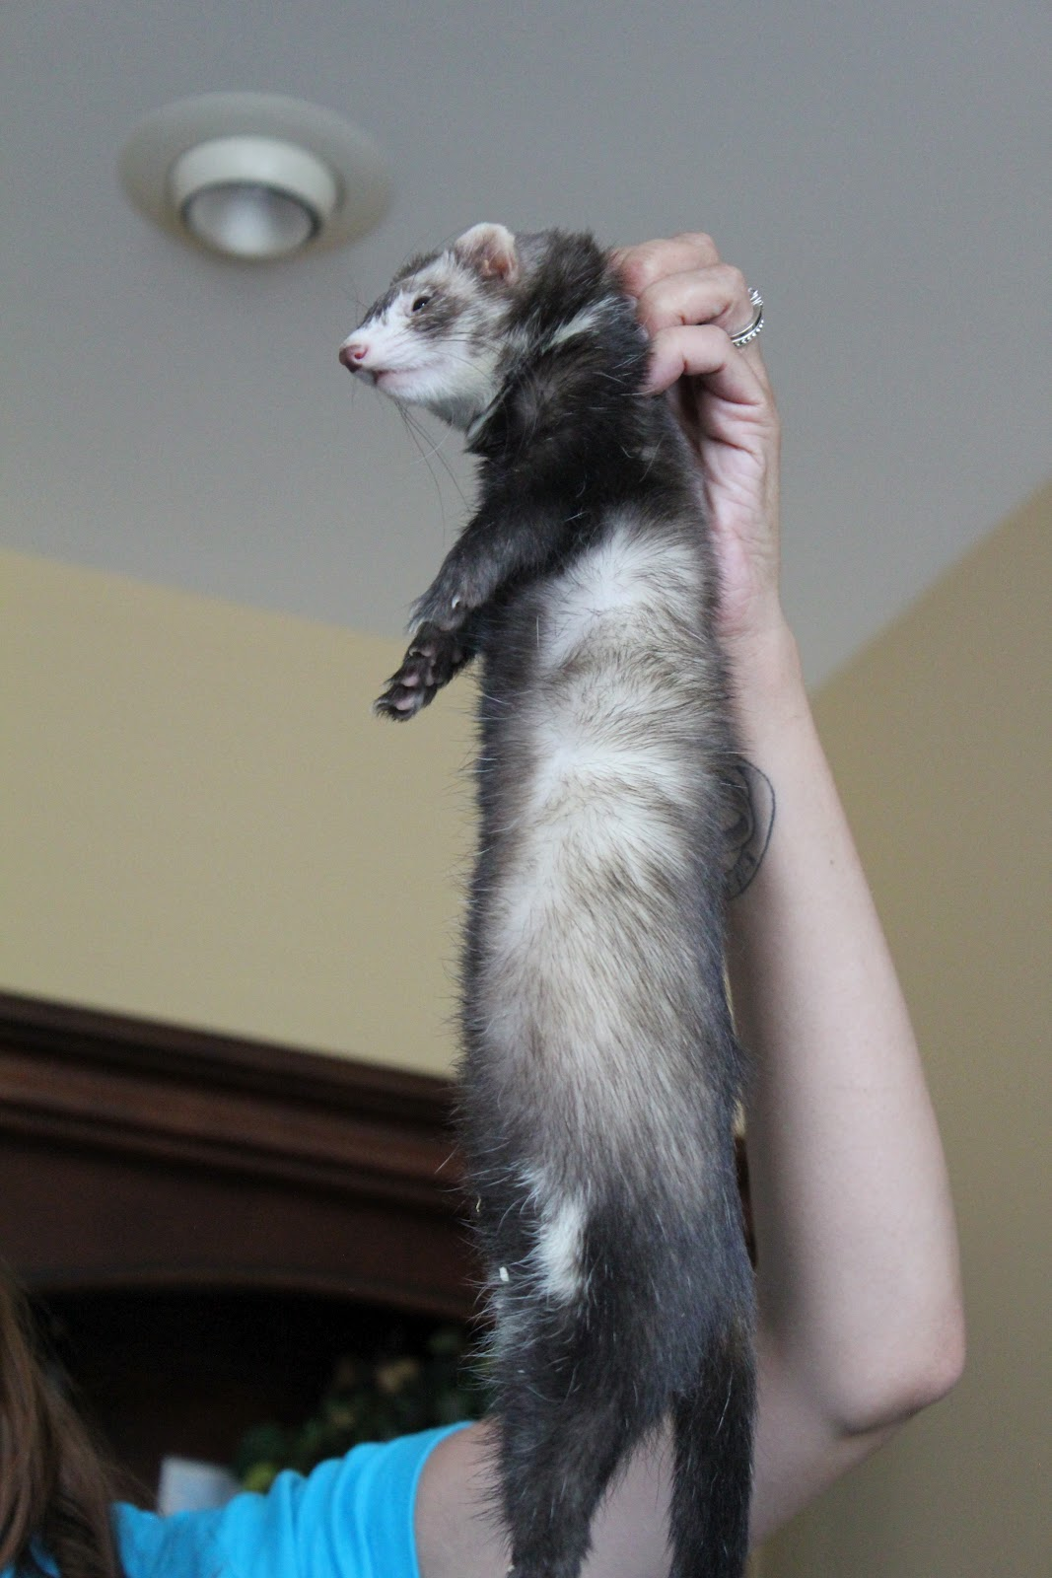
Handling Ferrets
Can initially grasp by scruff
Position one hand under the shoulders with a thumb under the jaw
Position other hand to support the hindquarters (very important)

Slide 8
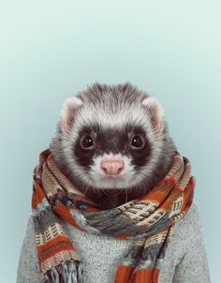
Ferret Introductions

