Slide 1
Fecal Egg Count for Small Ruminants

Slide 2
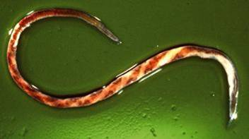
Haemonchus Contortus
Barber Pole Worm (nematode)
Females can produce 10,000 eggs/day
Feeds on blood from abomasal mucosa
↓ growth rates, ↓reproduction, ↑illness/death
Females can produce 10,000 eggs/day
Develops resistance quickly!
Control with strategic deworming

Slide 3
Haemonchus Contortus

Slide 4
Resistance
Failure of drug when given at labeled dose
- Dewormer used to work, but now it doesn’t
Change in gene frequency in population
- Genetic diversity (~10000 eggs/day/worm)
- Resistant parasites exist prior to introducing drug
- Treatment only eliminates sensitive worms
- Resistant worms survive and create more worms

Slide 5
Next Generation
Drug Treatment
Susceptible
Resistant
Resistant
Notes:
This slide is courtesy of Dr. James Miller, Louisiana State University. Each time worm populations are exposed to an anthelmintic, the most susceptible worms are killed, leaving the more resistant survivors. These are the worms which pass on their genes to the next generation leaving a population of parasites that will be resistant to the drug that was previously used.

Slide 6
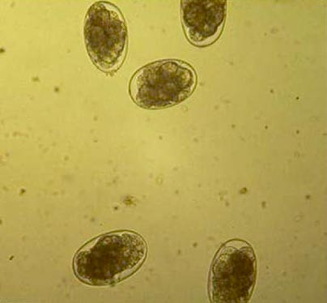
Fecal Egg Count (FEC)
Determine worm burden (FEC)
Determine efficacy of dewormer (FECRT)
- Best fresh and straight from animal
- Goal is 2 grams of feces
- Count eggs
- Treat goats
- Check FEC again in 3 weeks

Slide 7
Let’s get to work!

