Slide 1
Dermatitis
Rashes and Itchy Stuff

Slide 2
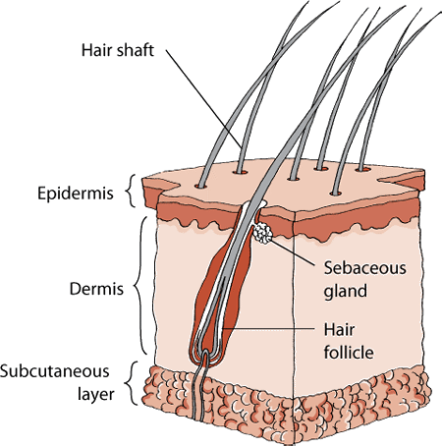
Structures of Skin

Slide 3
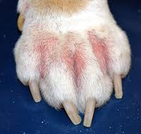
What is Dermatitis?
Dermatitis is inflammation of the skin
Incited by allergies, infection, mites, hormones or medication
Skin can become red, painful, itchy, crusty, flaky, oily or smelly
Caused by a combination of several factors:
- Skin barrier dysfunction
- Cell mediated immune responses
- IgE mediated hypersensitivity
- Environmental factors

Slide 4
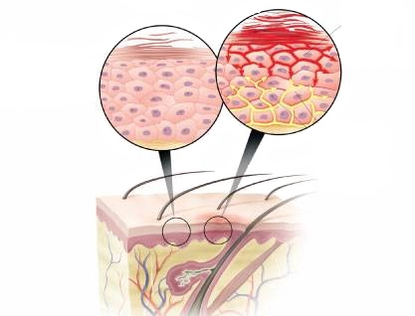
Dermatitis up Close
Normal skin cells with tight cell junctions
Allergen or chemical contacts skin
Cell connections start to loosen
Skin barrier is intact
Skin barrier is compromised

Slide 5
Dermatology terms
Otitis externa –inflammation of the outer ear canal
Atopic dermatitis – inflammation caused by allergens
Pododermatitis – inflammation of paws
Conjunctivitis – inflammation of eyelids
Acute moist dermatitis – commonly known as hot spots
Pyoderma – bacterial skin infection
Dermatophytosis – fungal skin infection
Demodicosis – inflammation caused by Demodex mite
Flea allergy dermatitis – inflammation due to flea bites

Slide 6
Common Vet Med Problems
Otitis Externa
Acute moist dermatitis
Atopic dermatitis
Flea allergy dermatitis
Pyoderma
Demodicosis
Dermatophytosis

Slide 7
Otitis Externa
More common with breeds that have long ears
Animal is genetically predisposed to skin inflammation
Ear mites can cause inflammation
Bacterial and fungal infections are usually secondary
Excess scratching can cause a hematoma
Diagnosed by an ear swab and microscopy

Slide 8
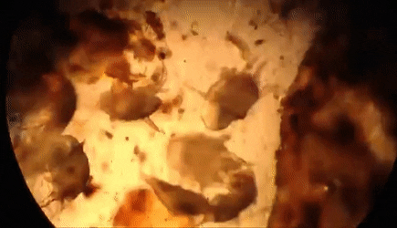
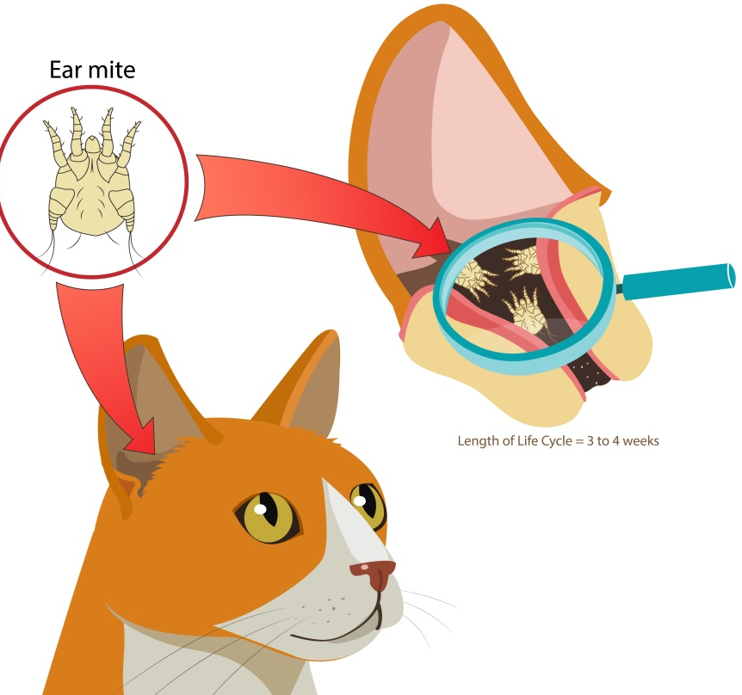
Ear mites
More common in cats – they are itchy and miserable
Diagnosed by microscopy
Mites are killed by a prescribed otic insecticide
An otic anti-inflammatory is usually prescribed

Slide 9
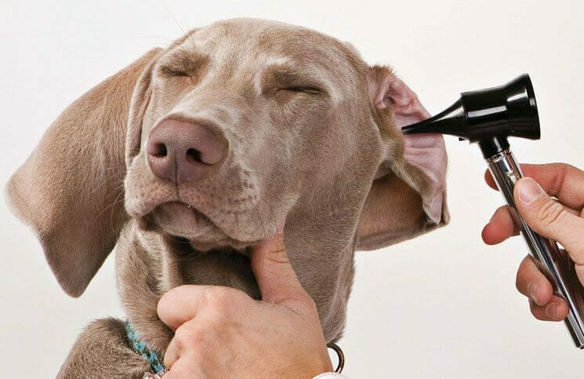
Ear infections
Ears are itchy and/or painful
Ear canal is usually red with yellowish, brown or black exudate
Yeast infection is most common
Commensal bacteria can overgrow
Pathogenic bacteria cause a true infection with pus
Treated with an otic antibiotic +/- fungicide and steroid

Slide 10
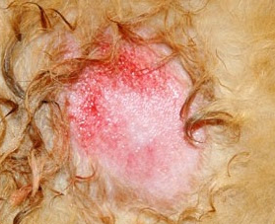
Acute Moist Dermatitis
Caused by any skin irritation that makes dog lick, chew or scratch
Skin is red, hot, painful and oozing
Long haired breeds are more susceptible
Topical steroids are usually needed to calm inflammation
Secondary pyoderma may require antibiotics

Slide 11
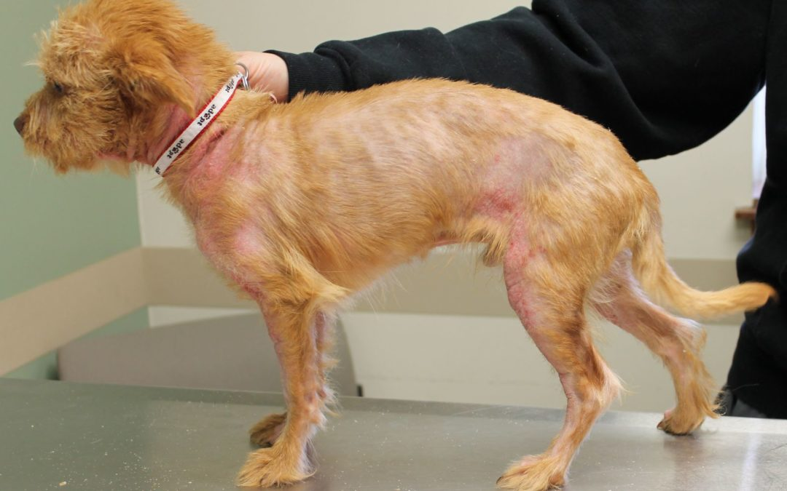
Atopic Dermatitis
Caused by a response to an allergen (topical or oral)
Goals are to treat inflammation and itchiness
Treated by anti-histamines +/- steroids or new inflammatory blockers
Control by reducing allergens (bathing and hypoallergenic diet)
Immunotherapy is an alternative

Slide 12
Flea Allergy Dermatitis
Caused by a hypersensitivity to a flea bite
A single bite can cause system-wide skin inflammation
Steroids are usually prescribed for inflammation
Fleas killed with topical or oral insecticide
Environment must also be treated

Slide 13
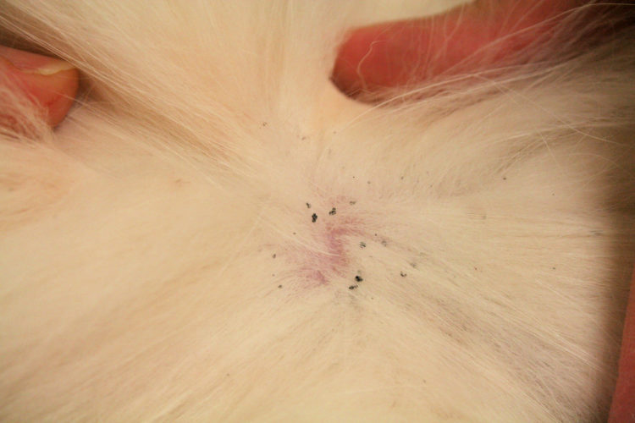
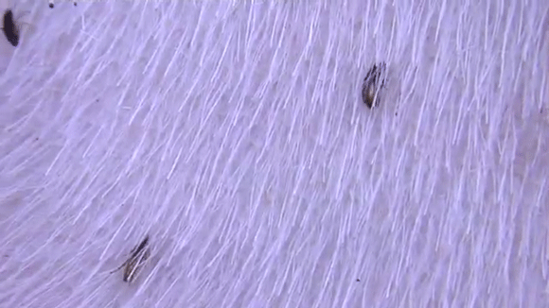
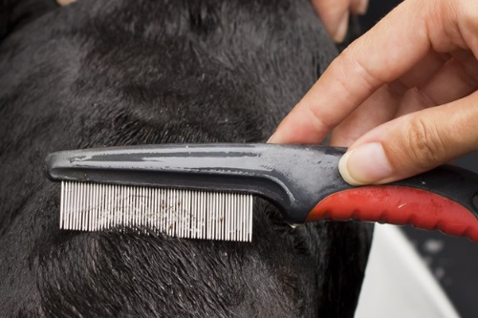
Finding Fleas
See fleas in fur
See flea dirt in fur
See fleas on flea comb or on table

Slide 14
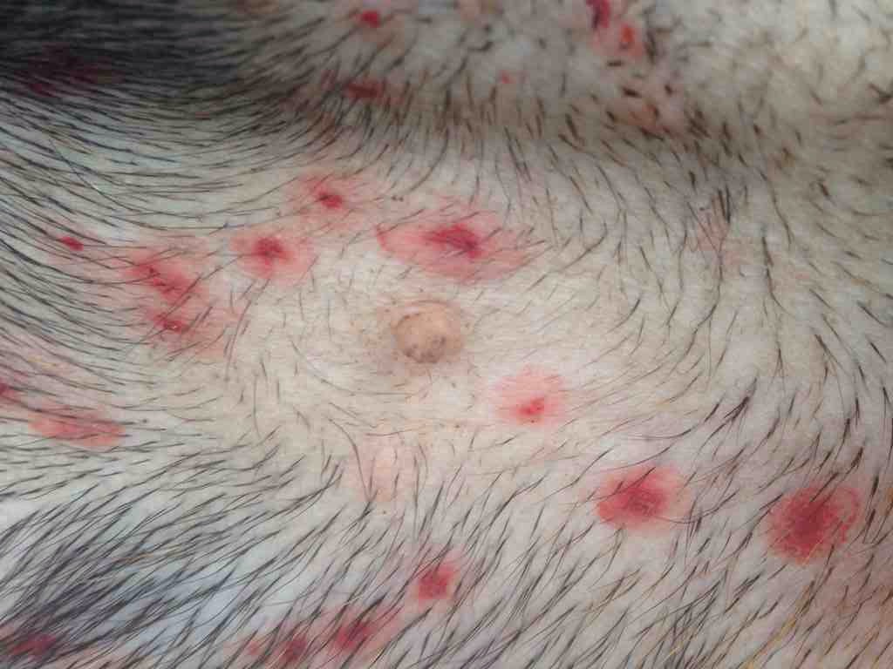
Pyoderma
Often secondary to dermatitis
Often seen on abdomen of puppies
Diagnosed by skin swab
Staph infections are most common
Treated with topical or oral antibiotics

Slide 15
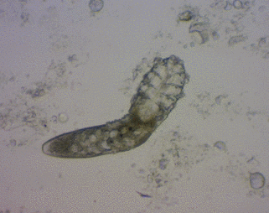
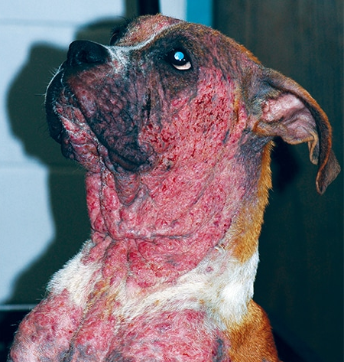
Demodicosis
Caused by the Demodex mite that normally lives in hair follicles
Dysfunction of skin barrier allows mite to cause inflammation
Fur loss and thick, crusty skin are hallmark signs
Secondary pyoderma is common
Diagnosed by skin scrape and microscopy

Slide 16
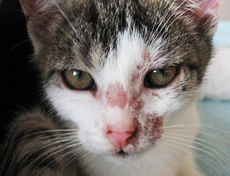
Dermatophytosis
Also called ringworm but is caused by a fungus
Common in shelter cats, but any animal can be infected
Itchy, contagious and zoonotic!
Fur falls out around lesion – lesion is round and red +/- dark edge
Diagnosed by ultraviolet light or fungal culture
Treat with oral or topical antifungal
Remove spores from environment

Slide 17
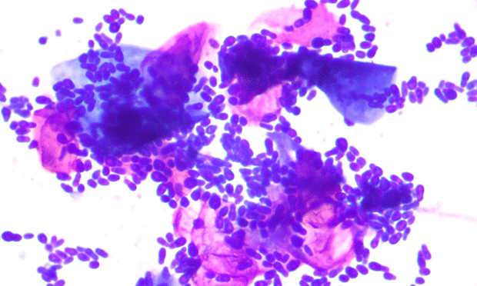
Time to play with Ear Swabs!

