Slide 1
Cardiopulmonary Auscultation

Slide 2
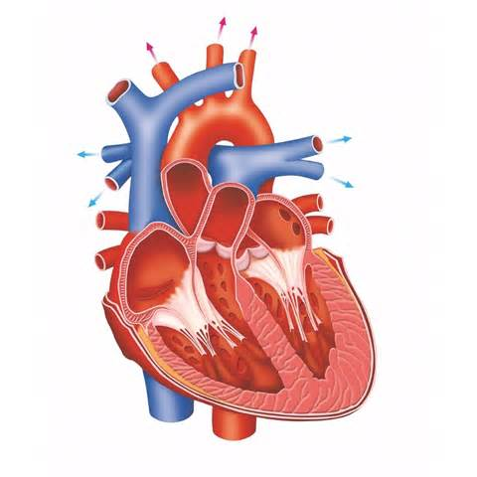
Listening to the normal heart
The normal heart sound (lub dub or S1 and S2)
“Lub” is closing of valves between atria and ventricles
“Dub” is the closing of valves between ventricles and pulmonary arteries or aorta
DUB
DUB
LUB
LUB

Slide 3
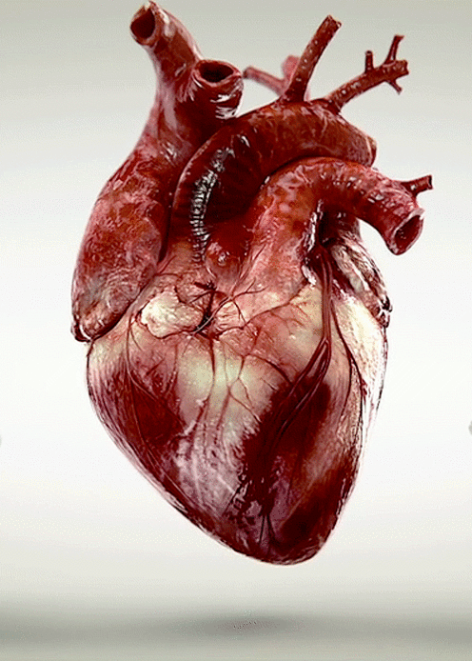
Phases of the heartbeat
Systole – the time between S1 and S2
Diastole – the resting period of heart between heart beats
Abnormal heart sounds occur in systole or diastole

Slide 4
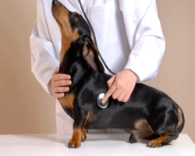
Abnormal sounds of the heart
Atrial fibrillation - rapid and irregular beat
Mitral regurgitation - whoosh sound caused by backward flow of blood through faulty mitral valve
Mitral valve click - sharp whoosh sound caused by a prolapsed mitral valve being pulled back suddenly by the chordae tendineae
Patent Ductus Arteriosus (PDA) – constant whoosh sound caused by blood from a persistent fetal blood vessel moving blood from the aorta to pulmonary artery
Pulmonic stenosis - extra sound caused by obstruction of flow from the right ventricle of the heart to the pulmonary artery
Subaortic stenosis (SAS) - whoosh sound caused by the flow of blood from the left ventricle being restricted under the aortic valve
Ventricular Septal Defect (VSD) – whoosh on second heart sound caused by turbulent flow into the left ventricle from the left atrium

Slide 5
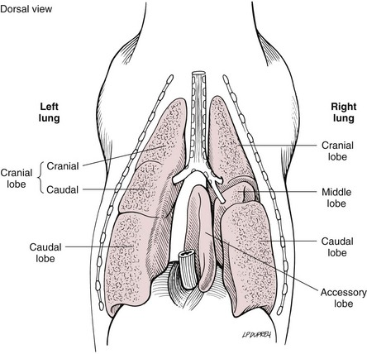
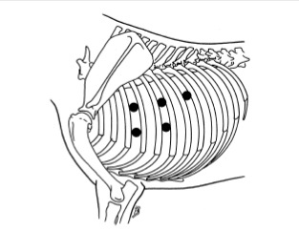
Listening to the lungs

Slide 6
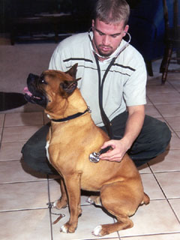
Abnormal lung sounds
Wheeze – course whistling sound that varies in pitch and caused by narrowing of airway anywhere from the trachea to lungs
Monophonic wheeze – same as above, but the sound has the same pitch when breathing in and out
Pleural friction rub- clicking sound caused by layers of the inflamed pleural membrane rubbing against each other
Stridor - a high pitched vibrating noise caused by obstruction of the trachea or larynx
Stertor - heavy snoring or gasping heard on inspiration
Crackles – popping or crackling sounds heard on inspiration caused by a buildup of fluid, mucus or pus in the small airways
Pulmonary edema – gurgling or crackling sound heard at the end of inspiration caused by fluid accumulation in the tissue and air spaces of the lungs

Slide 7
The Stethoscope
Earpiece
Binaural piece
(Ear tubing)
Chest piece
(diaphragm)
Flexible tubing

Slide 8
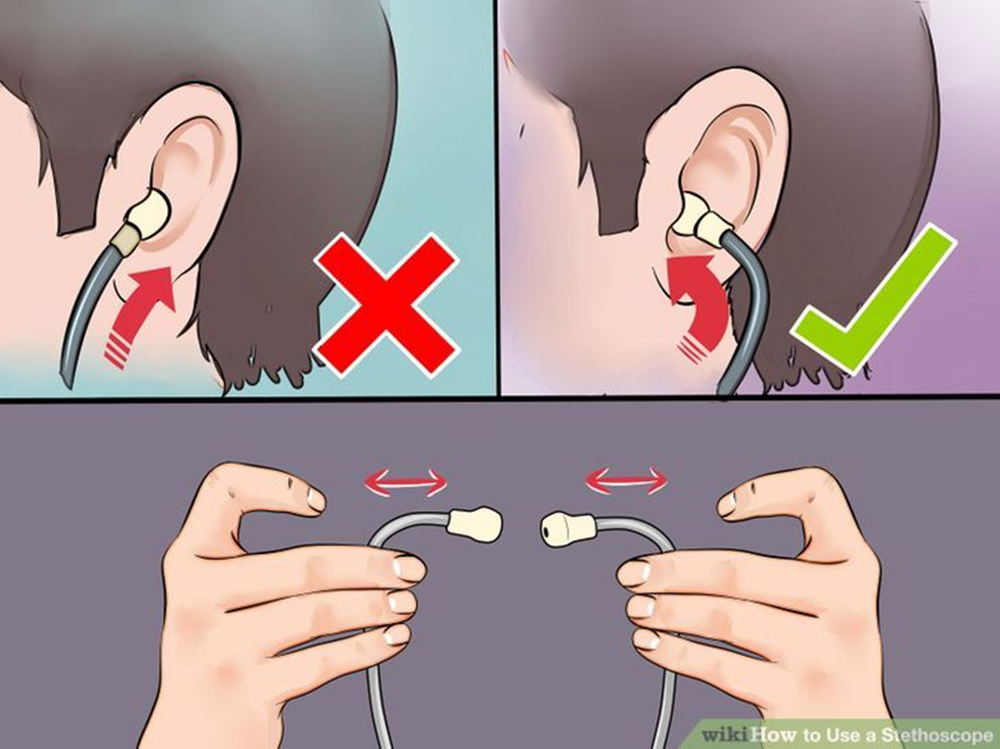
Using Stethoscope

Slide 9
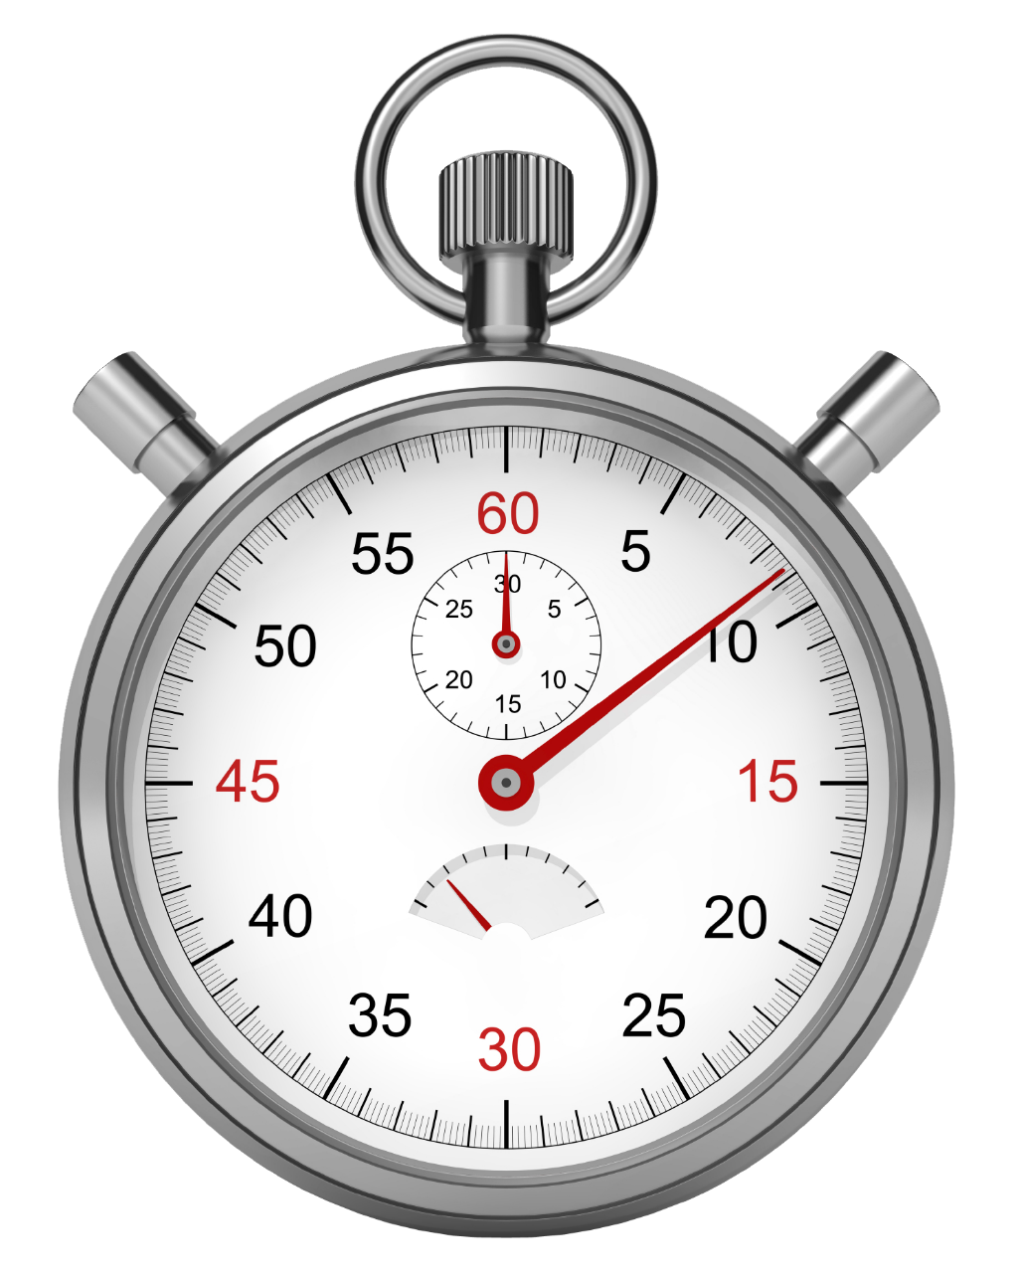
Time to Listen!

