Slide 1
Blood cytology

Slide 2
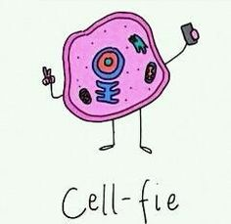
What is blood cytology?
The study of the microscopic appearance of cells, especially for the diagnosis of abnormalities and malignancies
The veterinarian or pathologist uses a microscope to examine the individual cells in the blood sample
Blood samples should be prepared ASAP

Slide 3
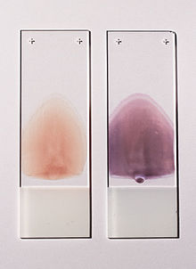
How can we see individual cells under a microscope?
A single blood drop is used to make a blood smear on a glass slide
The blood smear is allowed to dry at room temperature
The blood on the slide is stained
Each cell type can now be distinguished under a microscope!

Slide 4
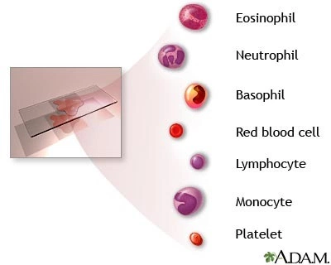
What should we see on the slide?

Slide 5
Blood cell abnormalities
Normal
Spherocyte
Target cell
Acanthocyte
Echinocyte
Schistocyte

Slide 6
Inflammation or infection?
Normal mature neutrophil
Toxic neutrophil
Normal banded neutrophil
Banded toxic neutrophil
* Banded neutrophils are immature meaning that the body is cranking up production to be distributed anywhere in the body (inflammation). The presence of bluish granules and an enlarged nucleus means the neutrophil is gearing up to fight something in the blood (infection).

Slide 7
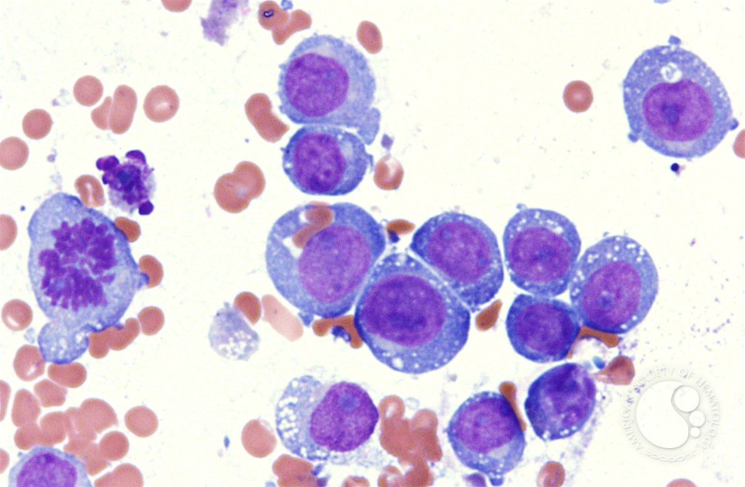
Is it neoplasia?
Large clusters of cells that are not RBCs
Cells are different sizes and shapes
Cells have multiple nucleoli
Active cell division can be visualized
B.
D.
C.
A.

Slide 8
How do you stain cells for cytology?
Put on gloves (or have blue/pink fingers!)
Pick up slide with clothespin
Dip slide slowly 5 times in light blue fixative
Dip slide slowly 5 times in dark pink stain
Dip slide slowly 5 times in purple counter stain
Gently rinse slide with distilled water
Allow to air dry before viewing

Slide 9
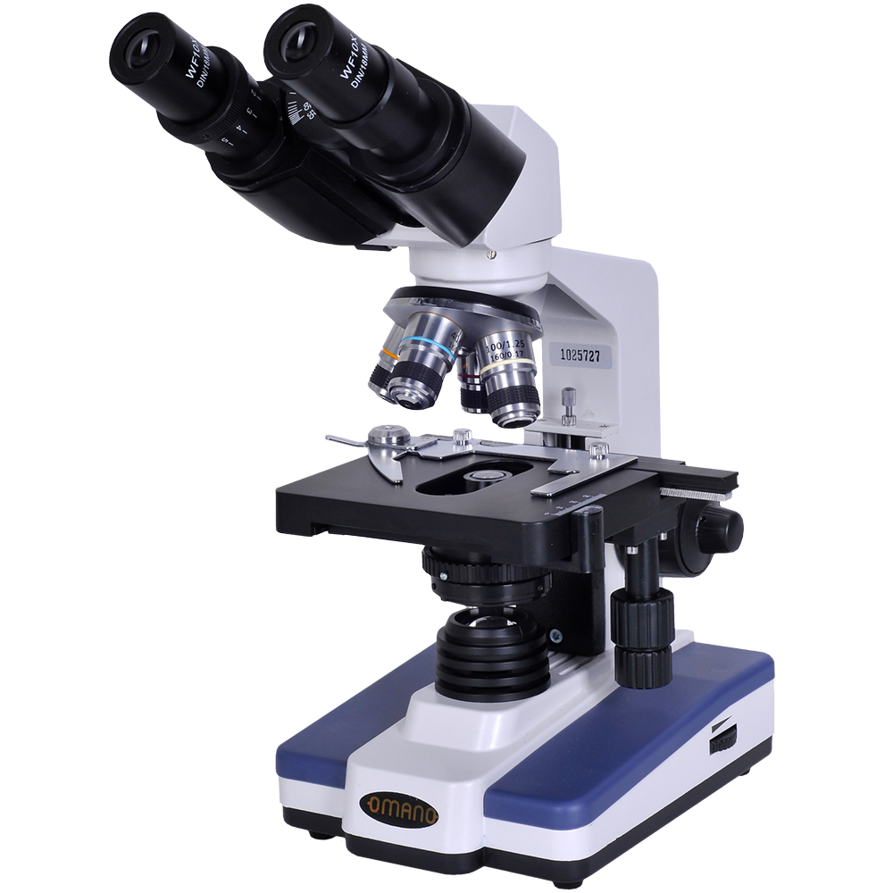
Eyepiece
The Compound Microscope
Objectives
Arm
Stage Clip
Stage
Fine Adjustment
Condenser
Course Adjustment
Stage Control
Lamp
Light switch and adjust
Base

Slide 10
GO TIME!

