Slide 1
Blood Smear

Slide 2
What is a Blood smear?
A blood smear is a blood test used to look for abnormalities in blood cells
The three main blood cells that the test focuses on are red cells, which carry oxygen throughout the body, white cells, which help the body fight infections and platelets, which are important for blood clotting
An ideal blood smear has an even distribution with a feathered edge and a thin monolayer (zone of morphology)
The feathered edge will contain larger white blood cells and platelet clumps

Slide 3
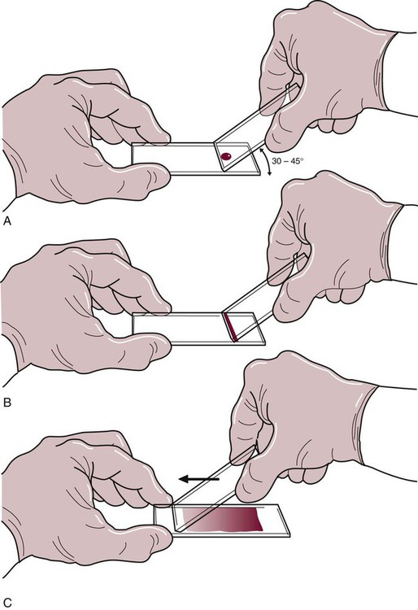
What is the process?
Apply single blood drop at one end of a clean slide ➢
Use another clean slide to briefly pull drop backward ➢
In smooth motion, spread the drop to toward other end ➢

Slide 4
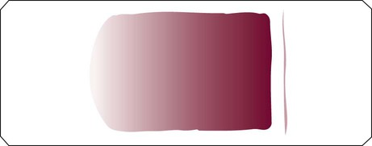
Finished Product
Feathered edge
Monolayer

Slide 5
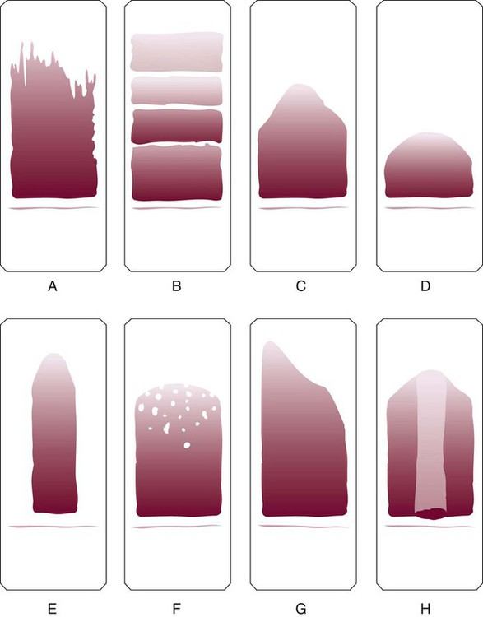
What can go wrong?
Rough edge on spreader slide
Hesitation when spreading
Spreader slide pushed too quickly
Drop of blood was too small
Blood not allowed to spread across the width of the slide
Dirt or grease on the slide (elevated lipids in the blood)
Uneven pressure on the spreader slide
Time delay; drop of blood began to dry

