Slide 1
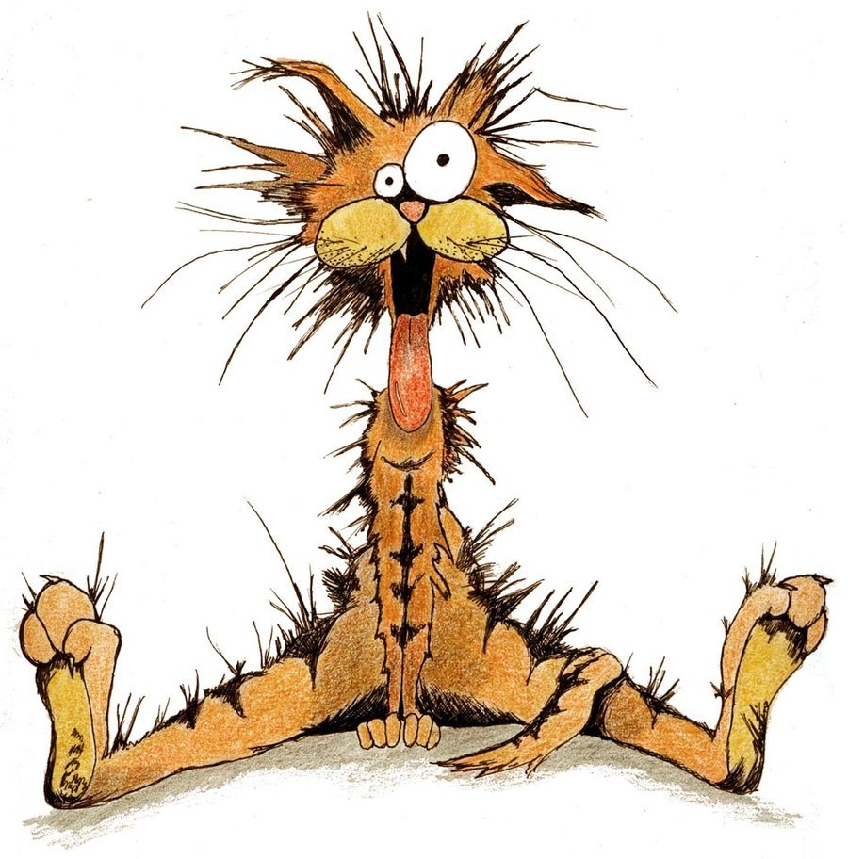
Animal Stress

Slide 2
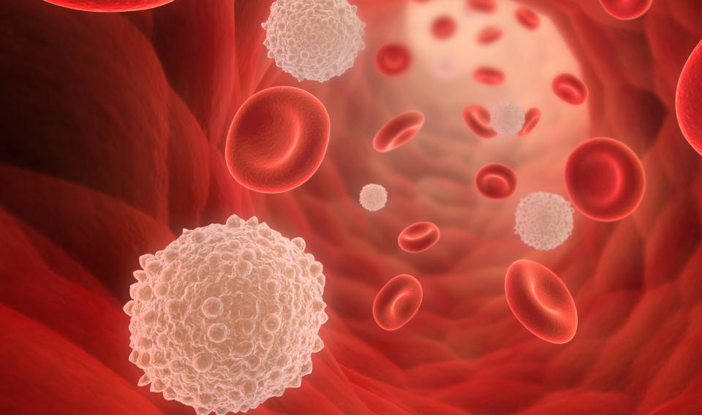
The Big Picture
Stress is a physical and biological response to an adverse event
Also known as fight-or-flight response
Stress hormones are released to prepare the body for action
Stress hormones also suppress immune function by inhibiting the production of white blood cells

Slide 3
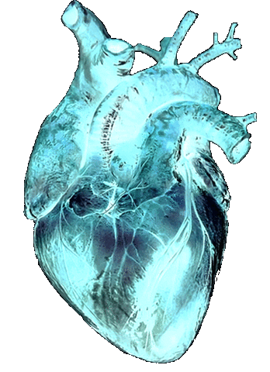
Stress and Circulation
Stress hormones increase heart rate and blood pressure through the HPA Axis (Hypothalamus, pituitary gland and adrenal glands)
Stress shuts down the negative feedback loop of the HPA Axis
The kidneys in cats are very sensitive to high blood pressure and can become damaged
Stress hormones worsen symptoms of animals with heart disease

Slide 4
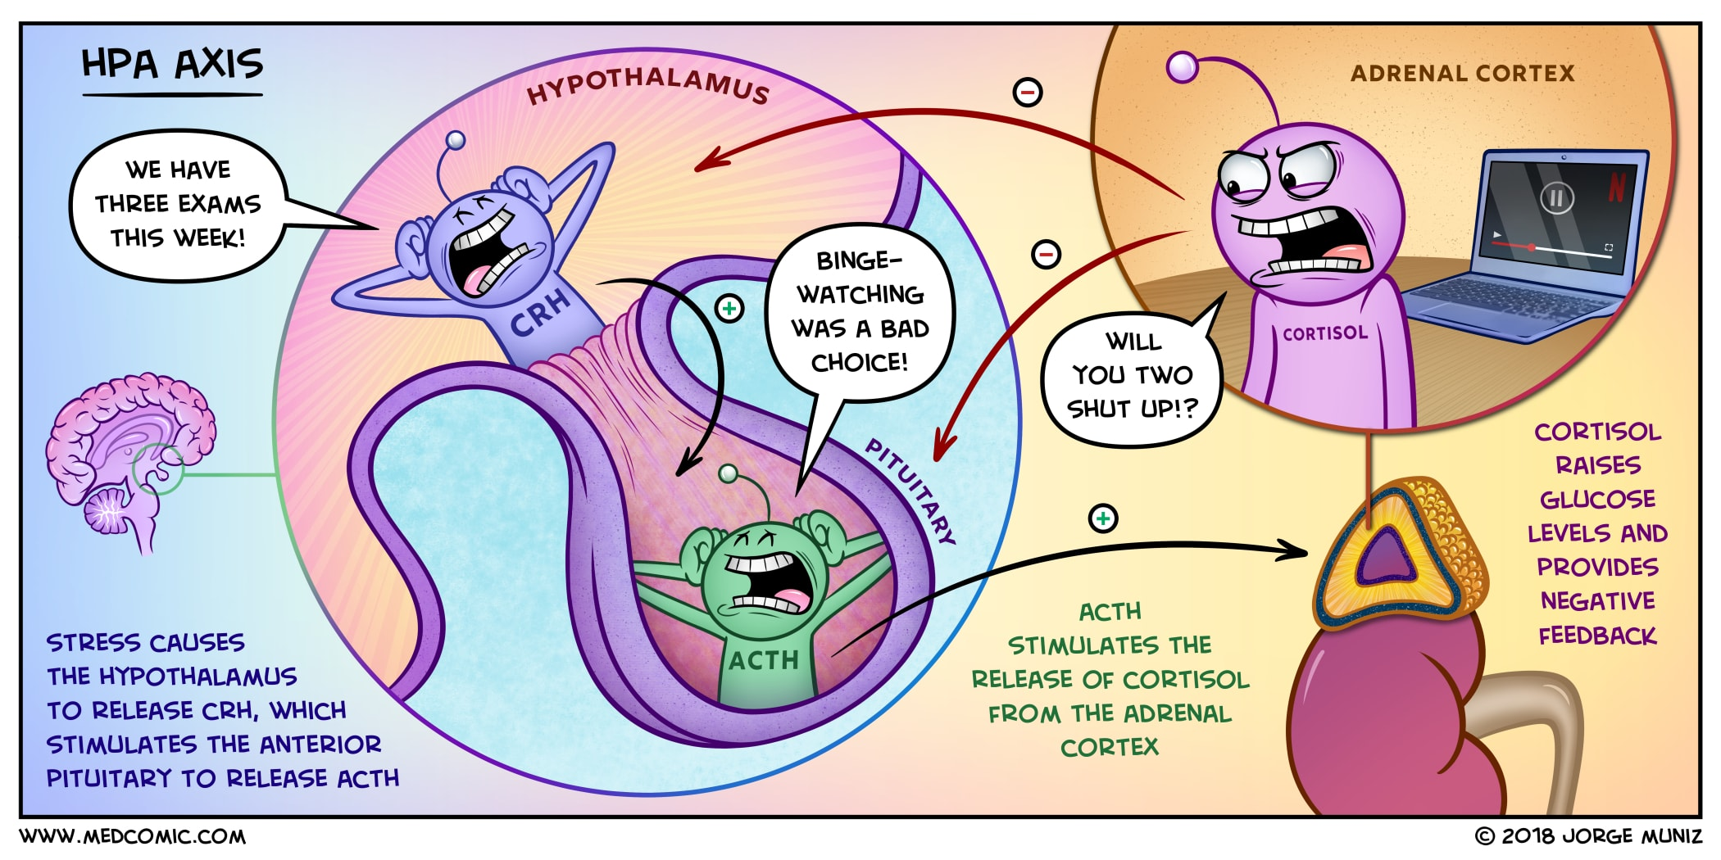
The HPA Axis

Slide 5
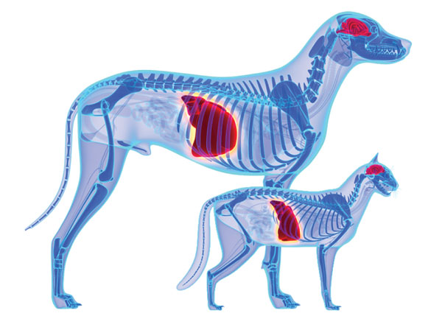
Stress and Digestion
Digestion is inhibited during the stress response
Digestive activity increases after the stress response and can cause diarrhea and/or ulcers
Chronic stress can lead to stress-hormone induced food allergies
Stress hormones also mobilize fat that is stored in the liver
Obese animals run the risk of fatty liver disease if overly stressed

Slide 6
Recognizing Dog Stress

Slide 7
Recognizing Dog Stress

Slide 8
Recognizing Cat stress

Slide 9
Recognizing cat stress

Slide 10
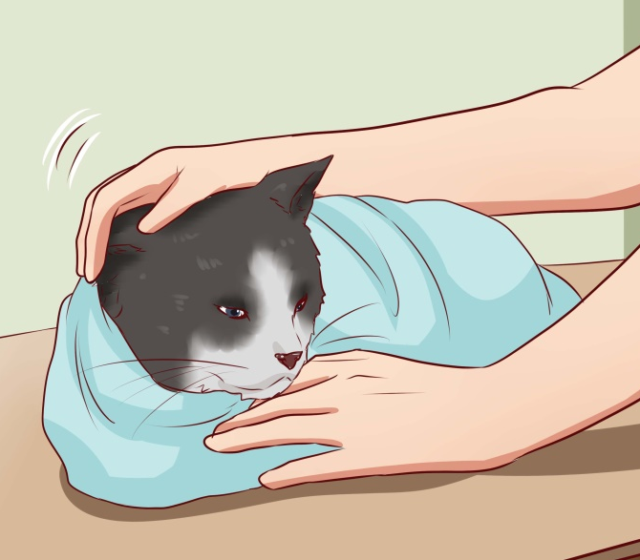
Addressing Animal Stress
All living creatures experience stress…even plants!
The flight-or-flight response is necessary for survival
Long-term stress is the real problem
Veterinarians must address animal stress every day
There are several ways to keep animals calm
- Keep room quiet with low lighting
- Spray calming pheromones
- Cover animal in a towel or apply mask
- Speak softly and approach slowly
- Do not make eye contact

Slide 11
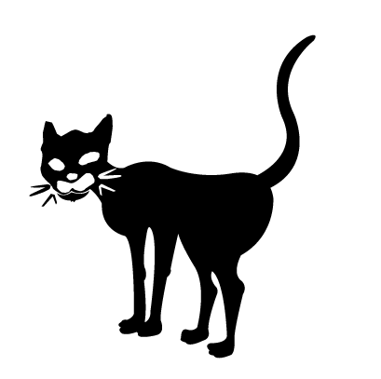
Time to practice!

