Slide 1
Anesthesia
It’s all about the oxygen…

Slide 2
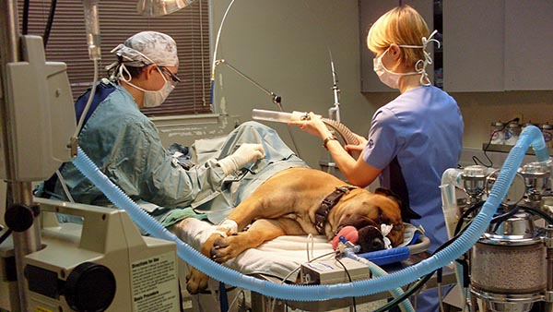
Why do we use anesthesia?
Prevent pain during surgical procedures
Keep the patient immobile for diagnostic/surgical procedures
Keep the patient from biting!
Provide adequate oxygen

Slide 3
Anesthesia
Oxygen and anesthetic are transported to the animal's lungs from the anesthesia machine through a face mask or tracheal tube. An inflatable cuff on the distal end of the tracheal tube facilitates a seal with the inner wall of the trachea.

Slide 4
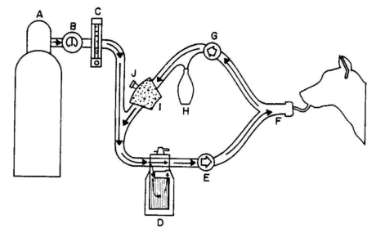
The Circle Breathing Circuit
Oxygen source
Pressure gauge
Oxygen flow meter
Gas Vaporizor
Inhalation tube
Connection port
Exhalation tube
Resevoir bag
Carbon dioxide absorber canister
Pop off valve

Slide 5
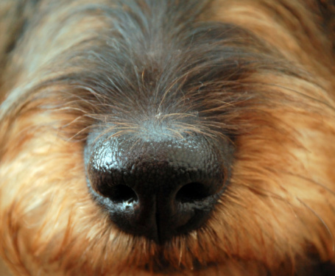
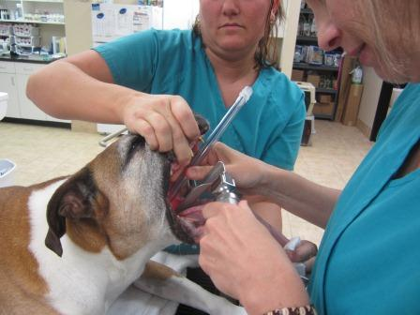
Tubing the patient
Choose endotracheal tube sizes and test cuffs
Sedate patient or mask down
Place animal into sternal recumbency
Place tube as soon as jaw is relaxed
Start with larger tube
Inflate the cuff and check for ventilation
Connect tube to circuit connection port
Turn on oxygen and anesthesia gas

Slide 6
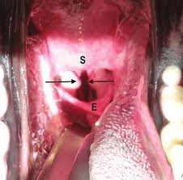
Is the tube in right?
If the chest moves when you squeeze the reservoir bag, you are in!
If you smell anesthesia gas, the tube or cuff may have a defect.

Slide 7
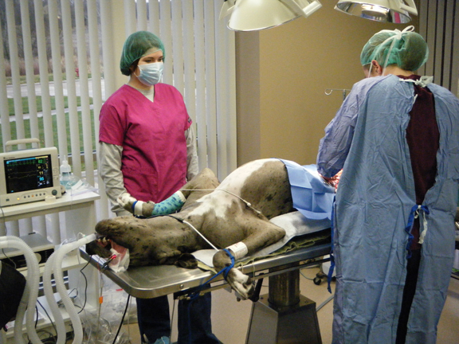
Monitoring during Anesthesia
Heart rate
Electrocardiogram
Respiratory rate
Temperature
Blood pressure
Oxygen saturation (spO2)

Slide 8
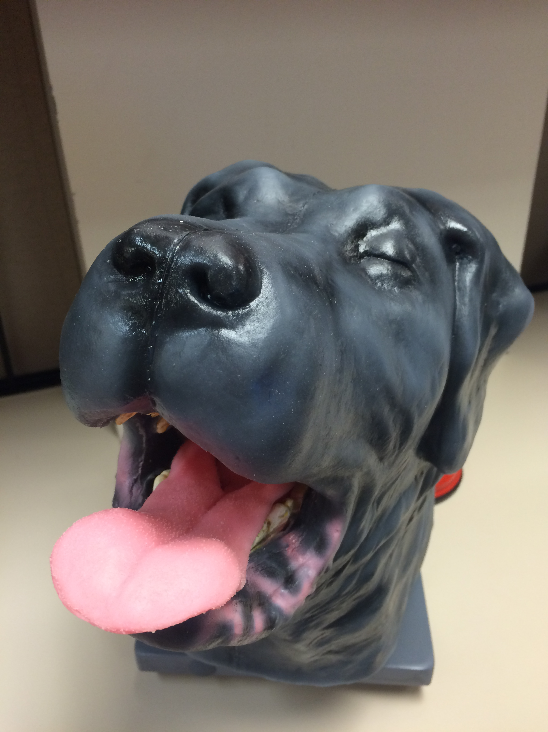
Now Let’s practice on brutus!

