Slide 1
Acupuncture

Slide 2
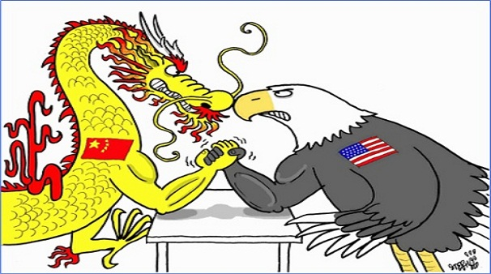
Western vs Eastern Medicine
Western - doctors see patients and treat their symptoms with the use of prescription medications, surgical operation, various forms of therapy and radiation
Eastern – practitioners heal patients with natural resources such as teas, herbs and essential oils and procedures such as meditation, acupuncture and tai chi

Slide 3
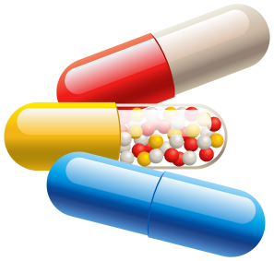
Western Medicine
Relies on diagnostic tests, pharmaceuticals and surgery
Can alleviate symptoms quickly
Tends to address symptoms rather than cause
Drugs often affect other parts of the body

Slide 4
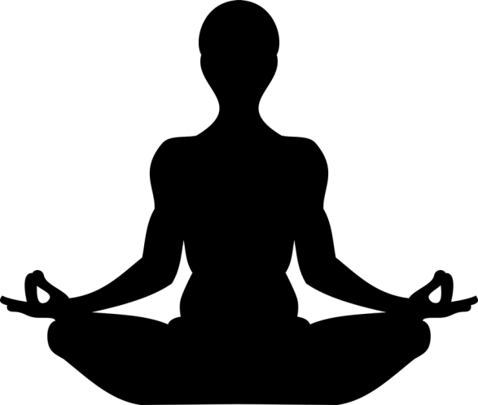
Eastern Medicine
Relies on the bond between mind, body and spirit
Less fear of negative interactions with other medicines, foods, or beverages
Little research and no government approval
Won’t help with emergency situations

Slide 5
Ancient Medicine
Eastern medicine developed based on the hemolymphatic and neural systems
- Meridians (life energy or qi)
- Pathways run throughout body
- Goal is to direct qi
Western medicine developed based on the hemolymphatic and digestive systems
- Humors (blood, yellow bile, black bile, and phlegm)
- Either too little or too much of a humor
- Goal is to balance the 4 humors

Slide 6
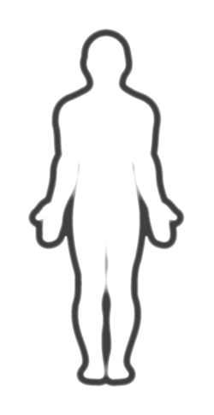

Slide 7
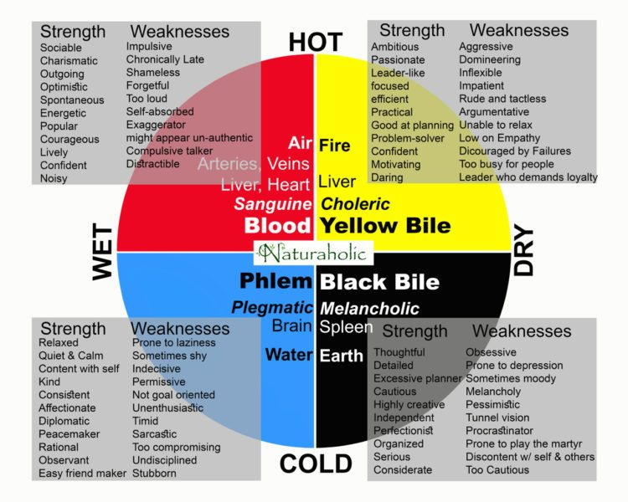

Slide 8
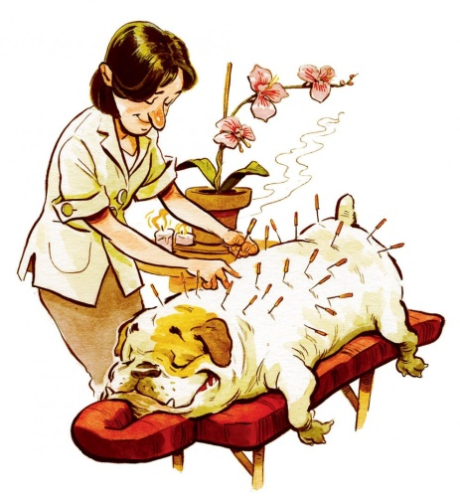
What is acupuncture?
Medical procedure that involves pricking the skin with fine needles on meridian points
Used to alleviate pain and to treat various physical, mental, and emotional conditions
Originated in China over 5,000 years ago
Received FDA approval in 1996

Slide 10
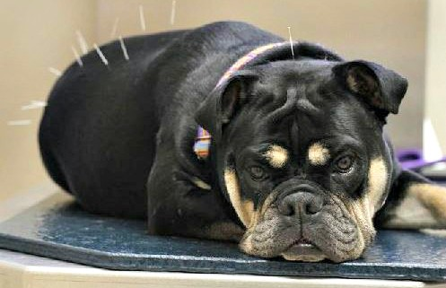
How does it work?
Works by stimulating “self healing”
Stimulates blood flow (⬆ nitric oxide)
Reduces inflammation (⬆ cortisol and ⬇ cytokines)
Reduces pain (⬆ endorphins)

Slide 11
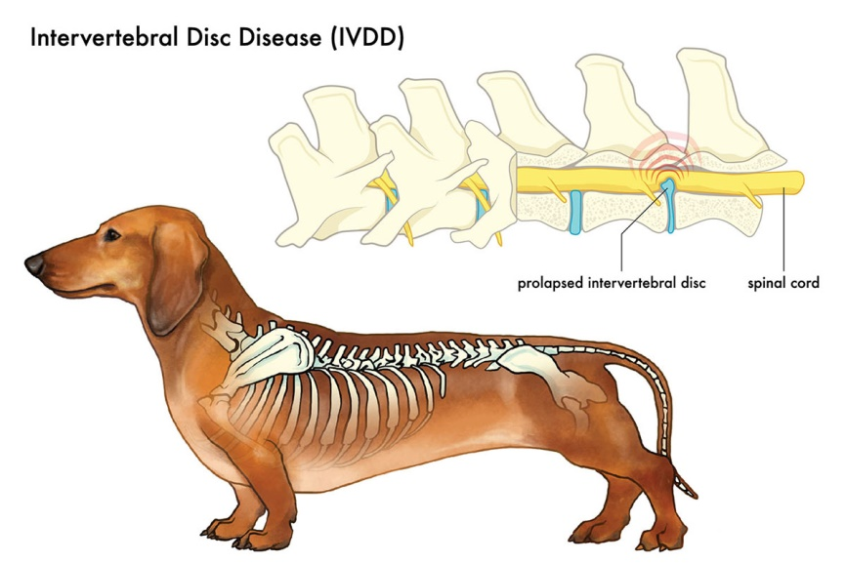
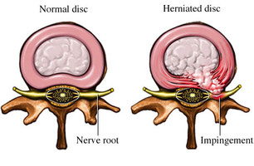
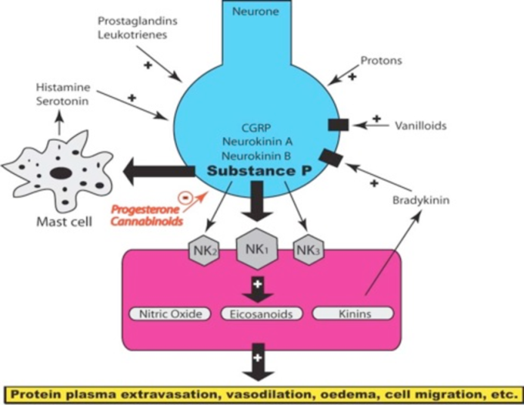
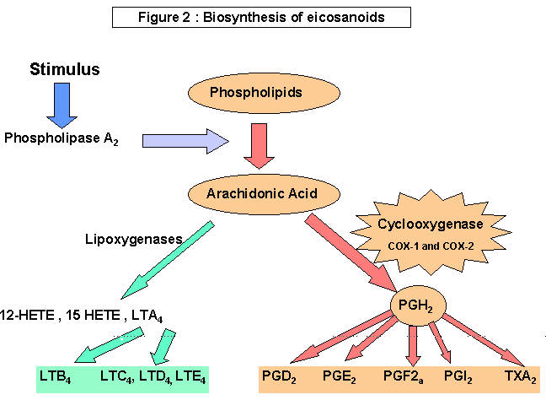
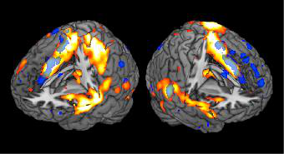
Does it really work?
Confirmed by functional MRI that detects blood flow
Inhibits Cox-1 inflammation pathway (NSAIDs)
Inhibits NK-1 pain pathway (Cannabis)
Stimulates damaged nerves from IVDD (Surgery)

Slide 12
Why is it becoming popular?
More research is being done
Pain control for cancer
Relieve menopause symptoms
Decrease arthritis inflammation
Opioid crisis
Decreased access to drugs
Drugs are too expensive

Slide 13
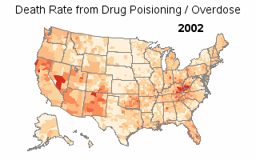

Slide 14
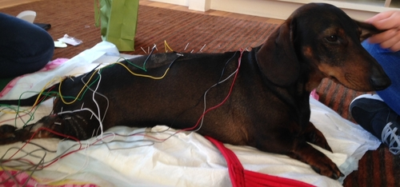
Electroacupuncture
Same meridian pathways
Needles are attached to a device that generates continuous electric pulses using small clips
Frequency and intensity are adjusted according to condition being treated
Stimulates larger area

Slide 15
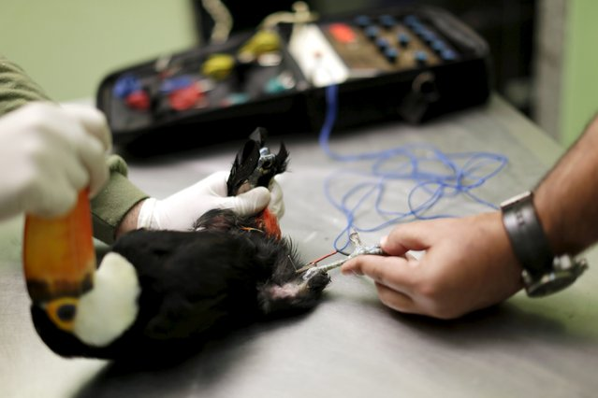
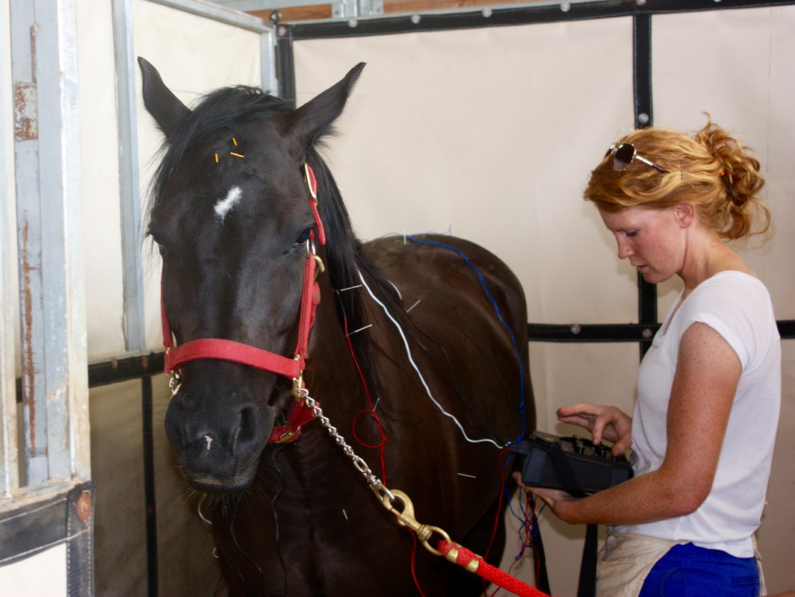
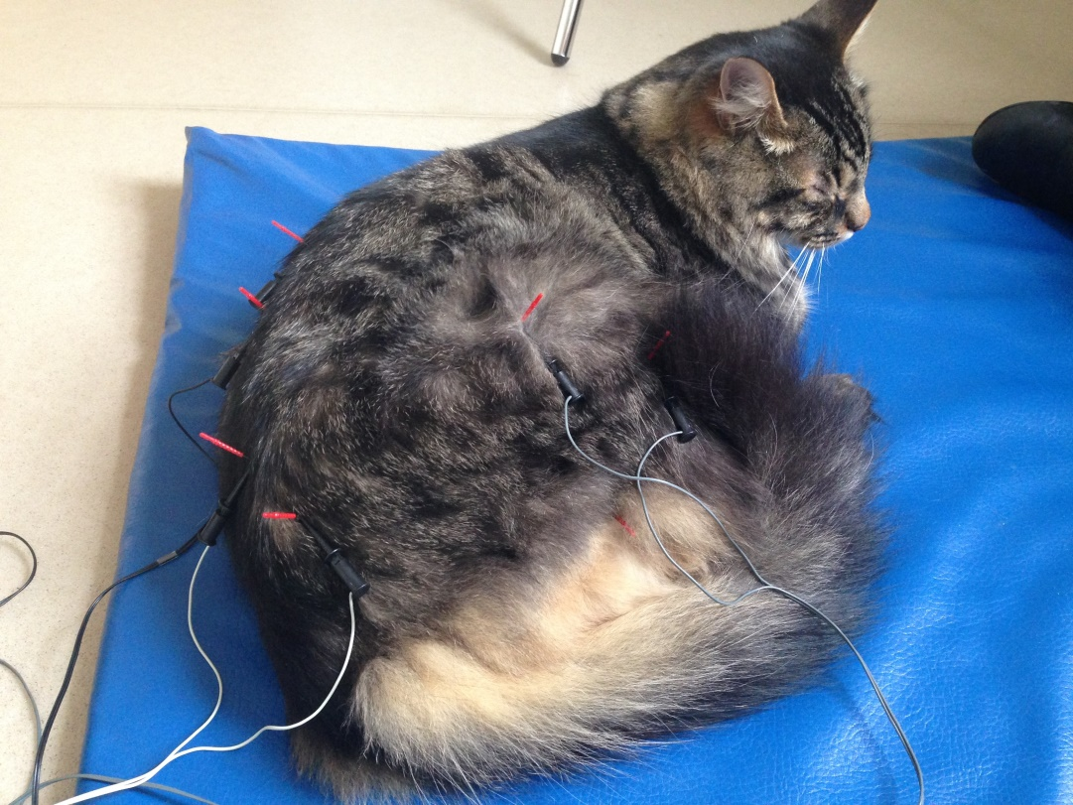

Slide 16
